Slide 1
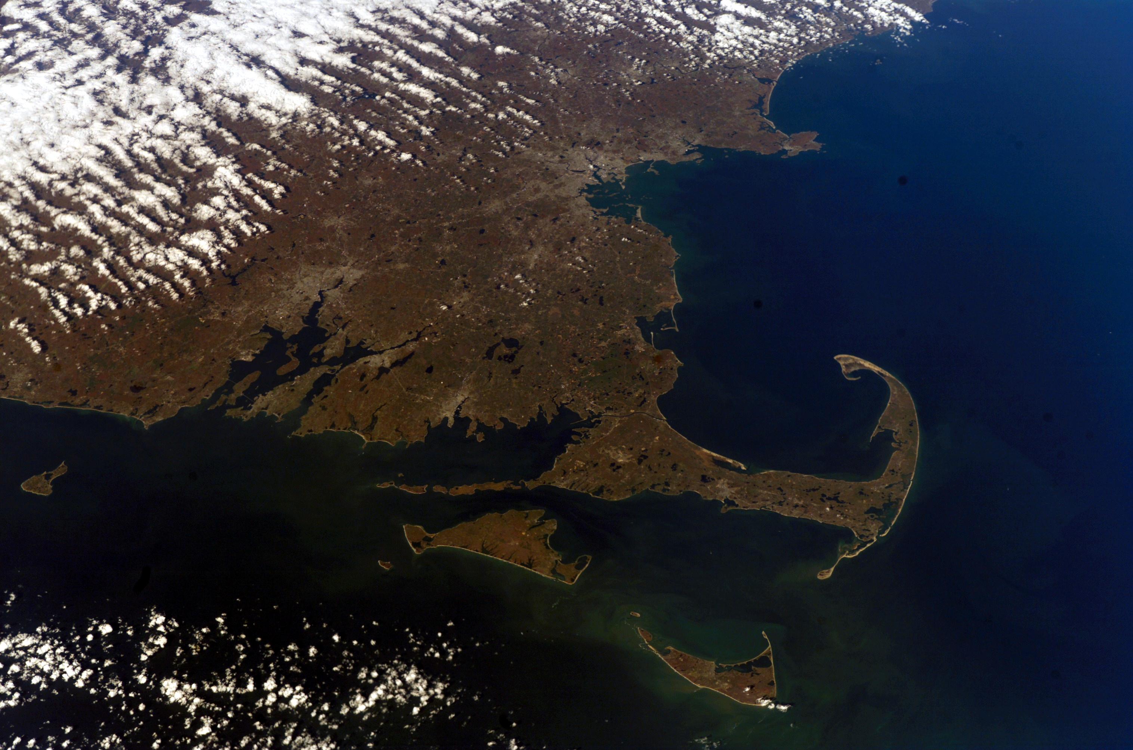



Salt-Water Intrusion Vulnerability Assessment in Plymouth, MA – Compounding effects of Sea-Level Rise on Water Quality and Aquifer Sustainability
Professor David Boutt and team
University of Massachusetts Amherst

Slide 2

Agenda for Today
Project team and update
Geologic Model
Hydrogeologic Model Domain and BC’s
Salt water intrusion and Submarine groundwater discharge
Gyben-Herzberg Interface Assessment
Hydrology and Sea-level Rise Scenarios
Open time for questions/discussion

Slide 3
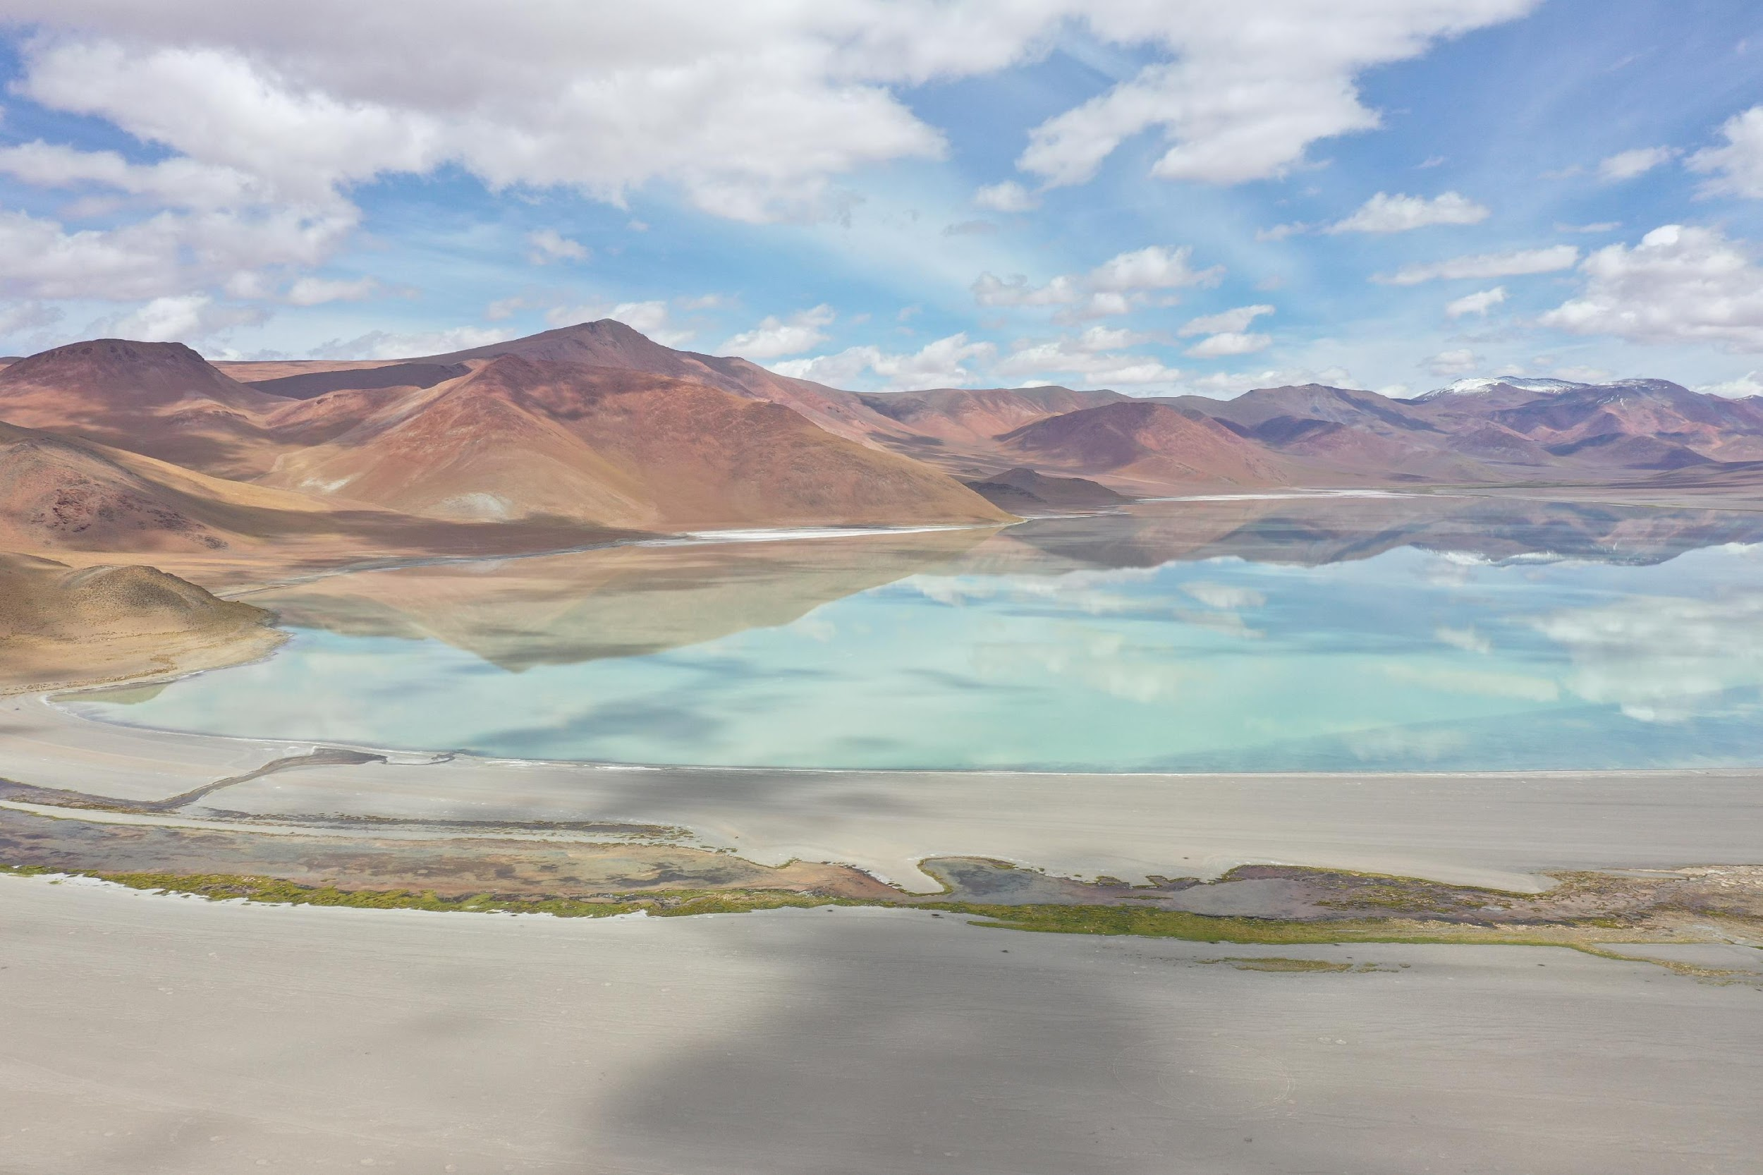

Project Lead
Dr. Boutt leads an internationally recognized research laboratories that support the education and training of undergraduate, MS, and Ph.D. students. He is a leading authority on the hydrology and hydrogeology of catchments and watersheds across New England
David Boutt, Ph.D. – Professor, University of Massachusetts Amherst dboutt@umass.edu
  20+ years research experience in field and computational hydrogeology

Slide 4
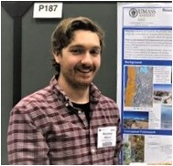


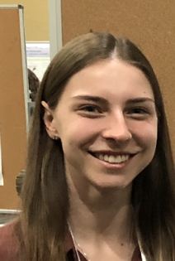
Research Team Collaborators
Dr. Brendan Moran, Post-doctoral fellow, UMass Amherst
  7 years research experience in hydrogeology and hydroclimate of New England
Xander Kirshen, Research Technician, UMass Amherst
  2.5 years experience in hydrogeology research and environmental consulting
Daniel Corkran, Ph.D. candidate, UMass Amherst
  9 years experience in environmental consulting, specializing in groundwater transport
Carly Lombardo, Master’s Candidate, UMass-Amherst
  BS in Geosciences, working on developing models to assess SWI in Plymouth

Slide 5

MVP
SWI Project Objectives
Assess the impacts of salt-water intrusion (SWI) into the freshwater aquifer and surface water bodies of Plymouth
Develop a numerical model of the aquifer system that can simulate possible sea-level rise scenarios and impact on SWI

Slide 6
FY23 Project Road Map
SWI Assessment using Existing Water Table Maps
New Model Structure and Boundaries
Final Density Dependent GW Flow Models
Assessment of SWI and impacts of sea-level rise on aquifer hydrology
Final Report and Presentations
WP1
WP2
WP3
WP4
Completed
Completed
Completed
Completion Feb 2023
Completion May 2023
100% Planned Completion
June 2023

Slide 7

Plymouth Salt-Water Intrusion Project – Completed Work
Preliminary Assessment of possible location of FW/SW interface in region
Refine Existing Hydrogeologic Model of Aquifer System
Develop Groundwater Flow Model with Updated Geometry and Boundary Conditions

Slide 8
Plymouth Salt-Water Intrusion Project – Year 2
Determine the relationship between surface water features (ponds, etc) and the freshwater/salt water mixing zone
Assess the different mechanisms of saline intrusion and vulnerability to the freshwater aquifer system
Provide recommendations for future well placement/development and predictive scenarios for sea-level rise impacts on aquifer productivity and salinity

Slide 9

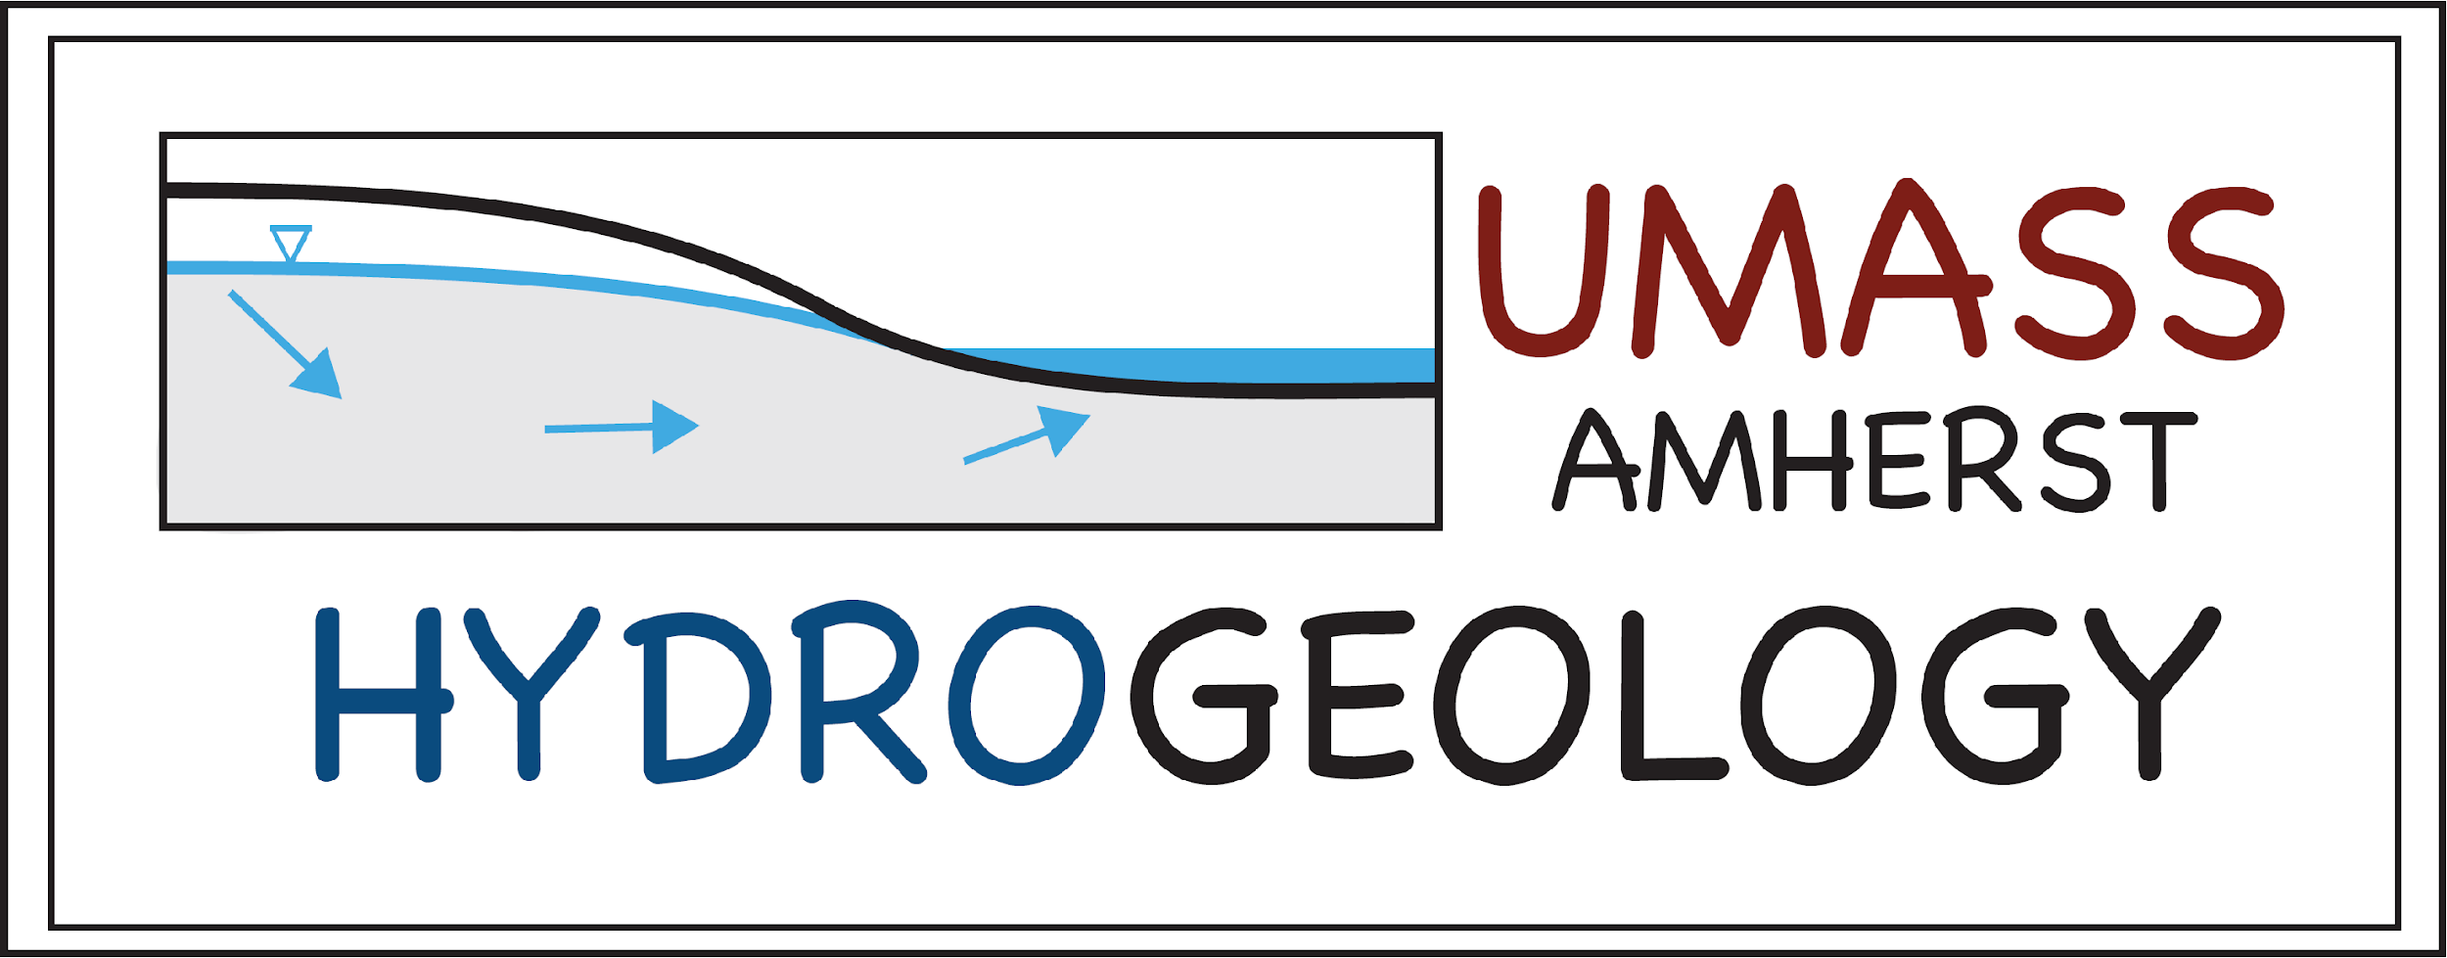
Expected Project Outcomes and Products
Updated Groundwater Flow model for Aquifer that simulates FW/SW interactions
Incorporation of the Sea-level rise (SLR) scenarios into forward looking aquifer models
Uncertainty-bounded predictions of SWI and SLR impacts on aquifer water quality
Strategies and suggestions for mitigating impacts of SLR on water resources

Slide 10
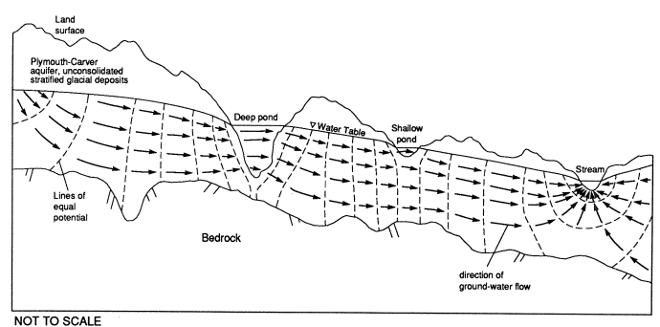
Groundwater Flow in the Plymouth-Carver Aquifer
Hansen and Lapham, 1992

Slide 11
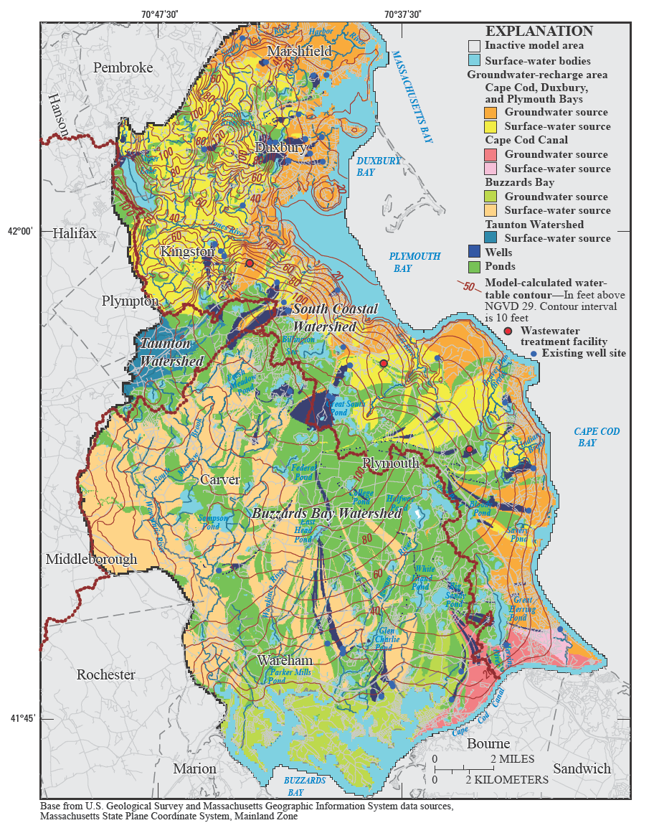
Green – areas to contributing to ponds
Yellow – drains to bay via surface
Orange – drains to bay via groundwater
Blue – captured by wells
Masterson et al., 2009
USGS SIR 2009–5063

Slide 12
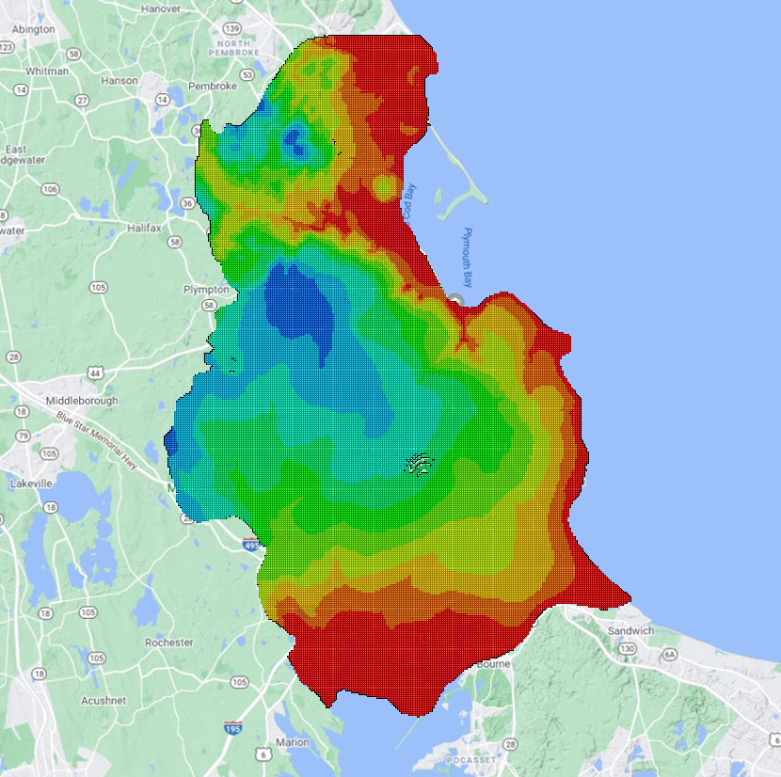
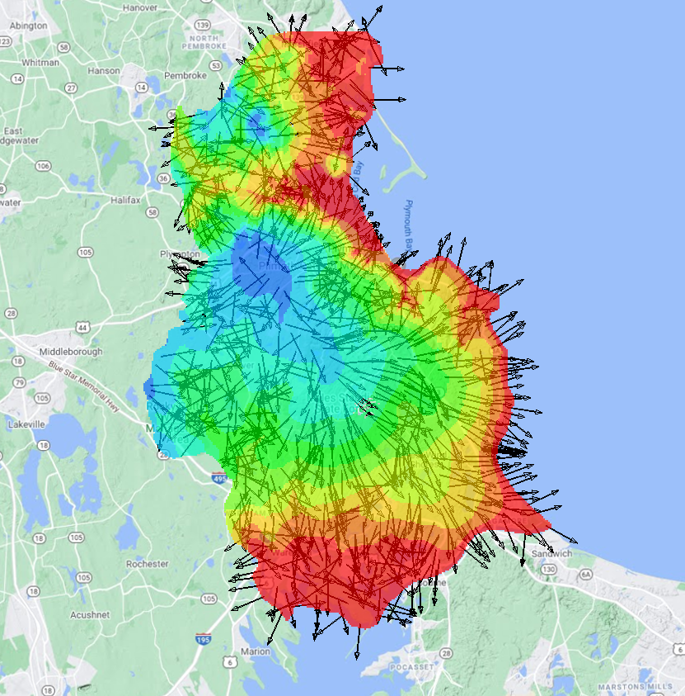
Existing USGS model of Aquifer is NOT adequate for assessing SWI impacts
Simulated Hydraulic heads in coastal areas are too high – significantly above land surface
Coastal Lakes and ponds are not simulated as open water bodies.
Does not incorporate physics of fresh/salt water interactions (single density)
Does not incorporate any sea-level rise scenarios

Slide 13
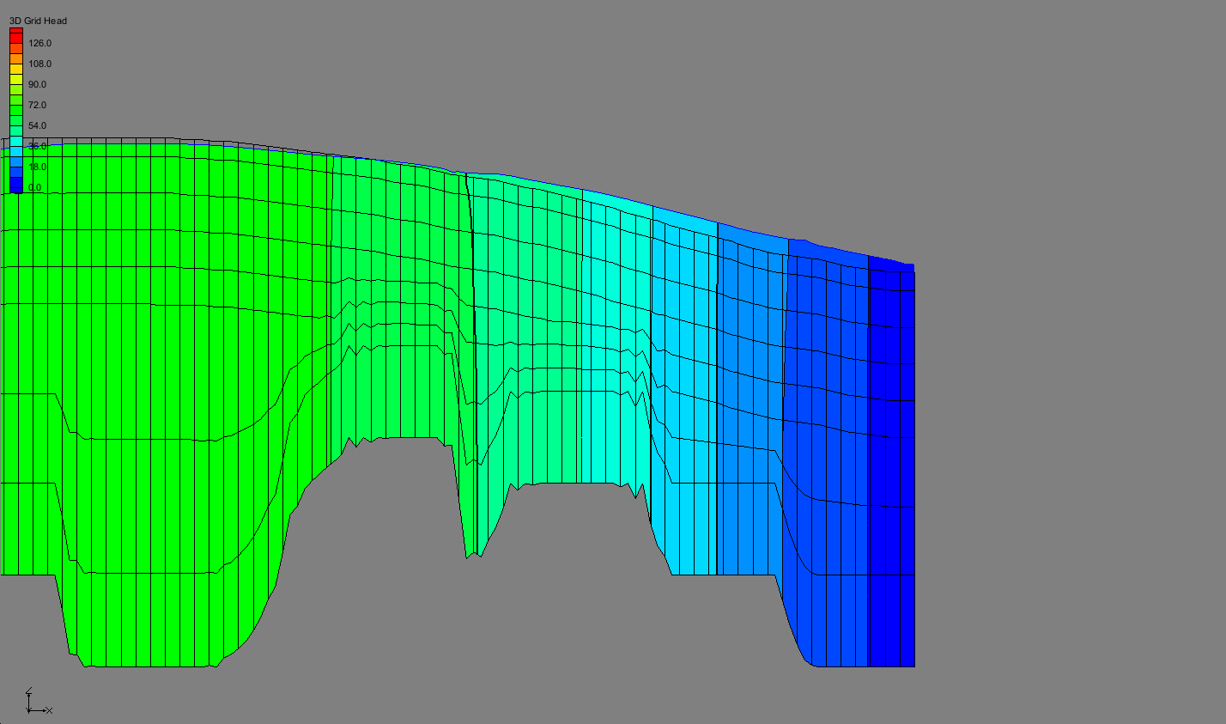
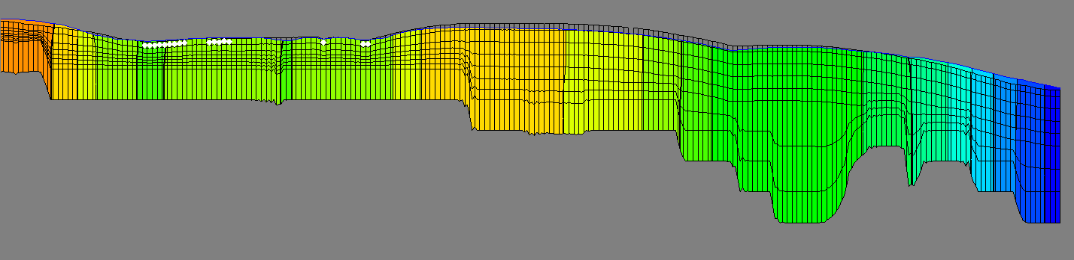
Water Table
Land Surface
Coast

Slide 14
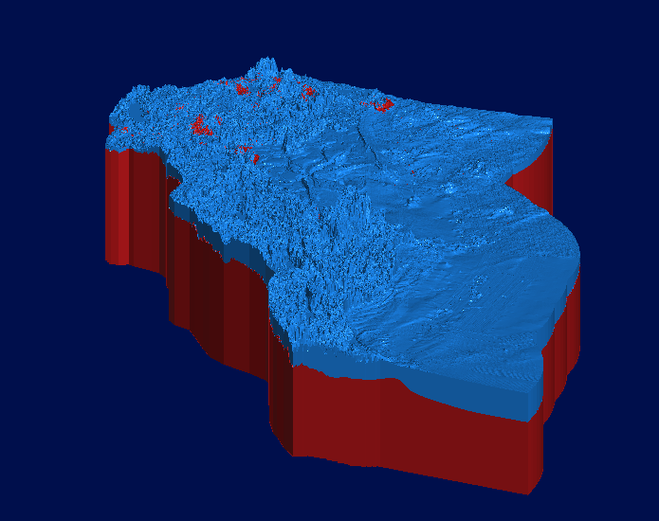
Geologic Model Development

Slide 15
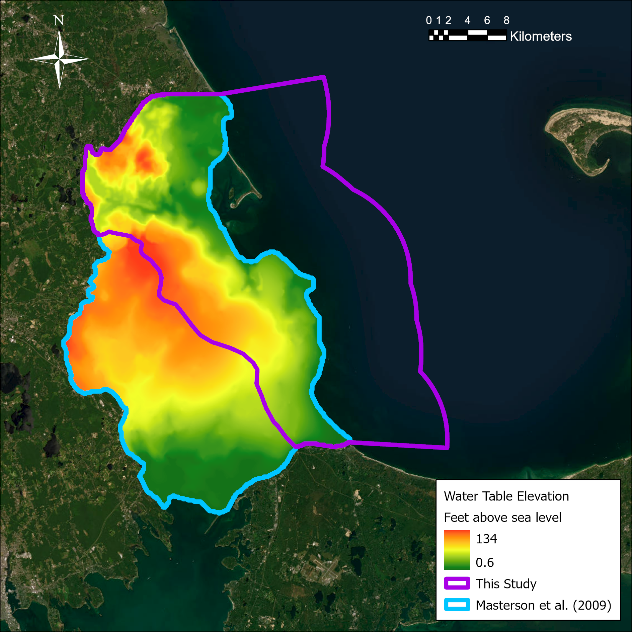
Model Domain
Model domain from Masterson et al. (2009) and this study
Identified groundwater divide from Masterson et al. (2009) steady state model
Created the model domain for this study based on the groundwater divide
Extended domain 10 km offshore

Slide 16
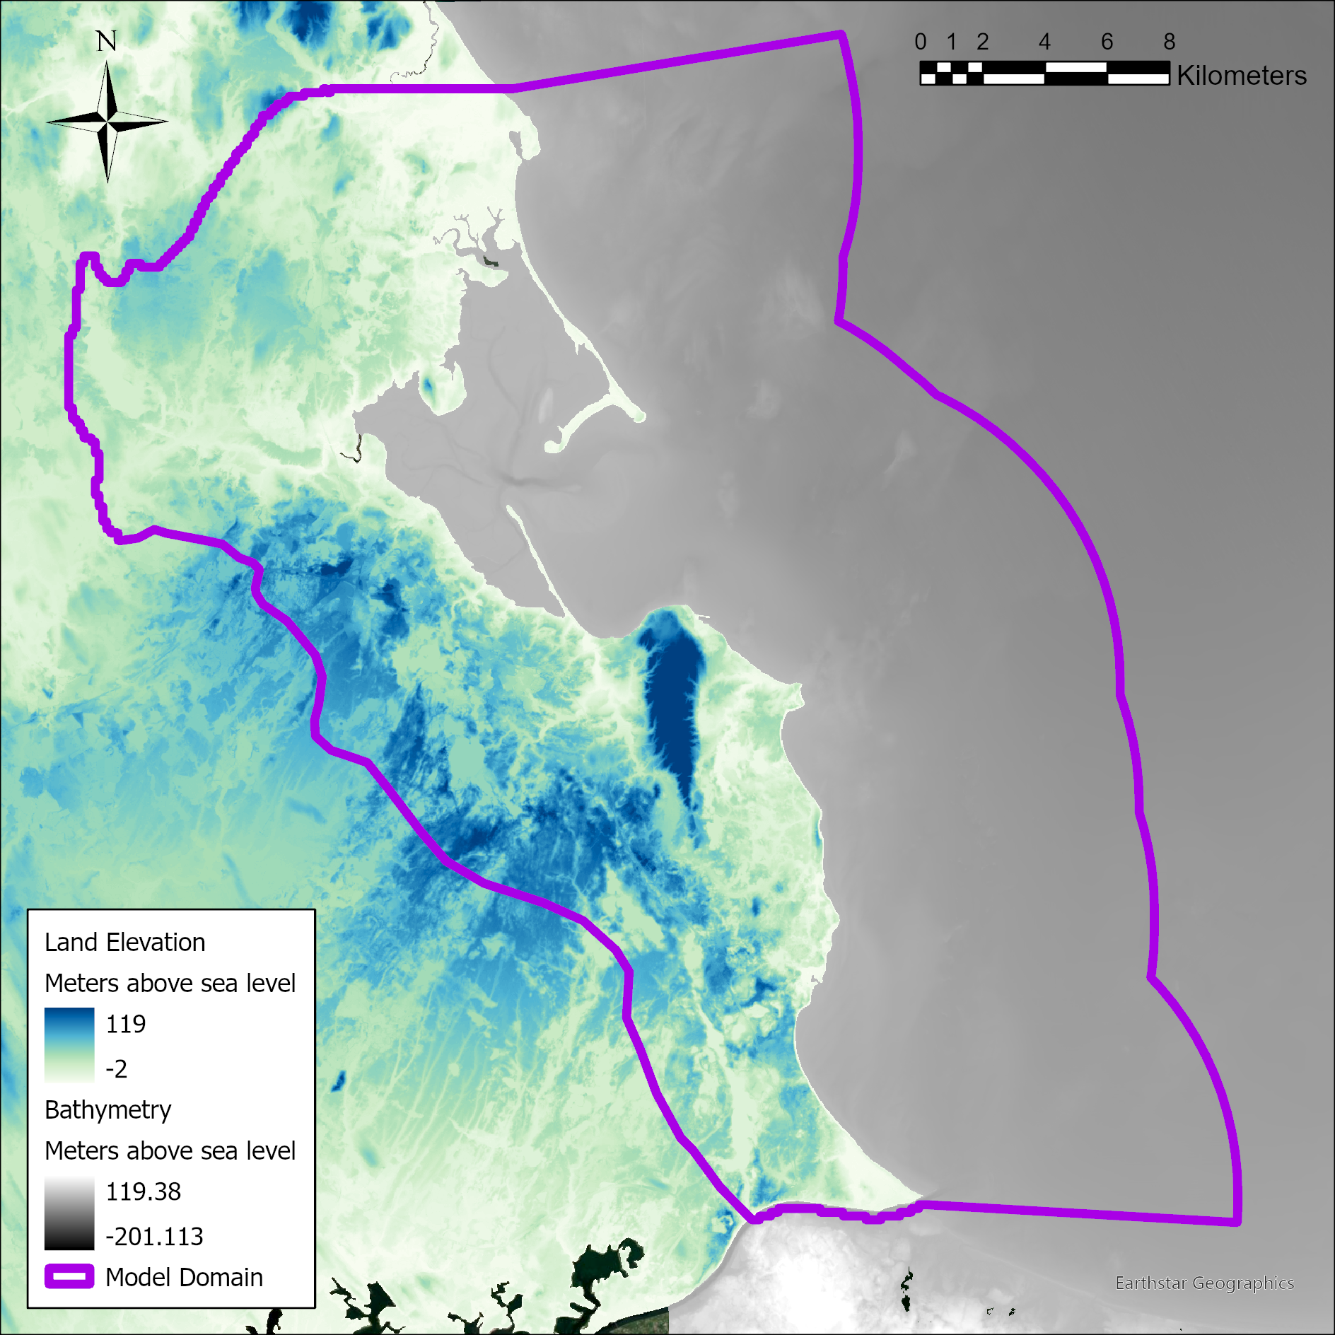
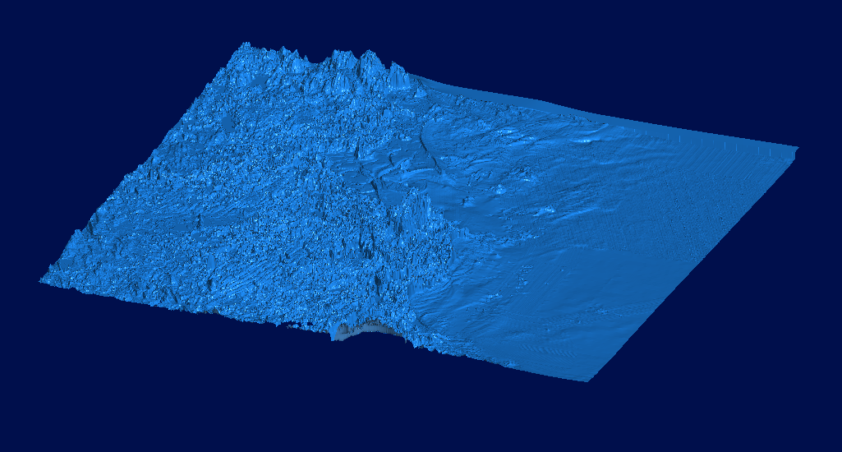
Geologic Model Development – Top Boundary
Final Top Boundary
Cape Cod Bay Bathymetry
(Andrews et al., 2018)
DEM Land Elevation
(MassGIS, 2022)

Slide 17
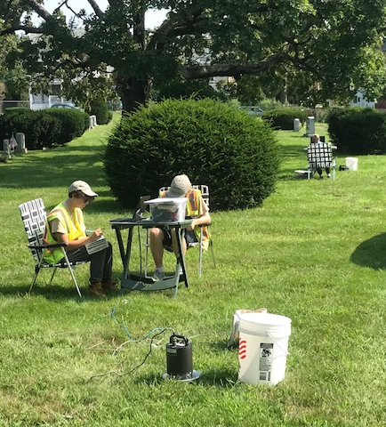
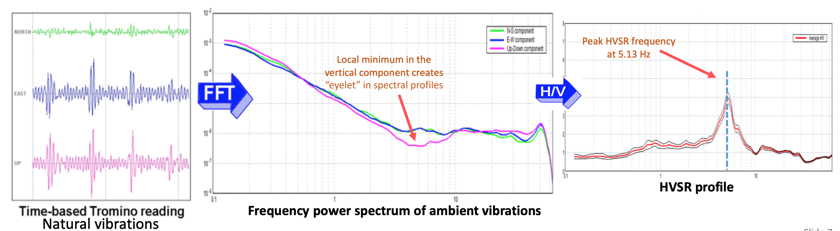
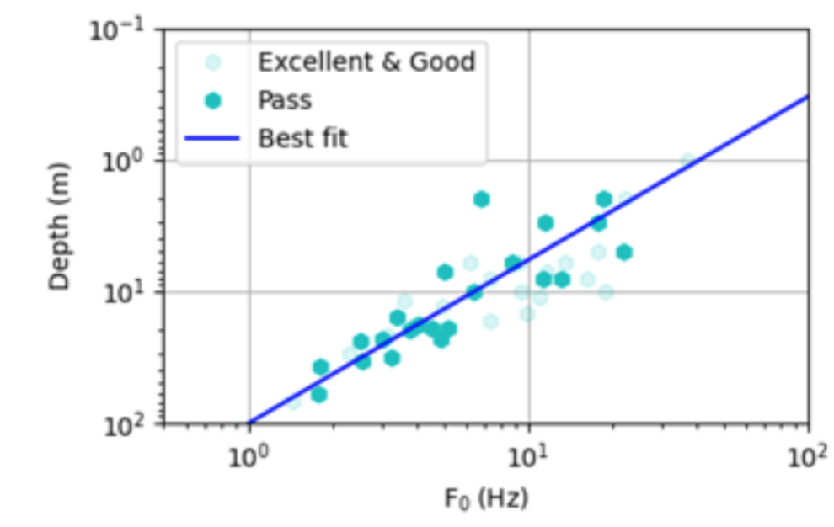
New Sediment Thickness Data:
Horizontal to Vertical Spectral Ratio
Record the ambient seismic signal with a 3-component seismometer to determine the resonance frequency and the amplitude of the ground motion of the underlying sediments
From the resonance frequency, we find the sediment thickness
Leave seismometer recording for about 30 minutes
Deep
Shallow
Dronfield et al., 2019
Mabee & Clement, 2021
Notes:
The other thing we did was collect Horizontal to Vertical Spectral Ratio (HVSR) data to estimate the depth to bedrock.
I am going to hand it over to Bill to provide a little background on this.

Slide 18
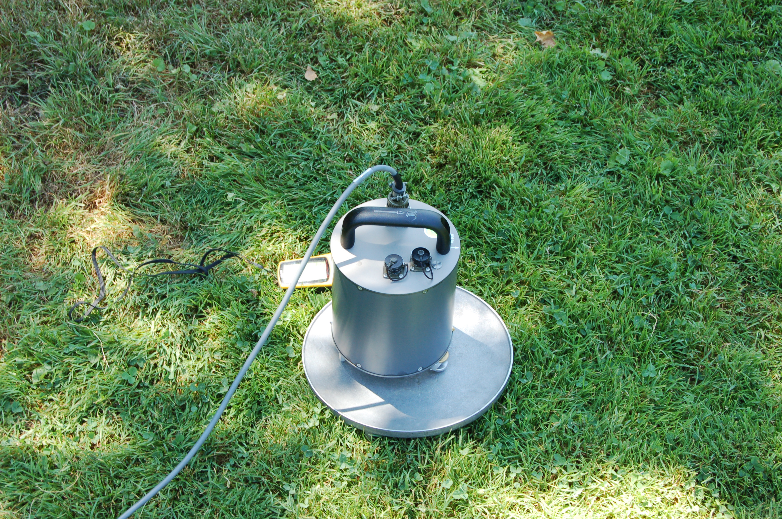
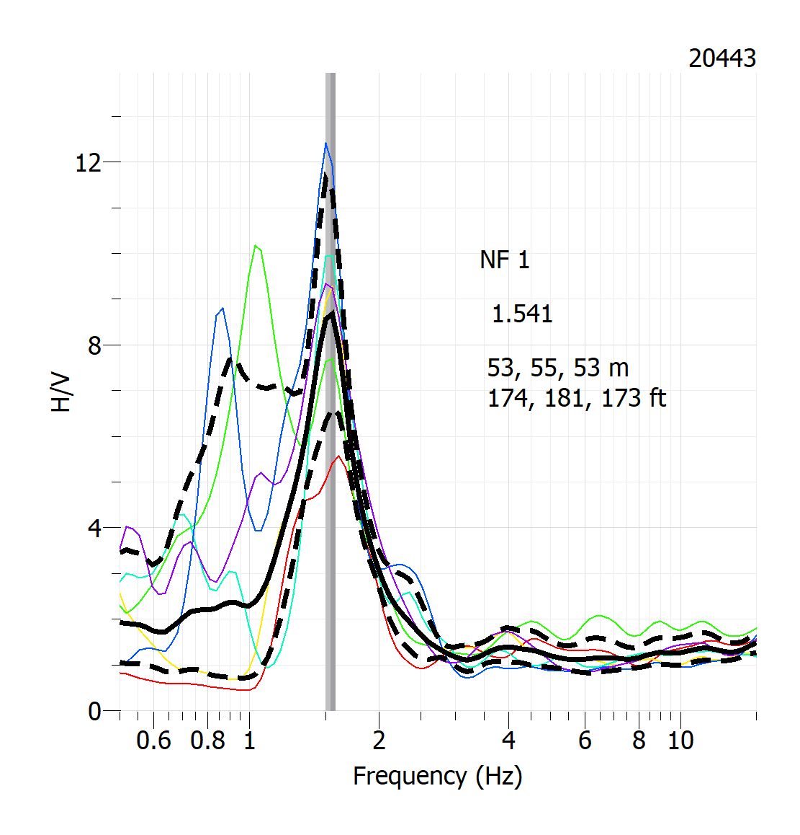
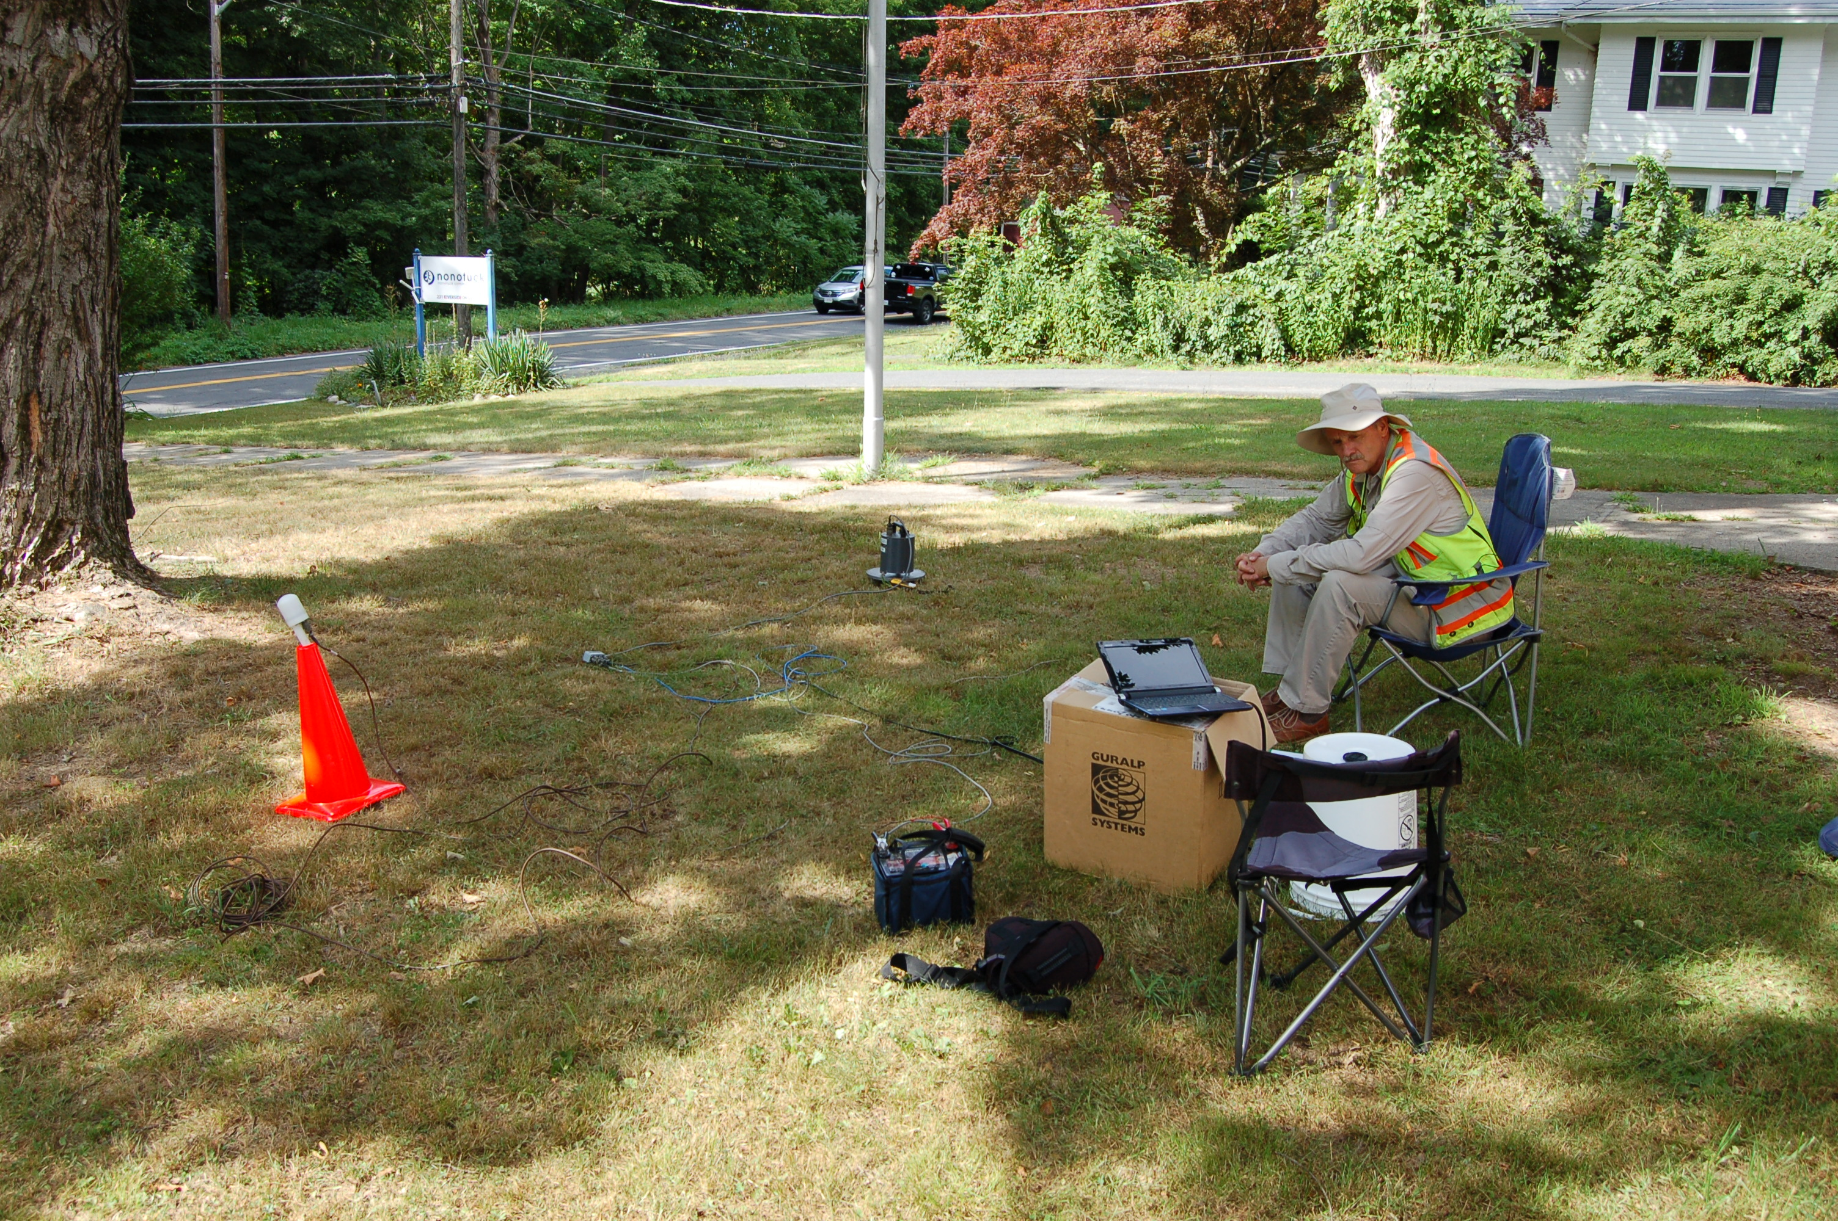
Notes:
To fill in gaps where we have sparser well coverage, we spent all last summer collecting HVSR (Horizontal to Vertical Spectral Ratio) data.
This is where Bill Clement will lead the project.
This is a passive seismic method that uses a three component seismometer to record ambient noise in the earth
This could be wind, storms, distant tremors, cars, waves crashing on the beach.
You place the seismometer on the ground oriented to north, connect it to a computer, battery and GPS device and simply record the ambient noise for 30 minutes.
The method relies on the high shear wave acoustic impedance contrast between the overlying unconsolidated sediments and the underlying solid bedrock.
Taking the spectral ratio of horizontal components to the vertical component produces a resonance frequency in the unconsolidated overburden that is a fundamental characteristic of the site
Besides fundamental frequency, HVSR also allows determination of the average shear wave velocity of the unconsolidated overburden when measurements are taken at locations with known depth to bedrock
We can determine the thickness of the overburden if a local depth vs. fundamental frequency calibration curve is available
One of the outcomes of this study will be to develop a local curve calibration curve for MA

Slide 19
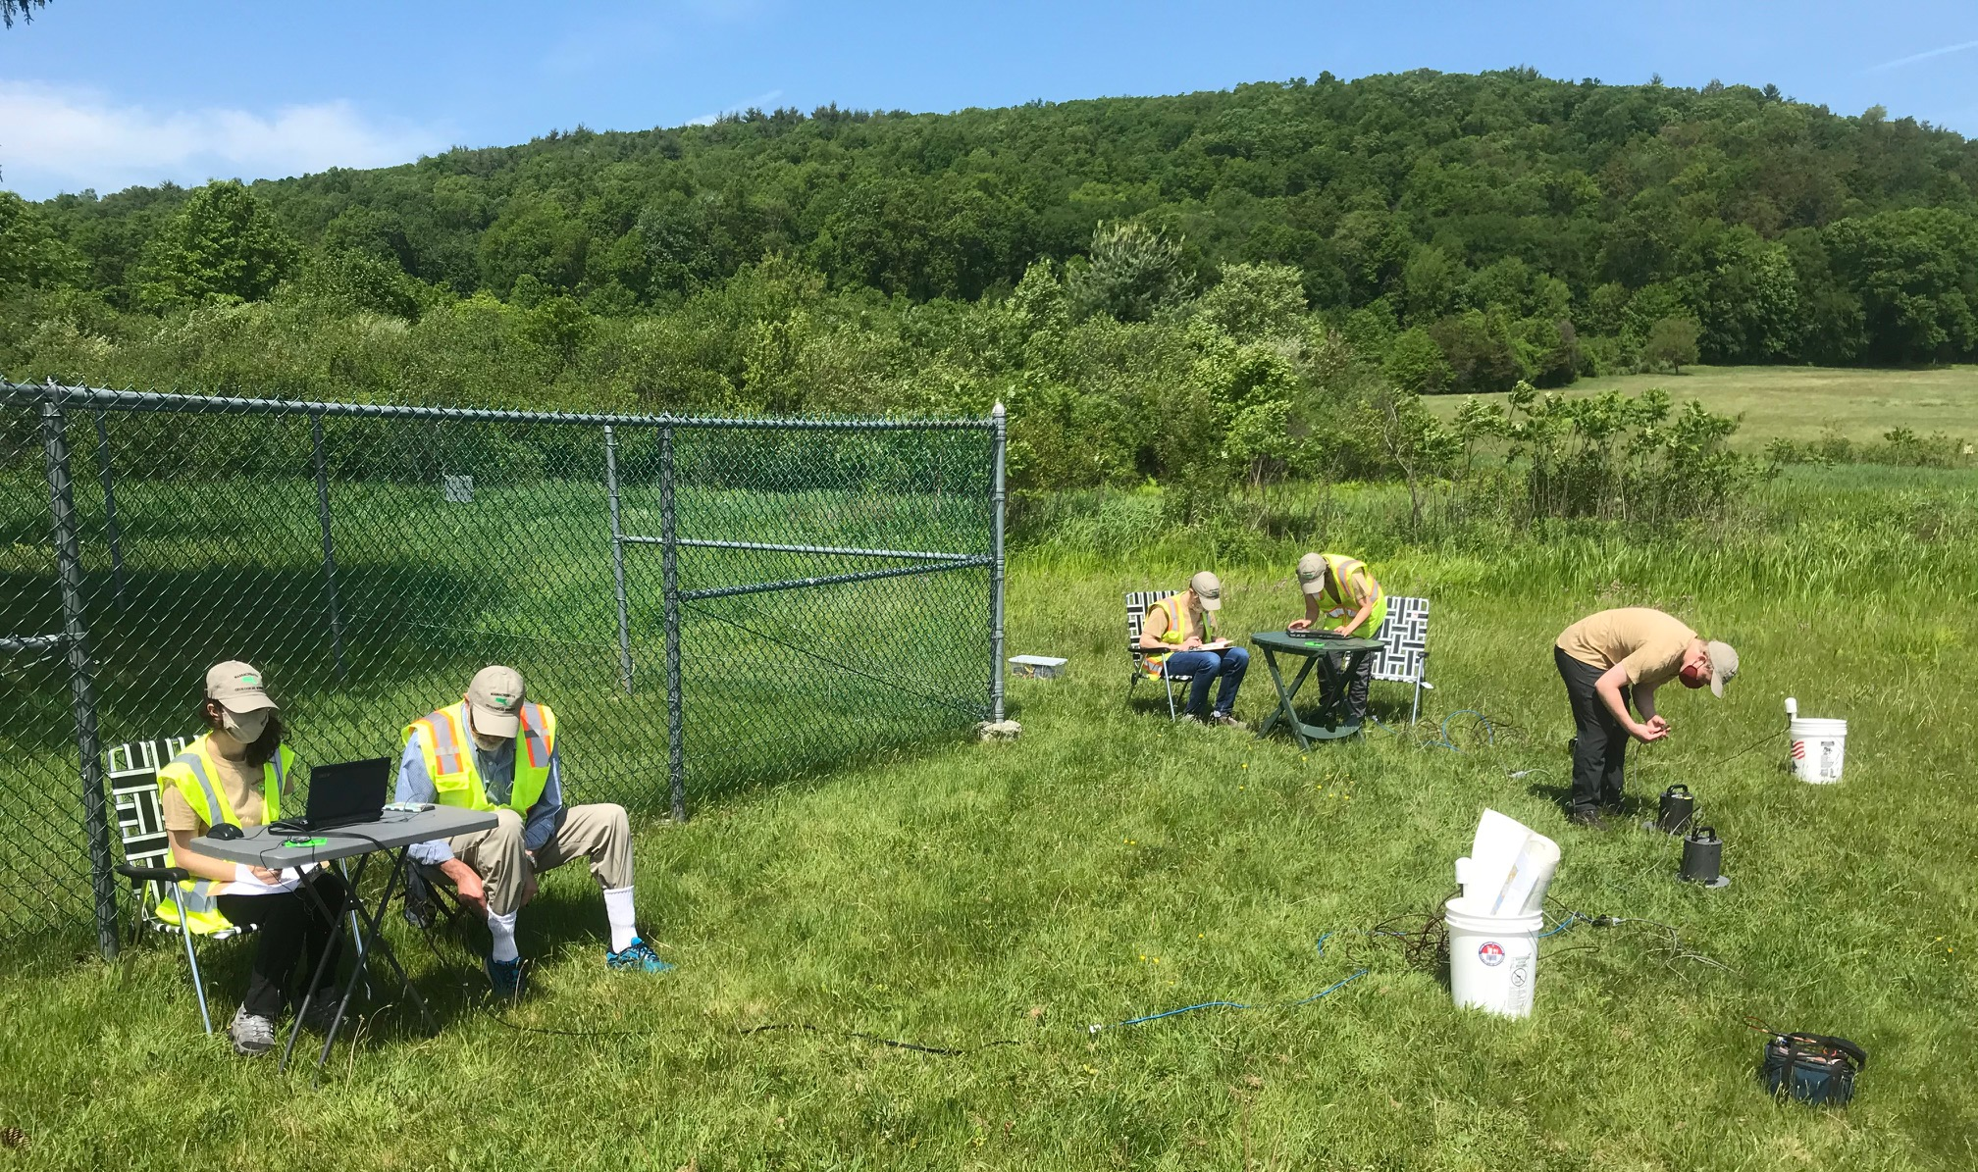
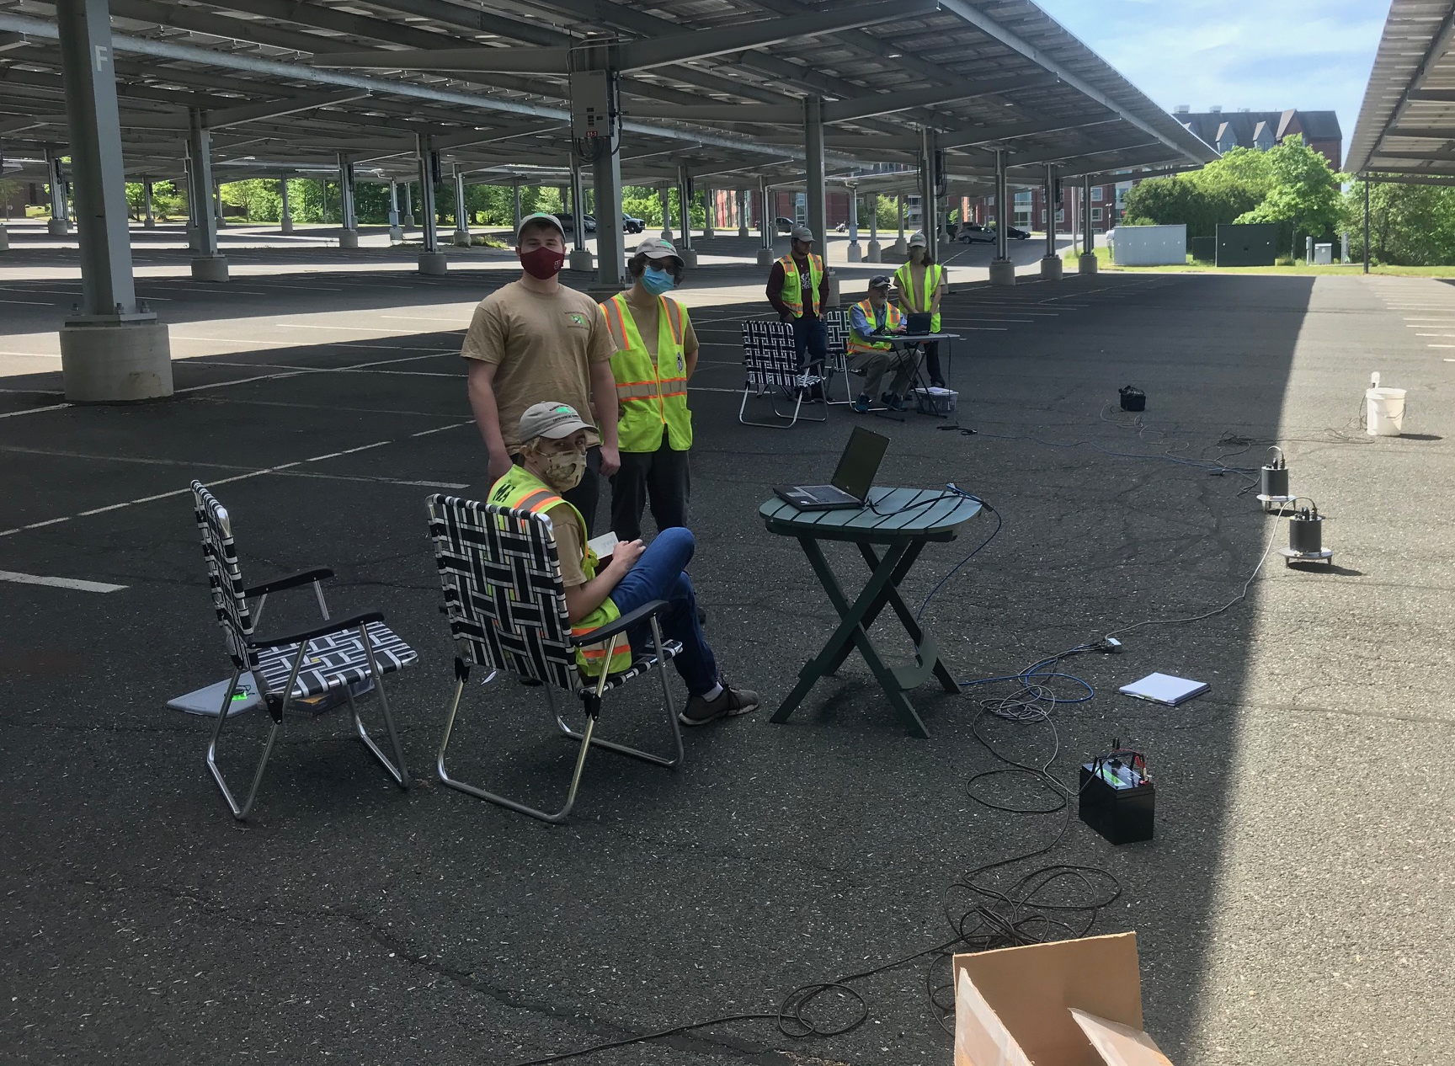
Hadley Public Water Supply Well
Collecting HVSR Data
Lot 44 UMass Campus
Notes:
1. So for about three months last summer the students teamed up in pairs and fanned out across Massachusetts

Slide 20
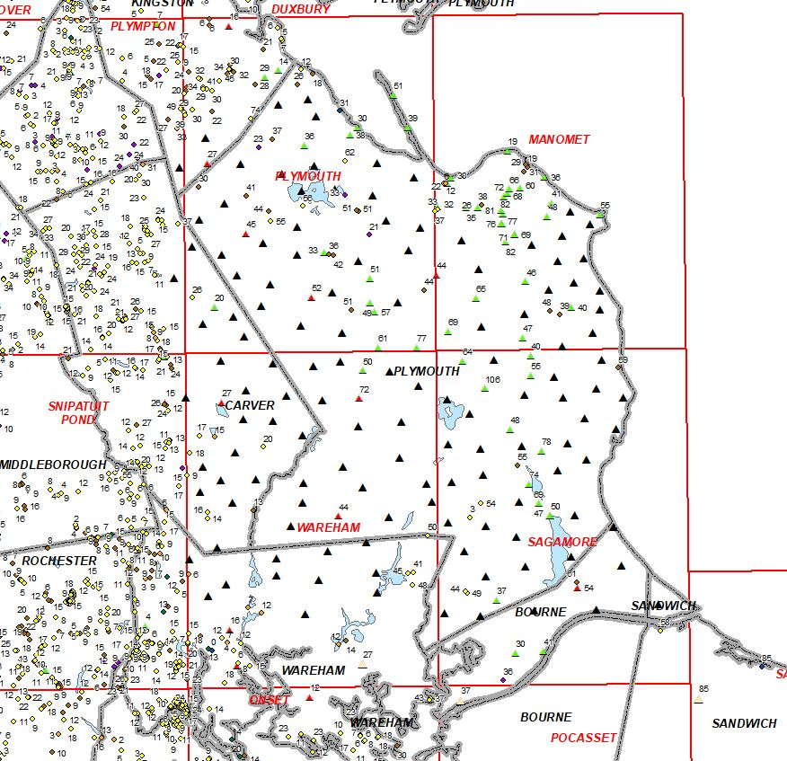
New HVSR Data Collected across the Plymouth Region
Black Triangles are new data to the model

Slide 21
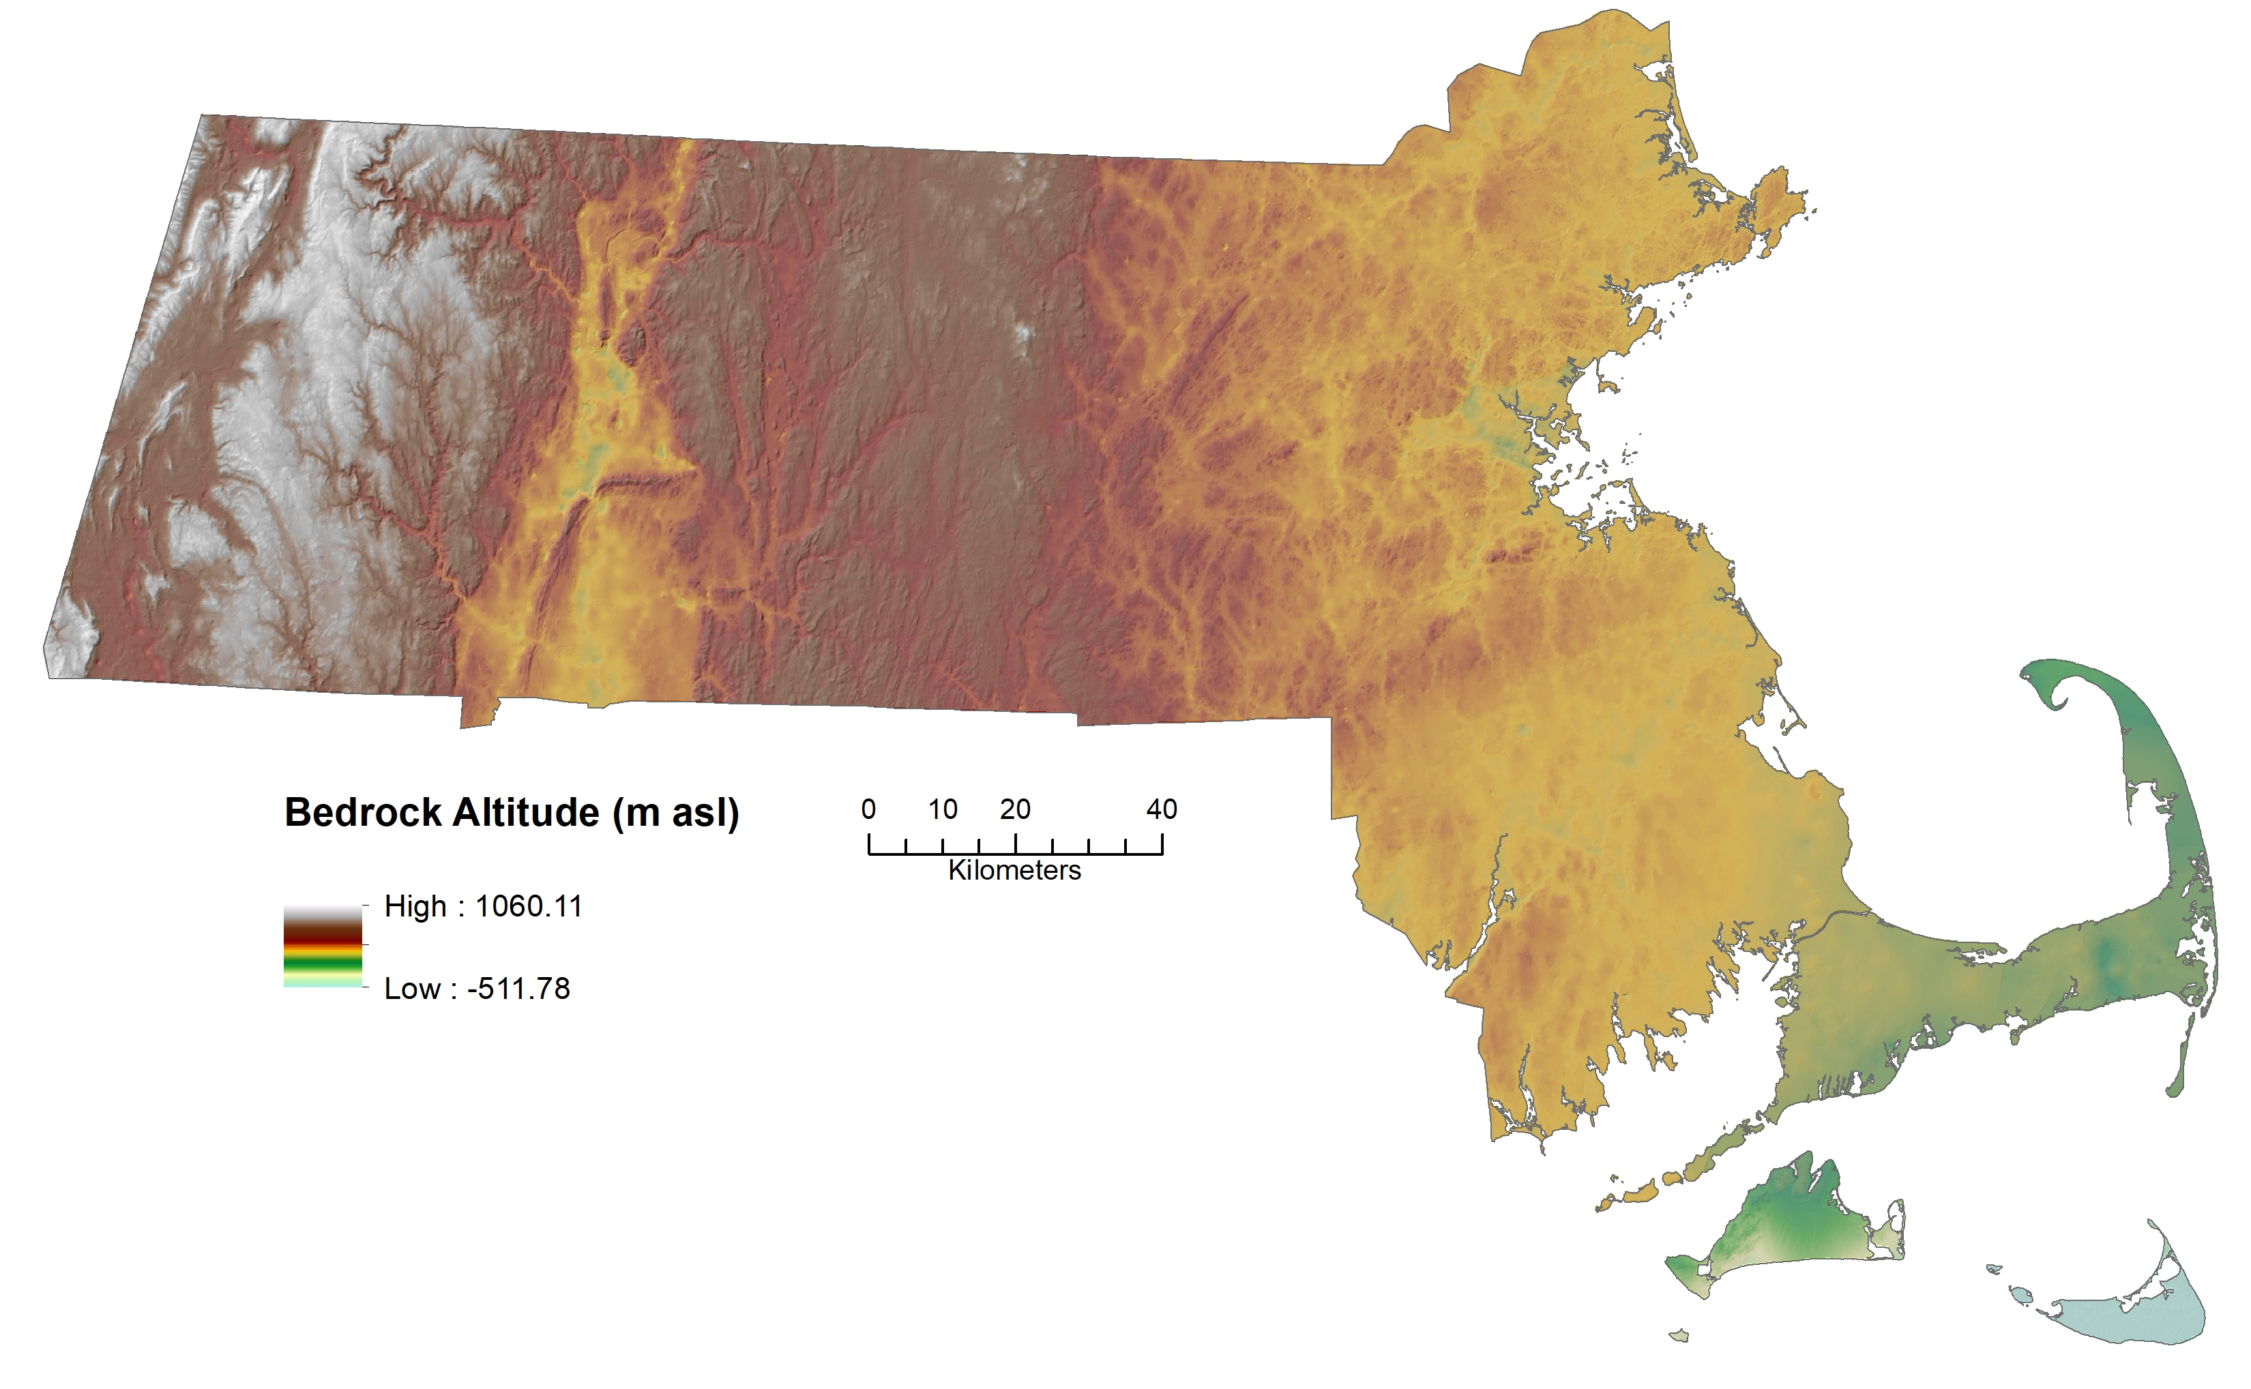
New Bedrock Elevation Map
S. Mabee, DRAFT 11/02/2022

Slide 22
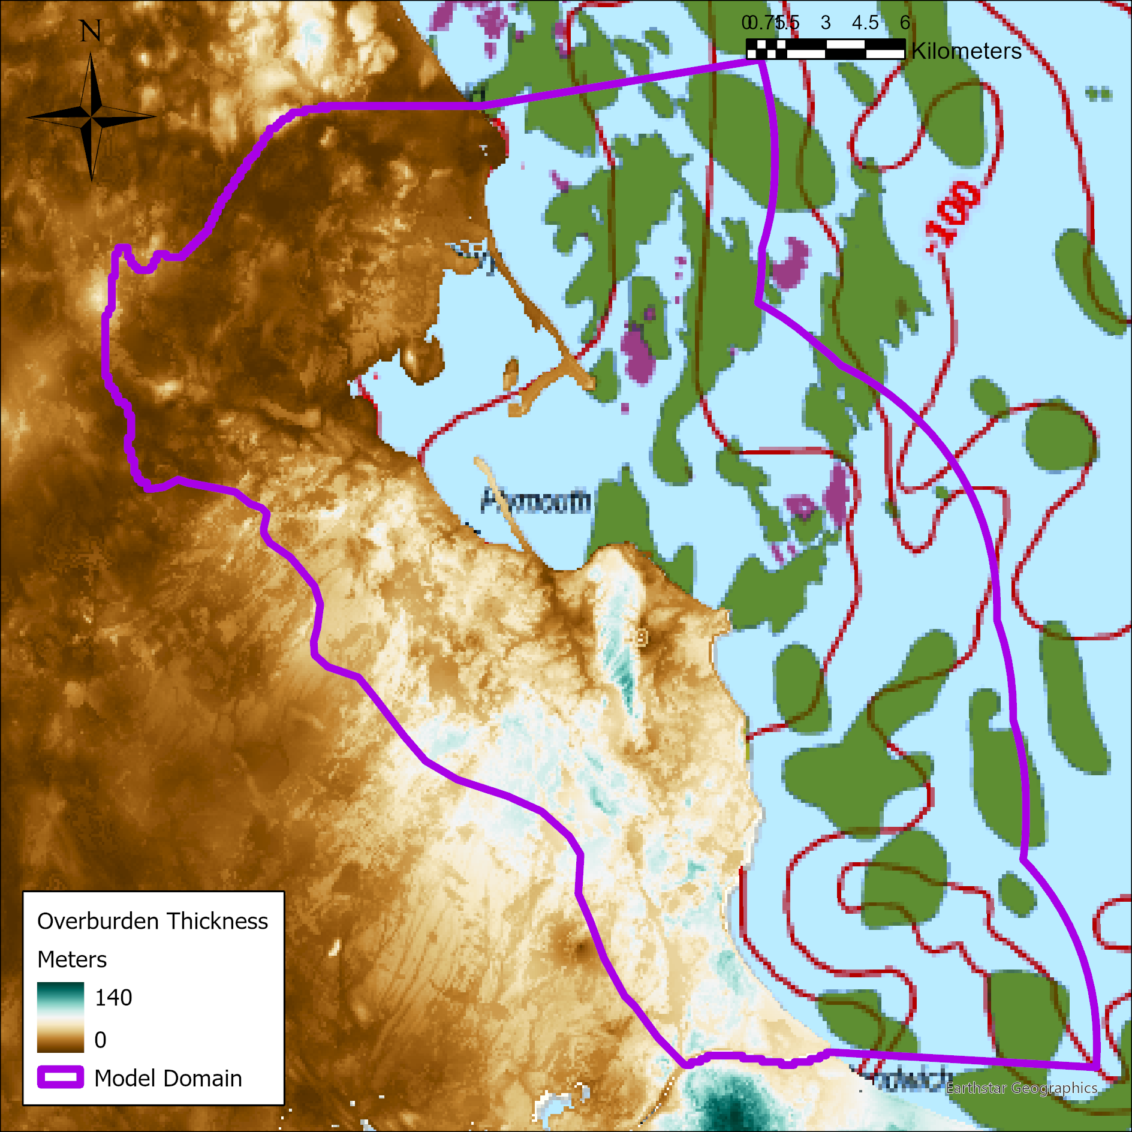
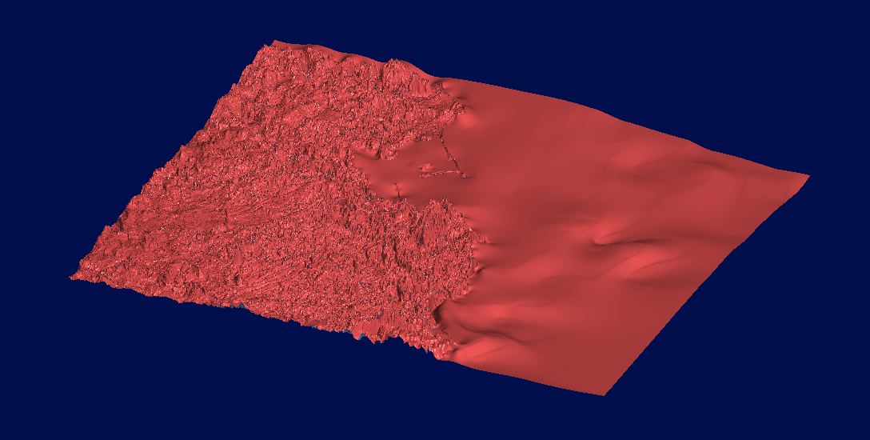
Geologic Model Development – Bottom Boundary
Final Bottom Boundary
Offshore bedrock elevation contour map
(Stone & Stone, 2019)
Onshore bedrock elevation raster
(Mabee et al., 2022)

Slide 23
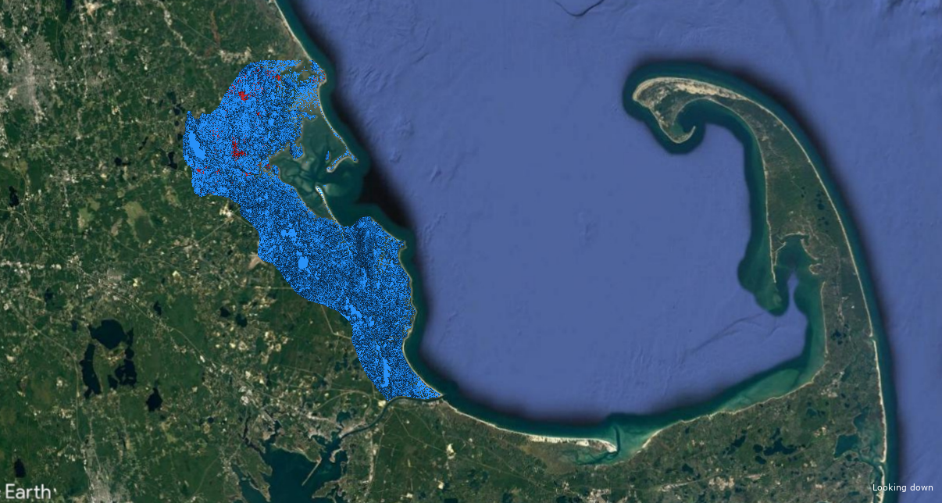
Geologic Model (walk through)

Slide 24
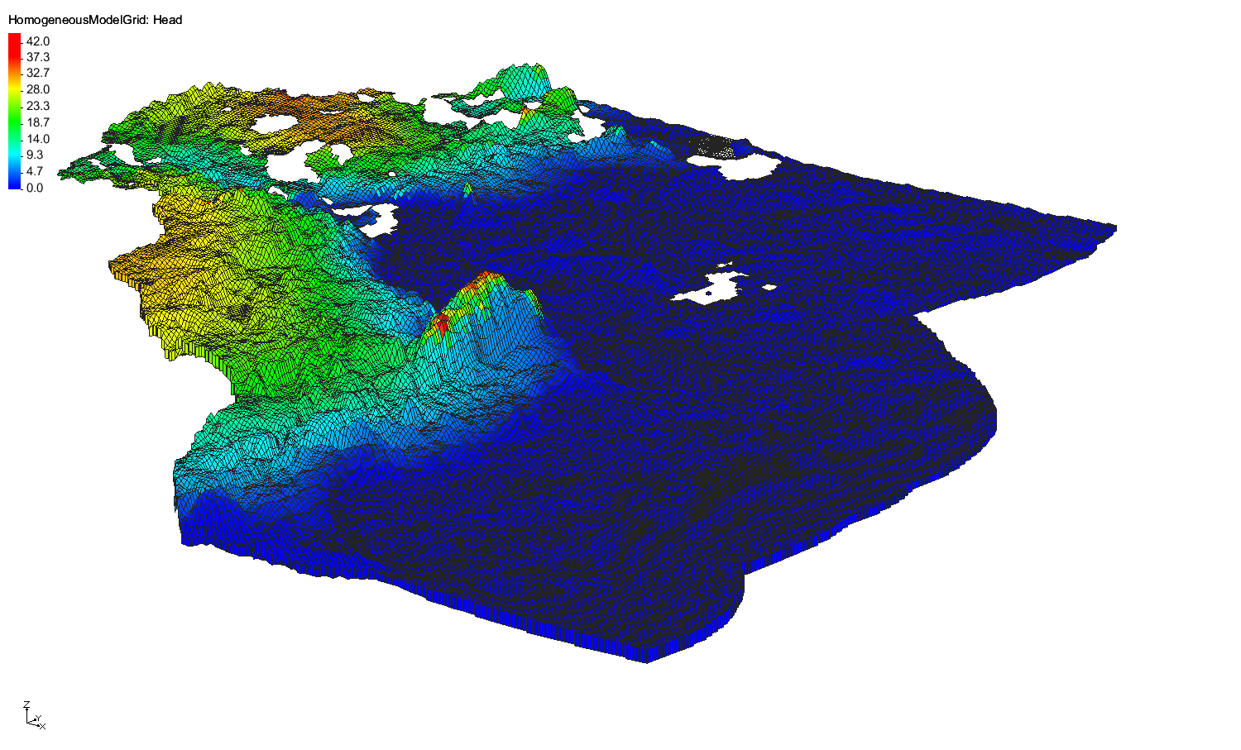
Hydrogeologic Model Development

Slide 25
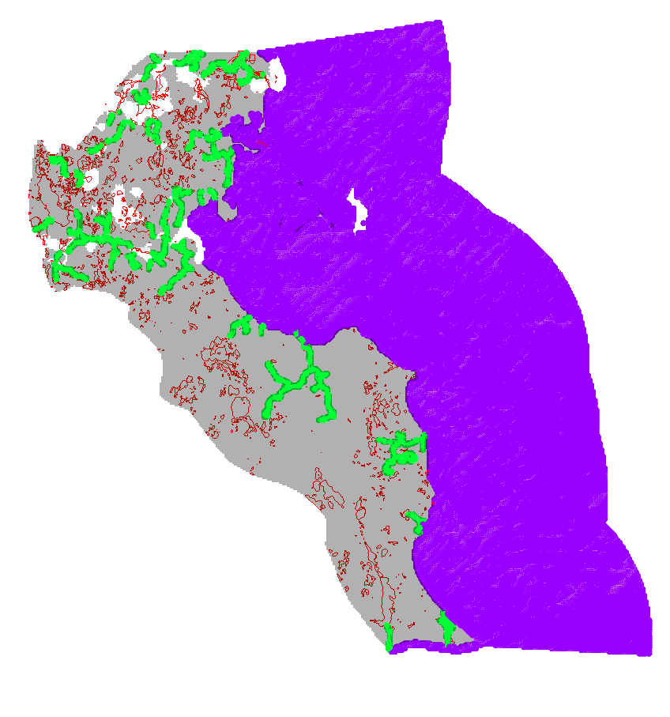
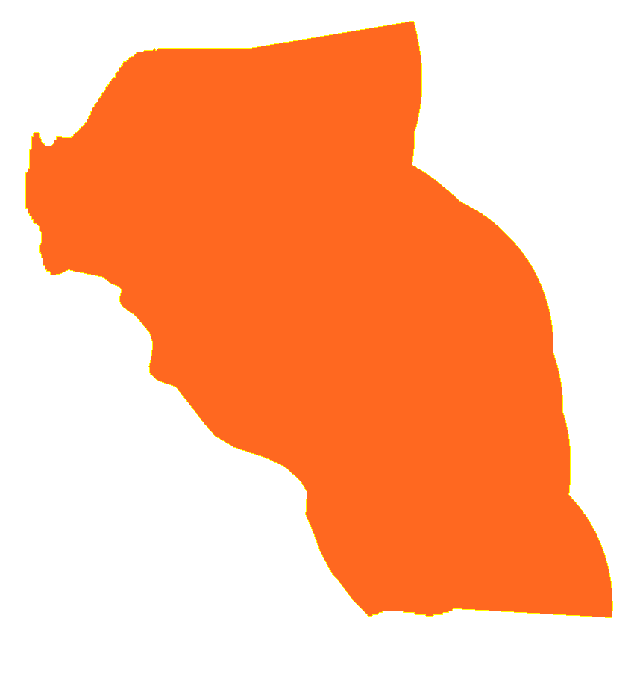
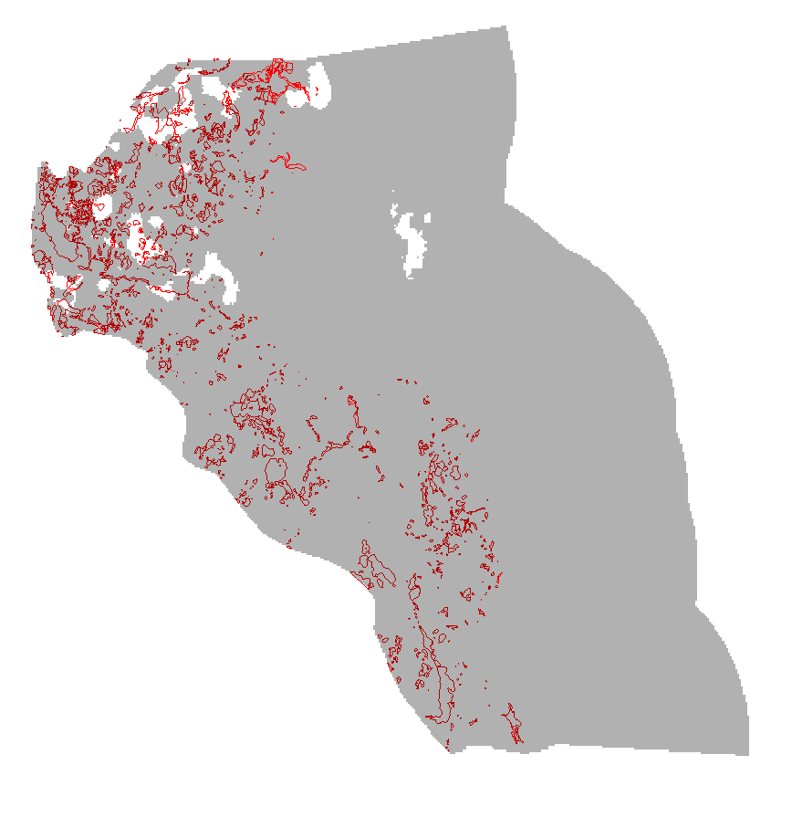
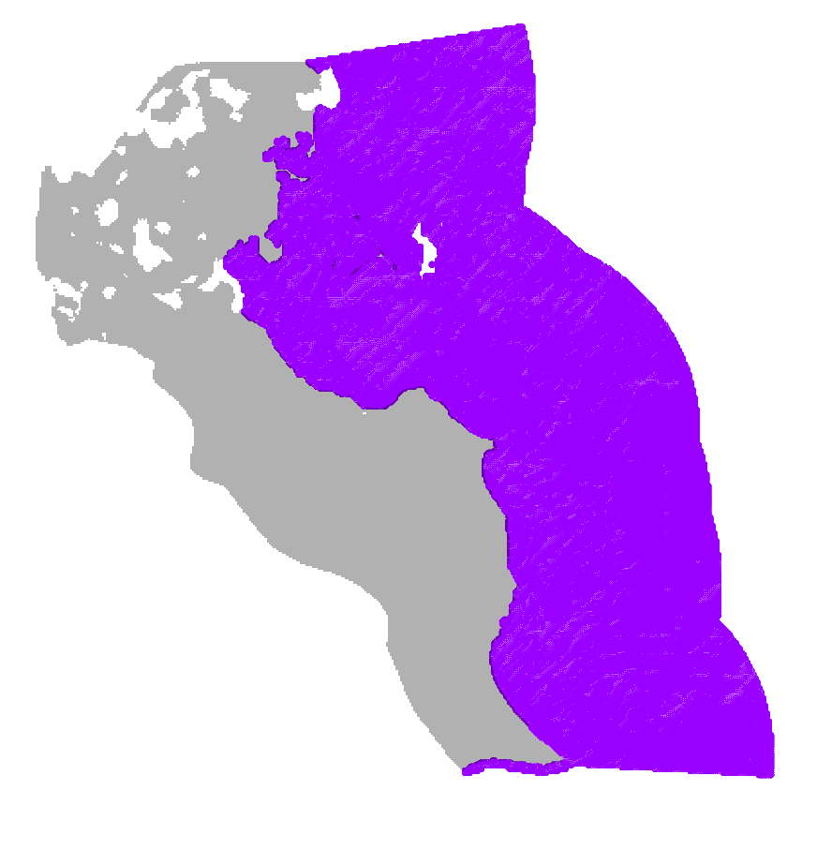
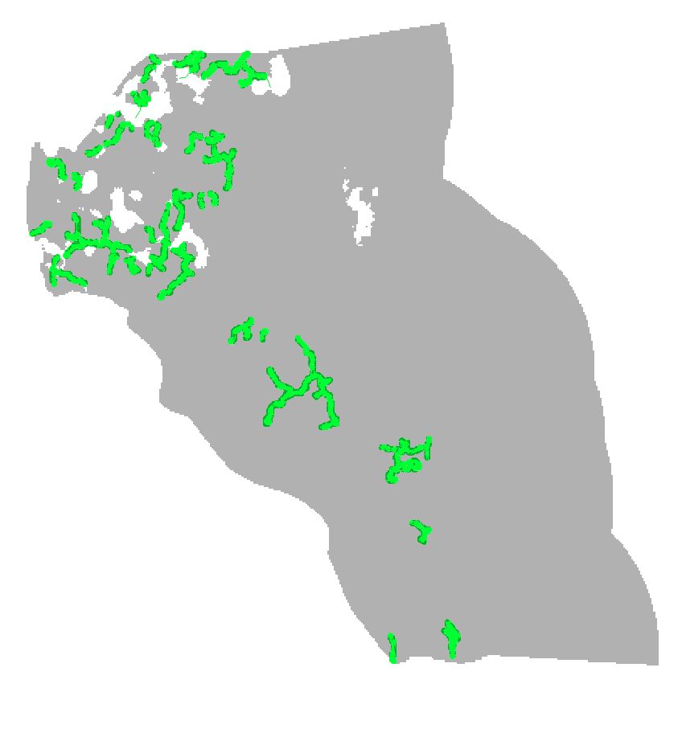
Hydrogeologic Model: Boundary Conditions
Rivers – DRAIN
Lakes, wetlands, ponds, cranberry bogs – High K & LAKE
Recharge – RCH (686 mm/year)
Ocean – Constant Head, Constant Concentration (35,000 mg/L TDS)

Slide 26
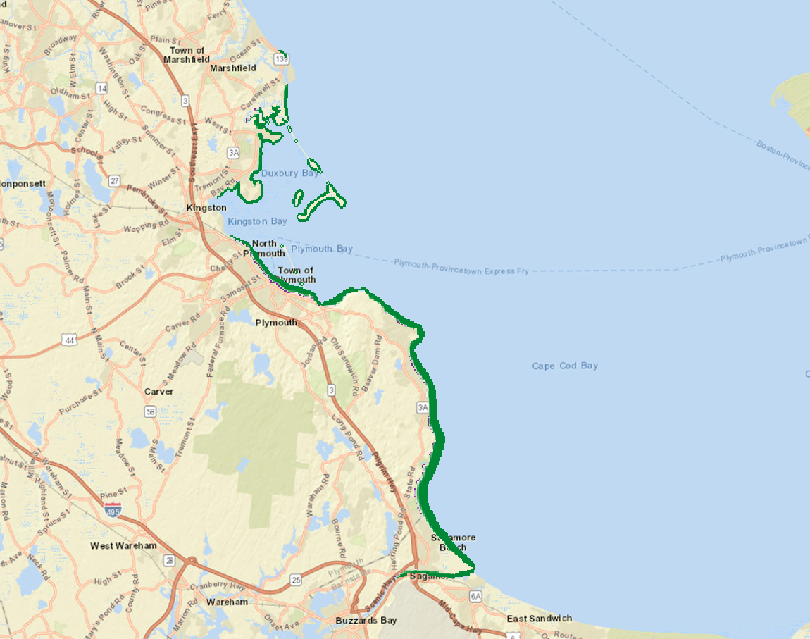
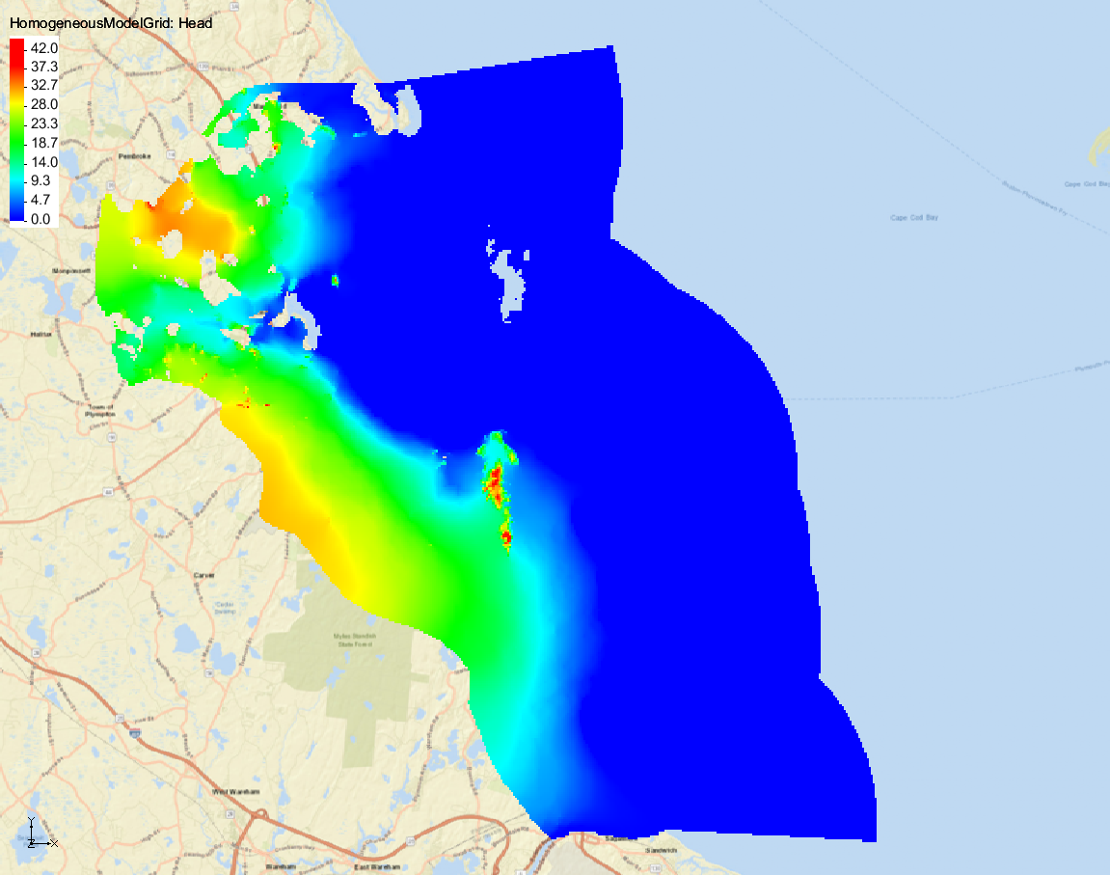
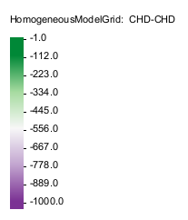
Steady State Hydrogeologic Model
Discharge to Ocean (m³/day)
Hydraulic Head Distribution
Inflow (m³/day):
Recharge: 630, 275
Outflow
Discharge to streams: 44%
Discharge to ocean: 56%

Slide 27
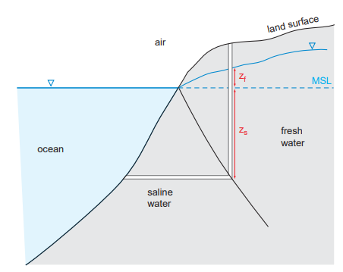
Estimated Depth to Salt Water
Fresh-salt water interface (feet below sea level) – Based on heads from Masterson et al., 2009
Ghyben-Herzberg relation
z = 40h
“Thus, there is 40 times more fresh water below the mean sea level than above it. In other words, for every 1 m of water table elevation above sea level there is 40 m of fresh water below it”

Slide 28
Saltwater Wedge Within Surficial Alluvium
Fresh-saltwater interface (feet below sea level)
Predicted salt groundwater within surficial alluvium

Slide 29
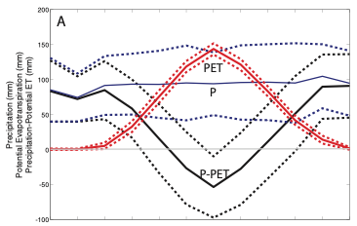
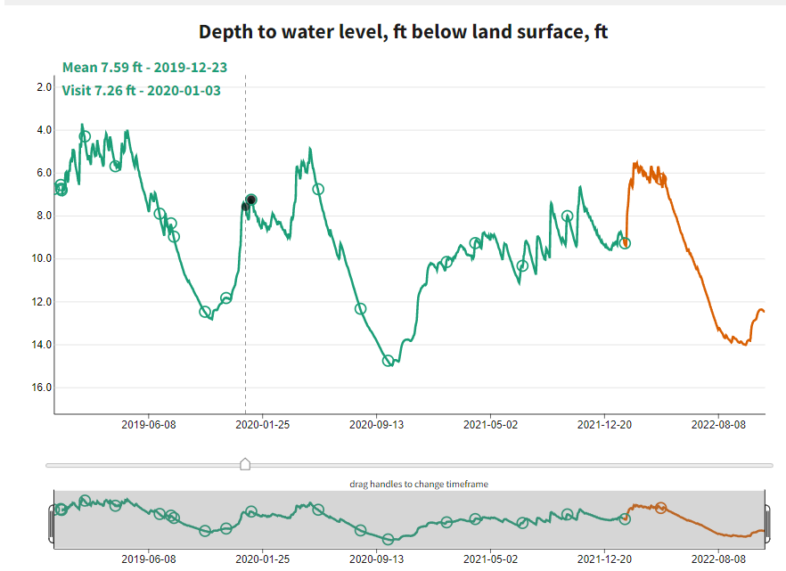
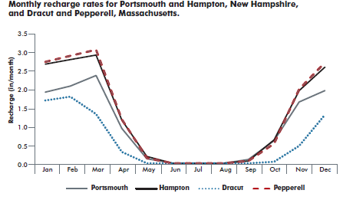
Recharge Rates in Aquifer – Monthly Time Series
Generalized climate for this region P-ET = GW Recharge
Average total recharge: 686 mm/year based on Masterson et al., 2009
Total monthly net recharge values for model
Month | P-PET Factor | Monthly Recharge (mm)
January | 84 | 109
February | 72 | 93
March | 85 | 110
April | 59 | 76
May | 0 | 0
June | 0 | 0
July | 0 | 0
August | 0 | 0
September | 0 | 0
October | 49 | 63
November | 91 | 118
December | 91 | 118
Total |  | 686
Jan
Jul
Dec
Net recharge occurs Oct-April, net loss on average from May-Sept
Left: monthly mean water levels in MA-LKW 14R screened at 41 feet below land surface in surficial Sand & Gravel aquifer
Right: measured monthly recharge rates illustrate this

Slide 30
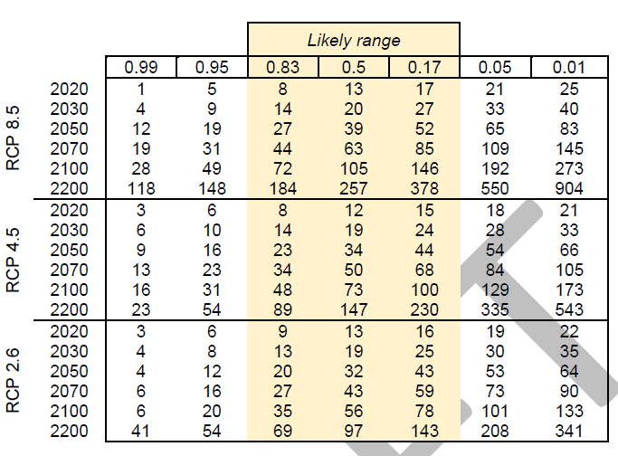
Sea Level Rise and Hydroclimate Change Scenarios
Sea level rise expected through 2100: Likeliest range, values
  Low end – RCP 2.6
  Moderate – RCP 4.5
  High end – RCP 8.5

Slide 31
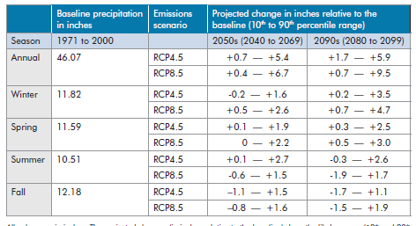
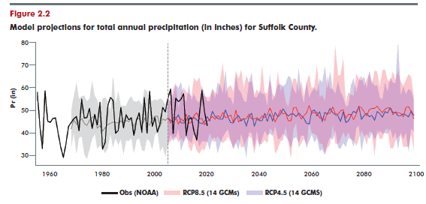
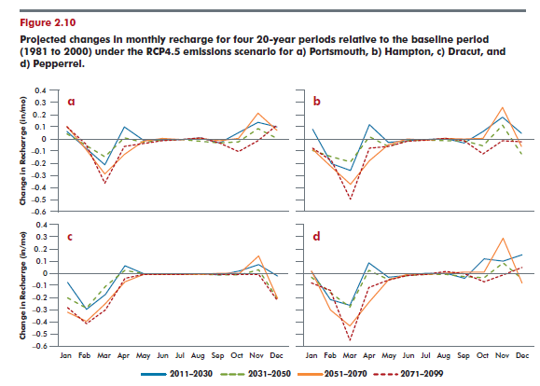
Hydroclimate Changes
Wetter overall (high end of range)
Drier overall (low end of range)
Shift in seasonality (away from winter – towards Fall

Slide 32
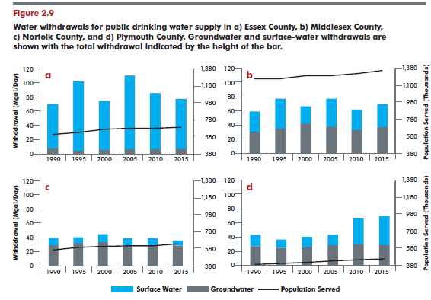
Freshwater Use Changes
  Constant rate
  High-end scenario (Linear projection)

Slide 33
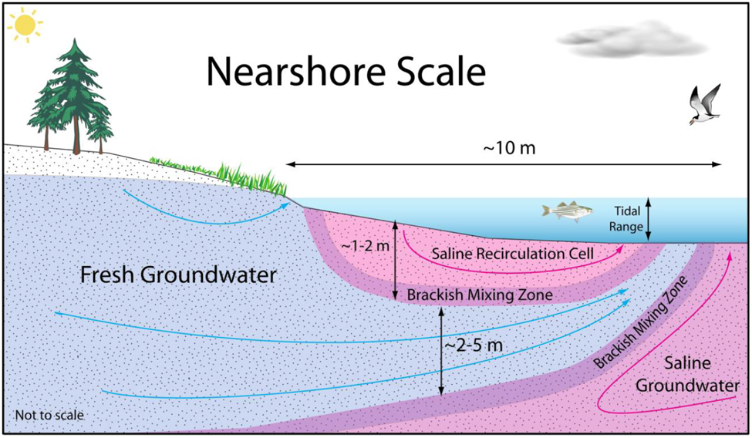
Submarine Groundwater Discharge (SGD)
Occurs where pressure (hydraulic head) from fresh groundwater exceeds hydraulic head of saline groundwater offshore
Sea level rise, groundwater pumping, and reductions in aquifer recharge (e.g. – impermeable surfaces) reduce SGD
Bratton, John. (2010). The Three Scales of Submarine Groundwater Flow and Discharge across Passive Continental Margins. J. Geol.. 118. 10.1086/655114.

Slide 34
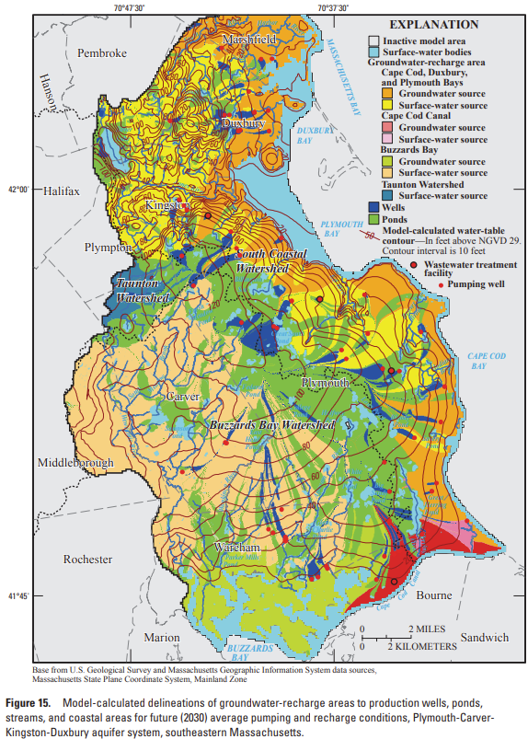
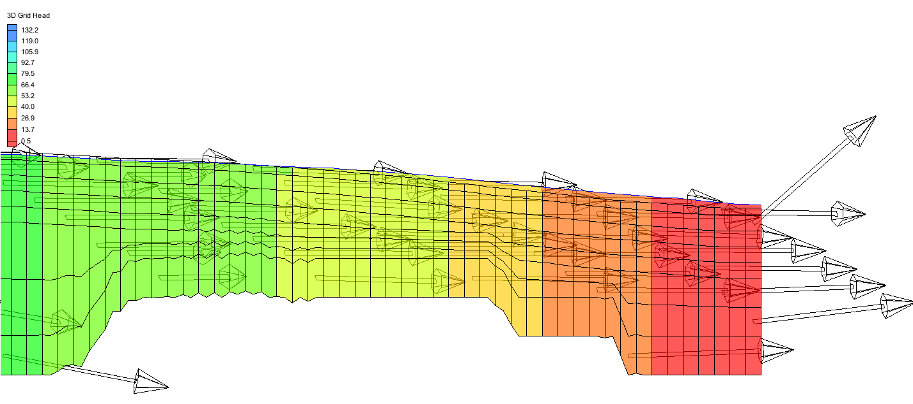
PCKD Aquifer SGD
SGD occurs along entire coast
May range from very near shore to far offshore
SGD expected to be significant due to high aquifer recharge rates

Slide 35
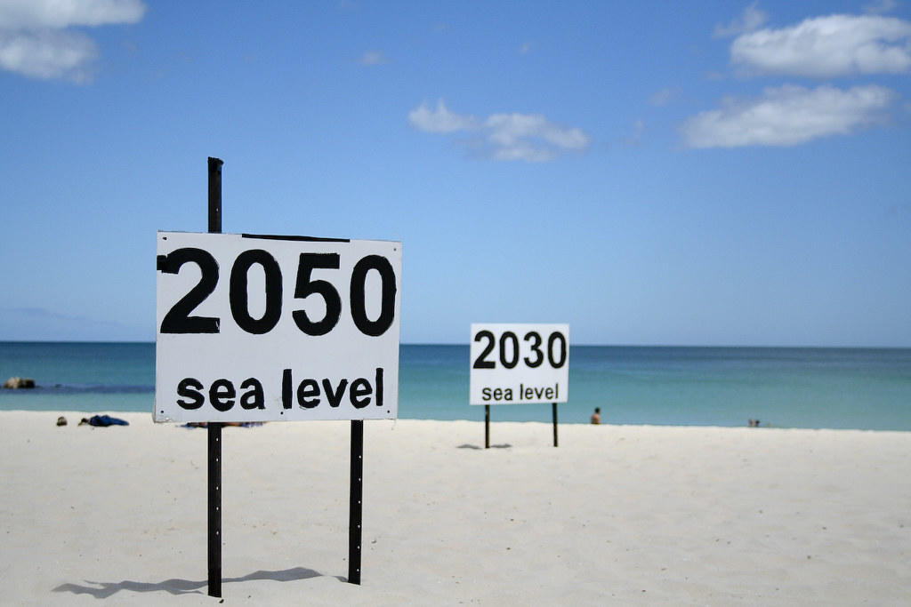


SGD and SWI are linked
The pressure balance between fresh and saline groundwater controls both SGD and SWI
Sea level rise, groundwater pumping, and reductions in aquifer recharge (e.g. – impermeable surfaces) reduce SGD and increase SWI

Slide 36
Questions and Discussion

