Slide 1
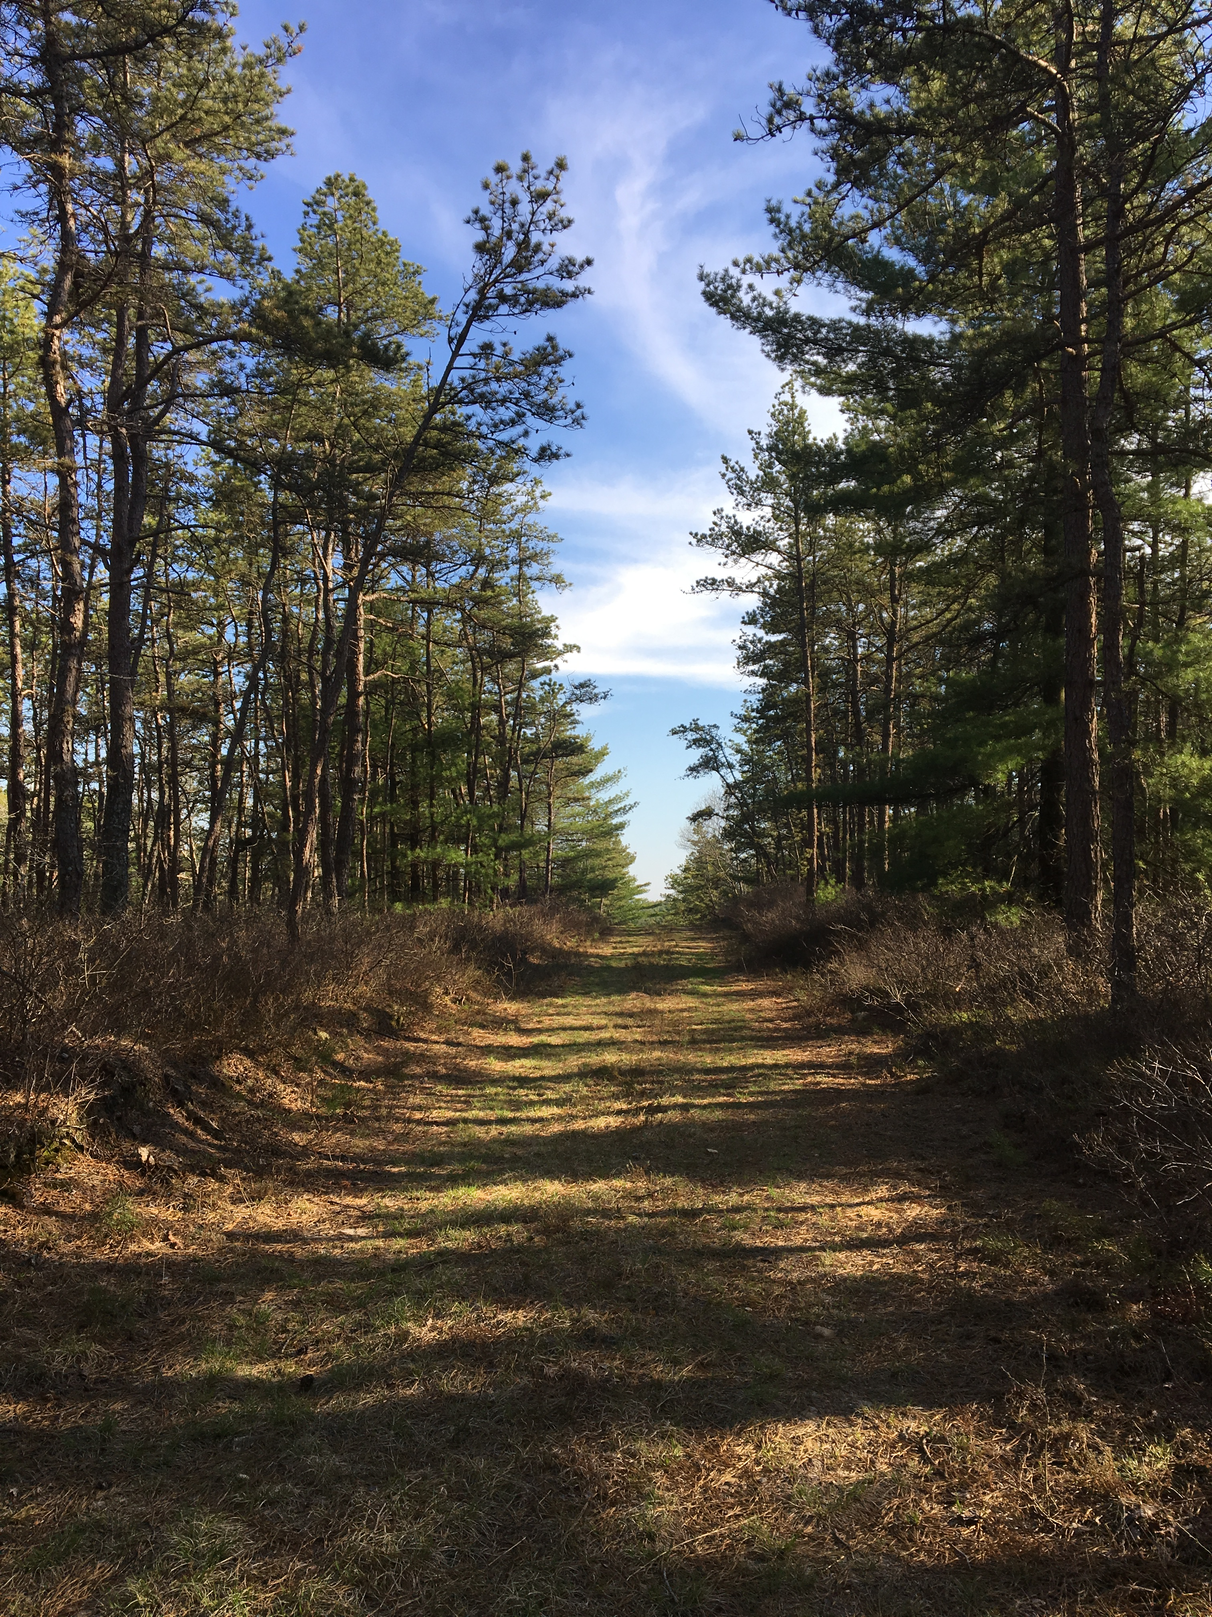

Subterranean resilience:
A locally-produced, state-funded Municipal Vulnerability Preparedness Action Grant to study Plymouth’s vulnerability to saltwater intrusion and to devise long-term mitigation strategies.
Sharl Heller
Frank Mand
Southeastern Massachusetts Pine Barrens Alliance
SEMPBA

Slide 2
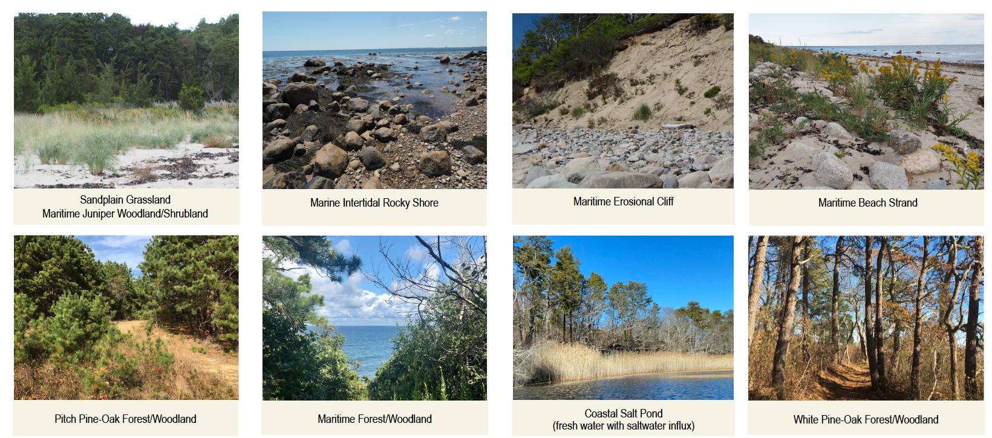
The Massachusetts Coastal Pine Barrens
Not just about trees…

Slide 3
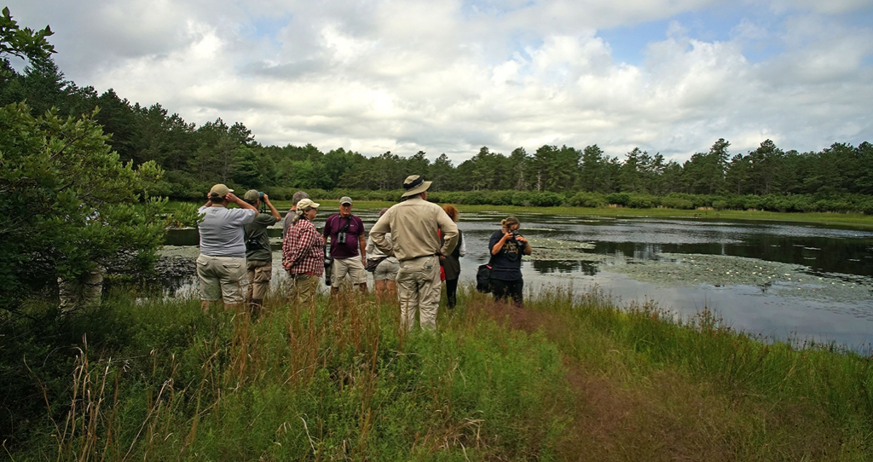
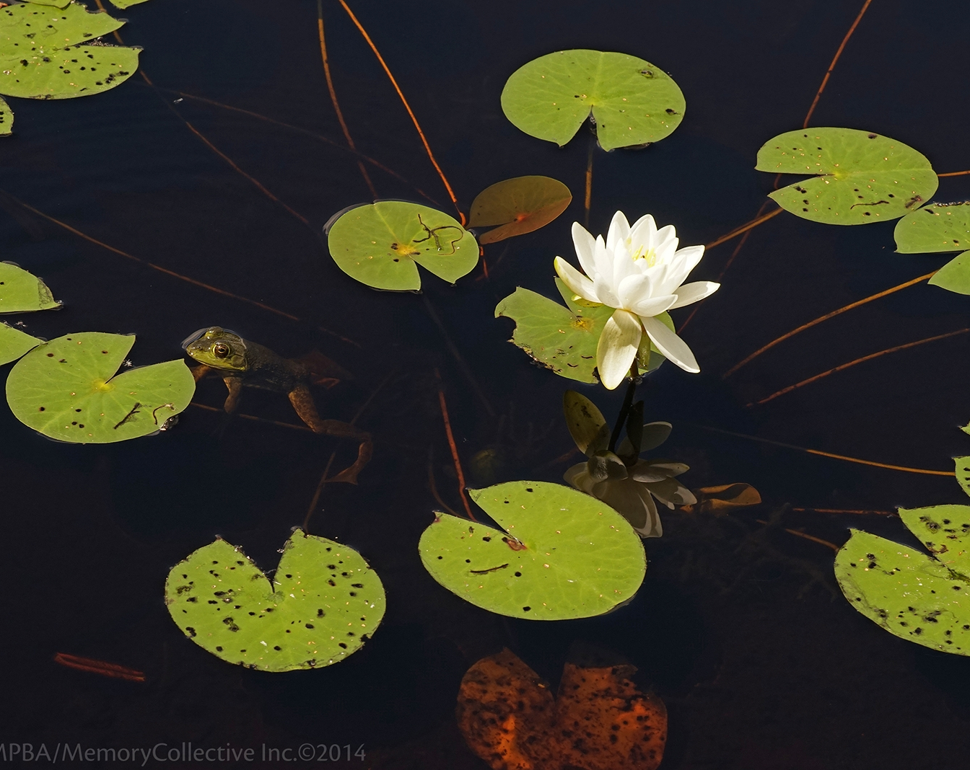
Why is a conservation organization dedicated to conserving the Coastal Pine Barrens Ecoregion leading an effort to identify our vulnerability to saltwater intrusion?

Slide 4
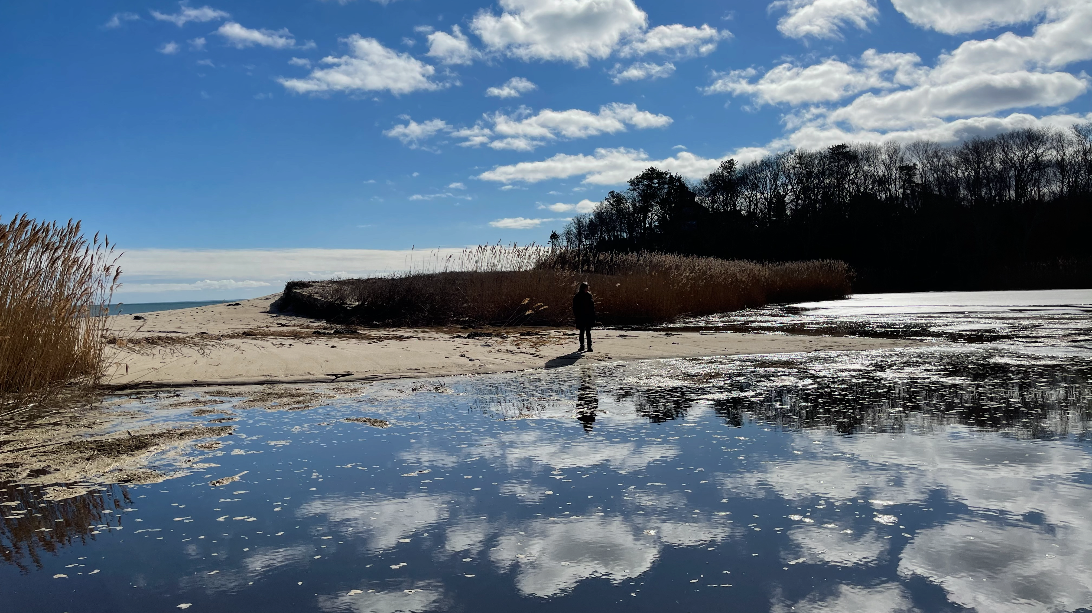
Here’s a little story
SEMPBA’s headquarters is on a hill overlooking the Plymouth coastline, at the Center Hill Beach.
Just 50 yards inland from that rocky beach is what used to be a freshwater pond, Center Hill Pond…

Slide 5
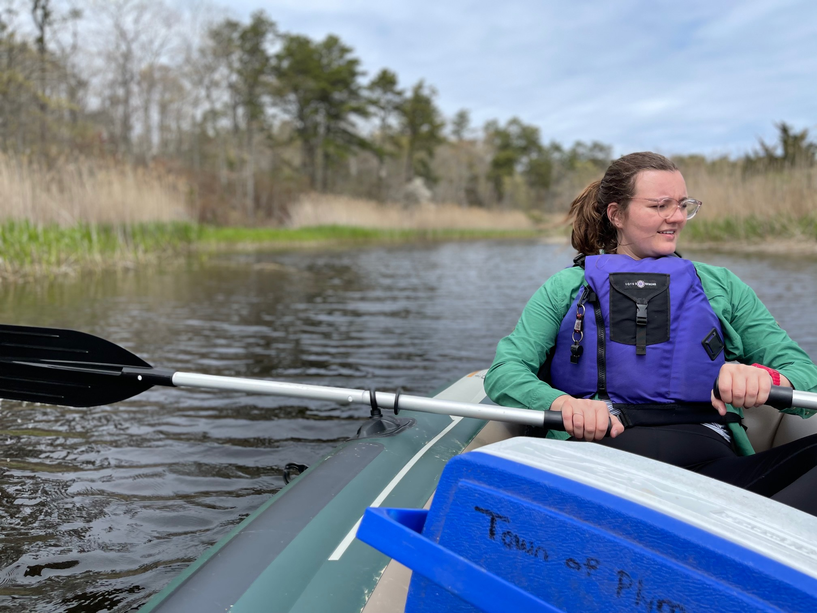
Center Hill Preserve
—Pond Sampling

Slide 6
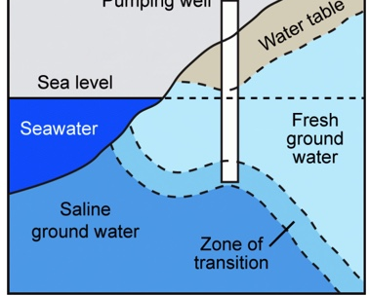
Saltwater intrusion?
A constant tug-of-war
Normally a stand-off
But if we take too much…
Or break down natural barriers,
Or with climate change,
THEN THE BALANCE IS UPSET!

Slide 7
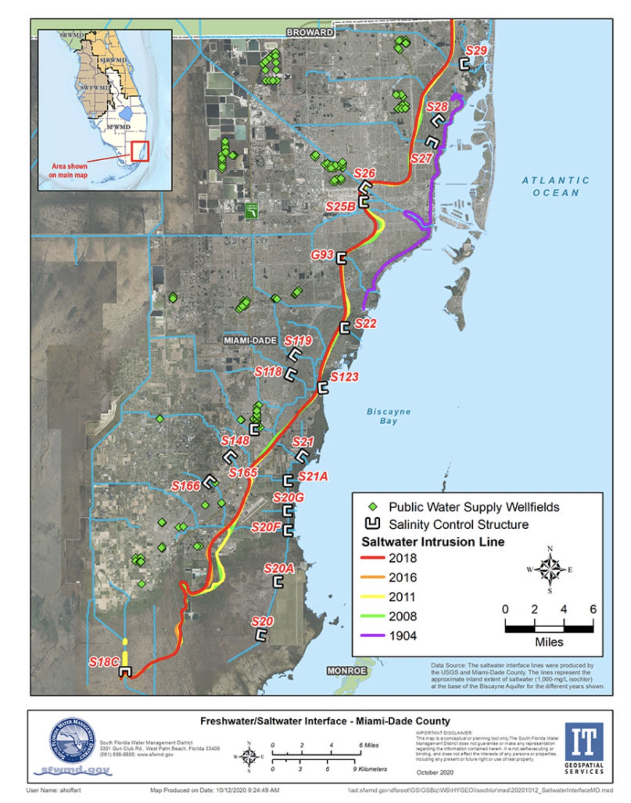
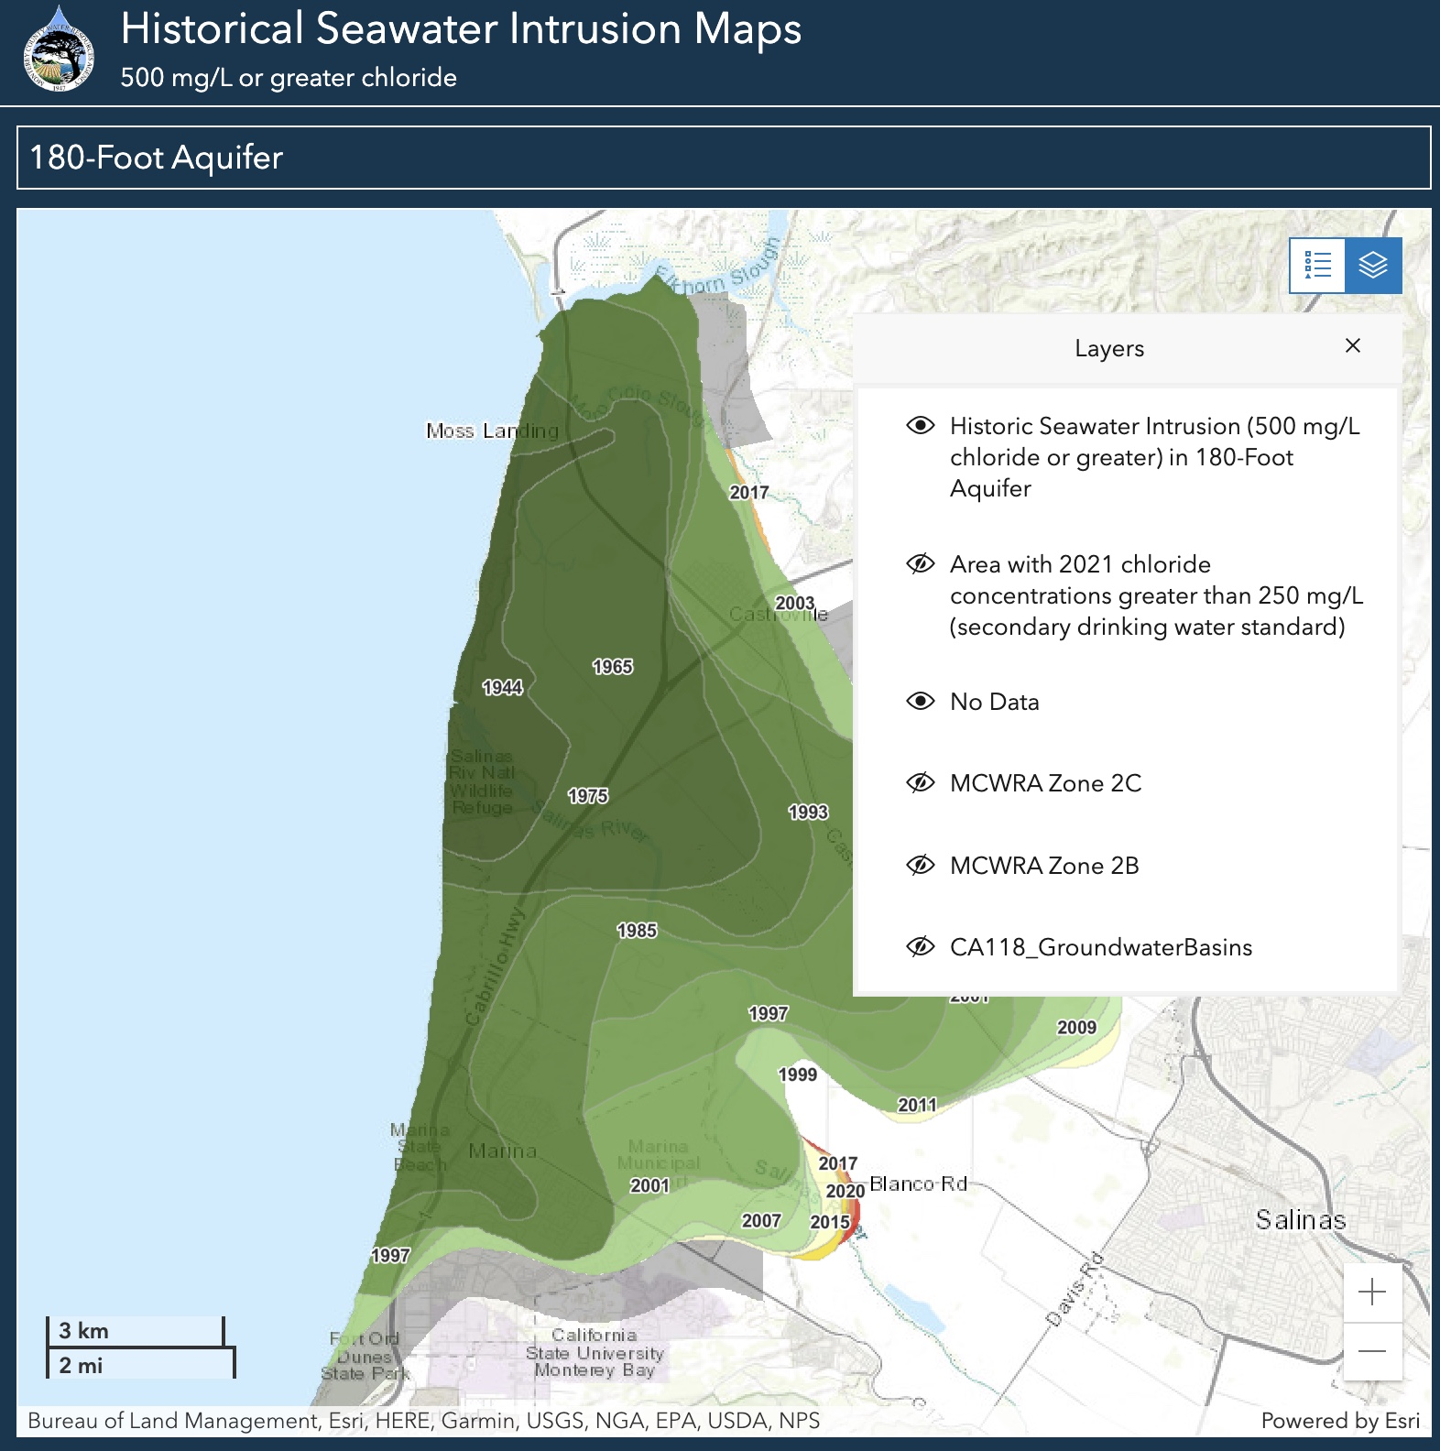
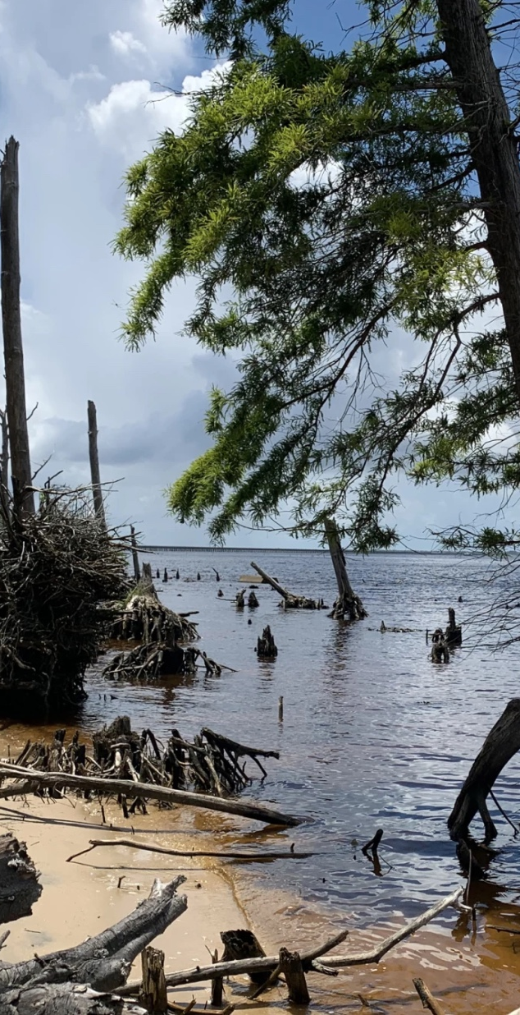
A Few Examples of
Things Going Wrong…
Salinas County, CA
In Florida
In California
In Delaware

Slide 8
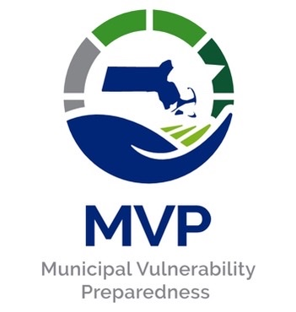
Municipal Vulnerability Preparedness
Incentivizing communities to find ways to use nature to mitigate the effects of climate change…
  Buy land to keep it open and more resilient
  Pay to move infrastructure out of harm’s way
  Evaluate our vulnerability to saltwater intrusion?

Slide 9
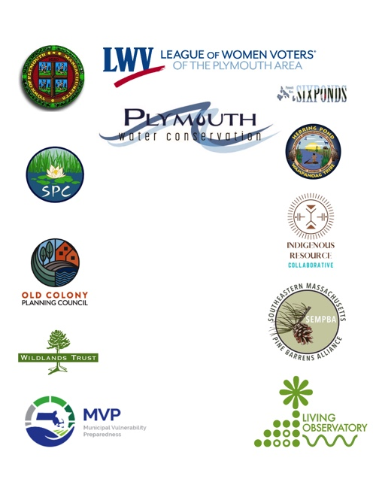

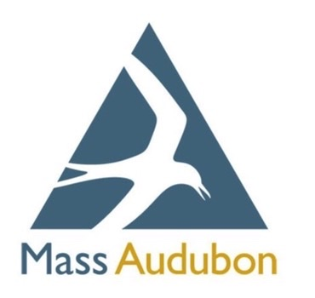

12 PARTNERS PLUS!
UP-TO-DATE HYDROGEOLOGICAL MODEL
PREDICT GREATEST VULNERABILITY POINTS
NATURE-BASED SOLUTIONS
OUTREACH ACTIVITIES

Slide 10
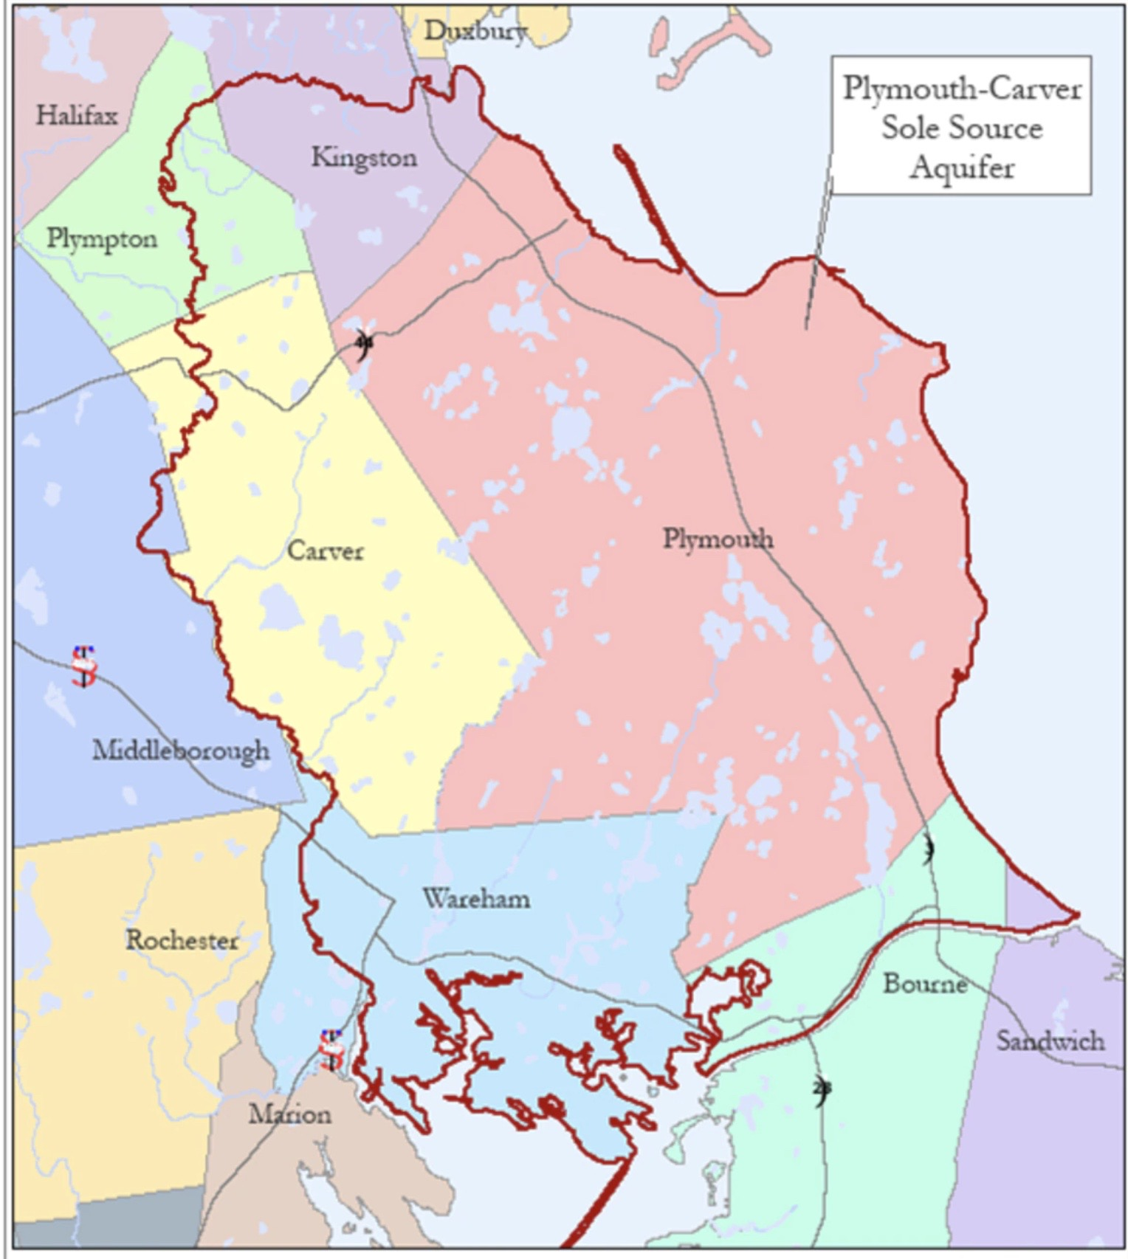
Plymouth-Carver Sole Source Aquifer

Slide 11
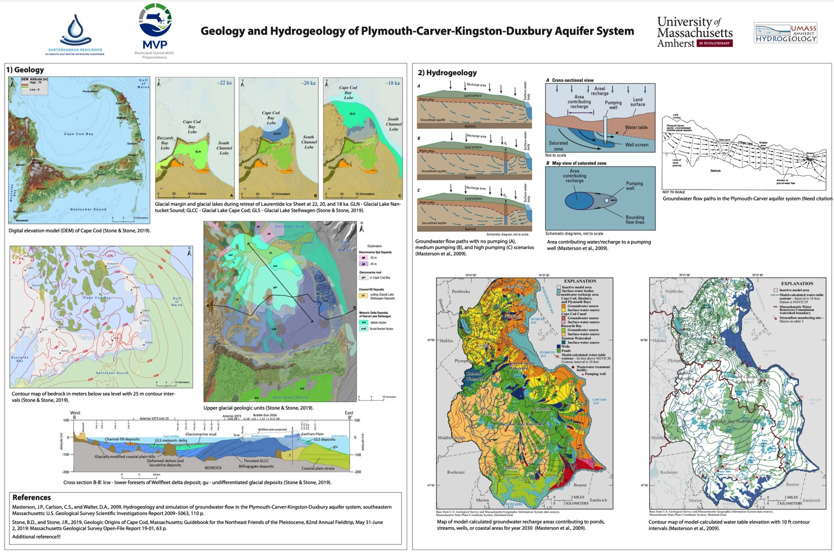
A brand-new hydrogeological model
The existing model is dated and inexact.
Add new info, and volunteer data
Well levels, salinity, and other data collected by volunteers.

Slide 12
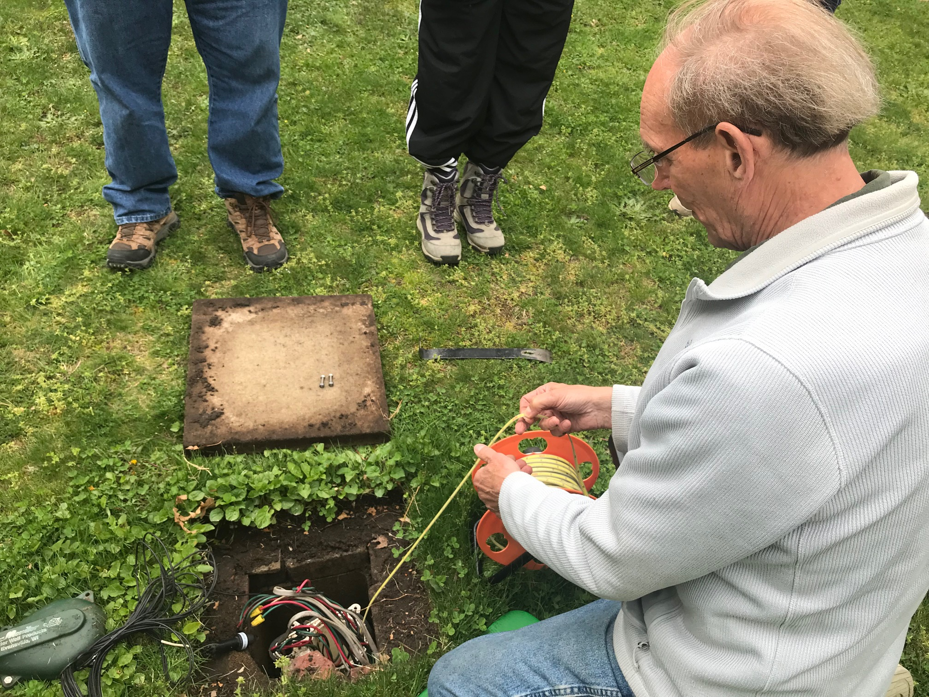
Volunteers Sampling
Plymouth Wells

Slide 13
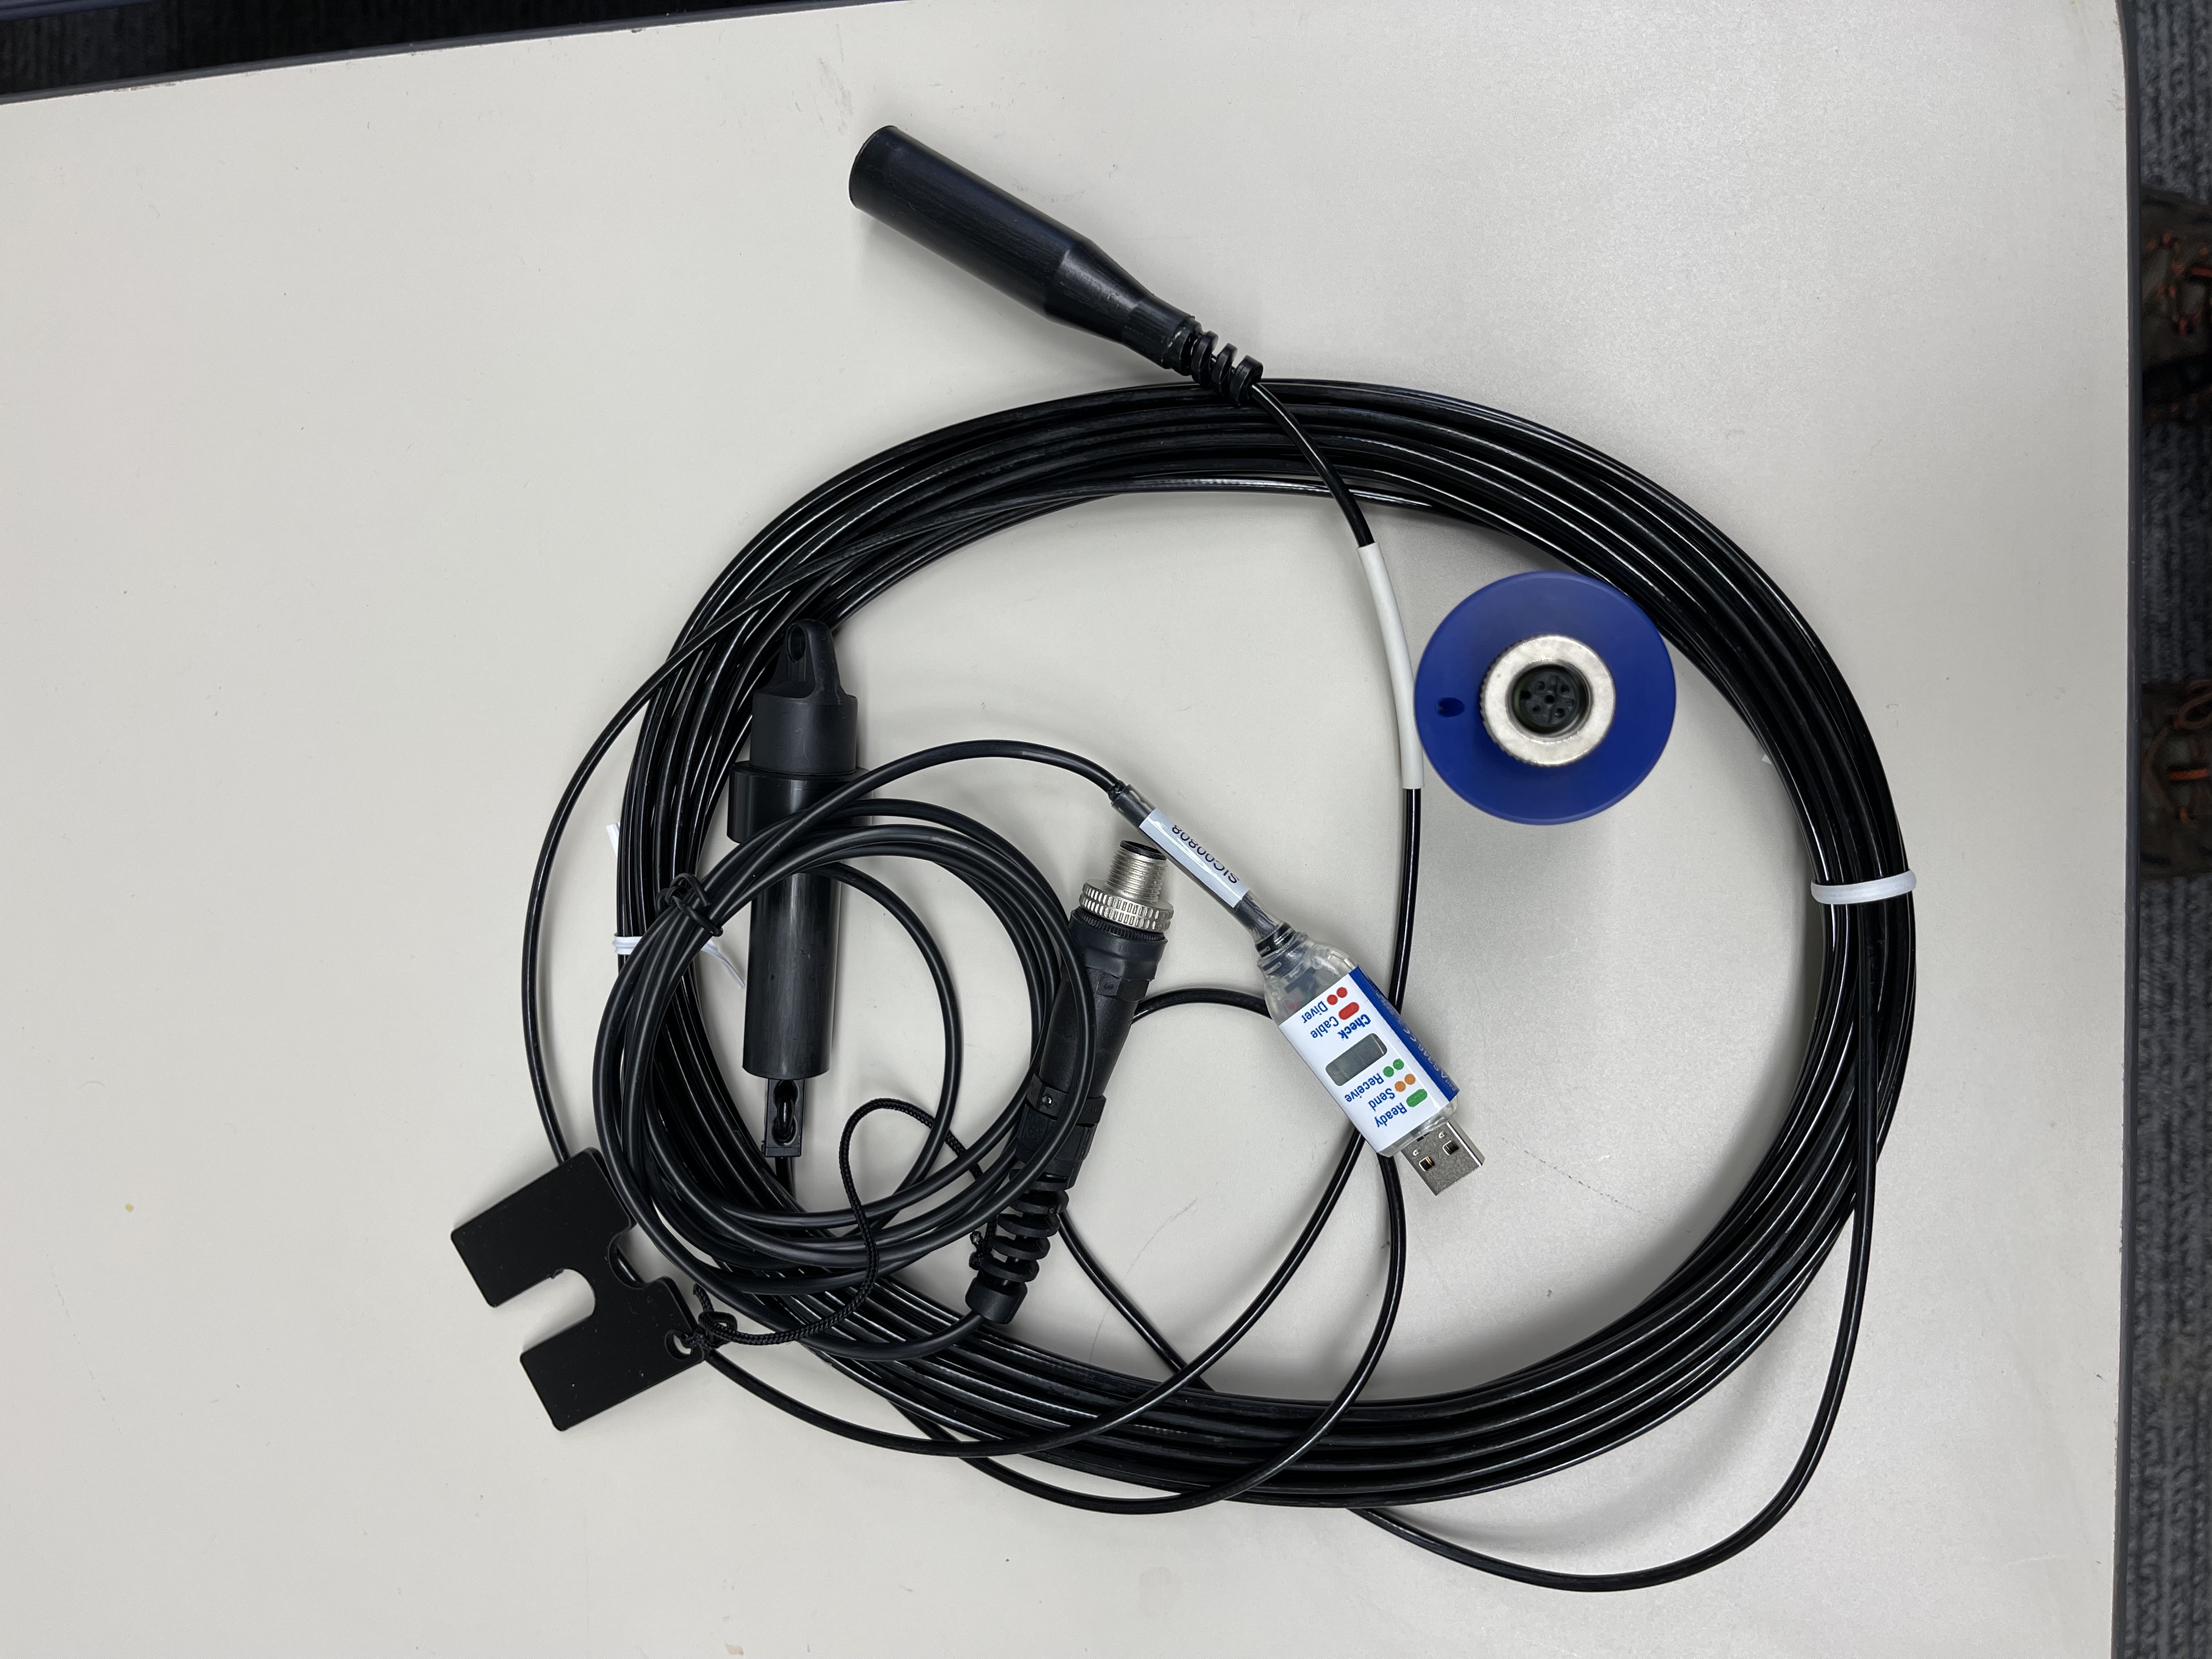
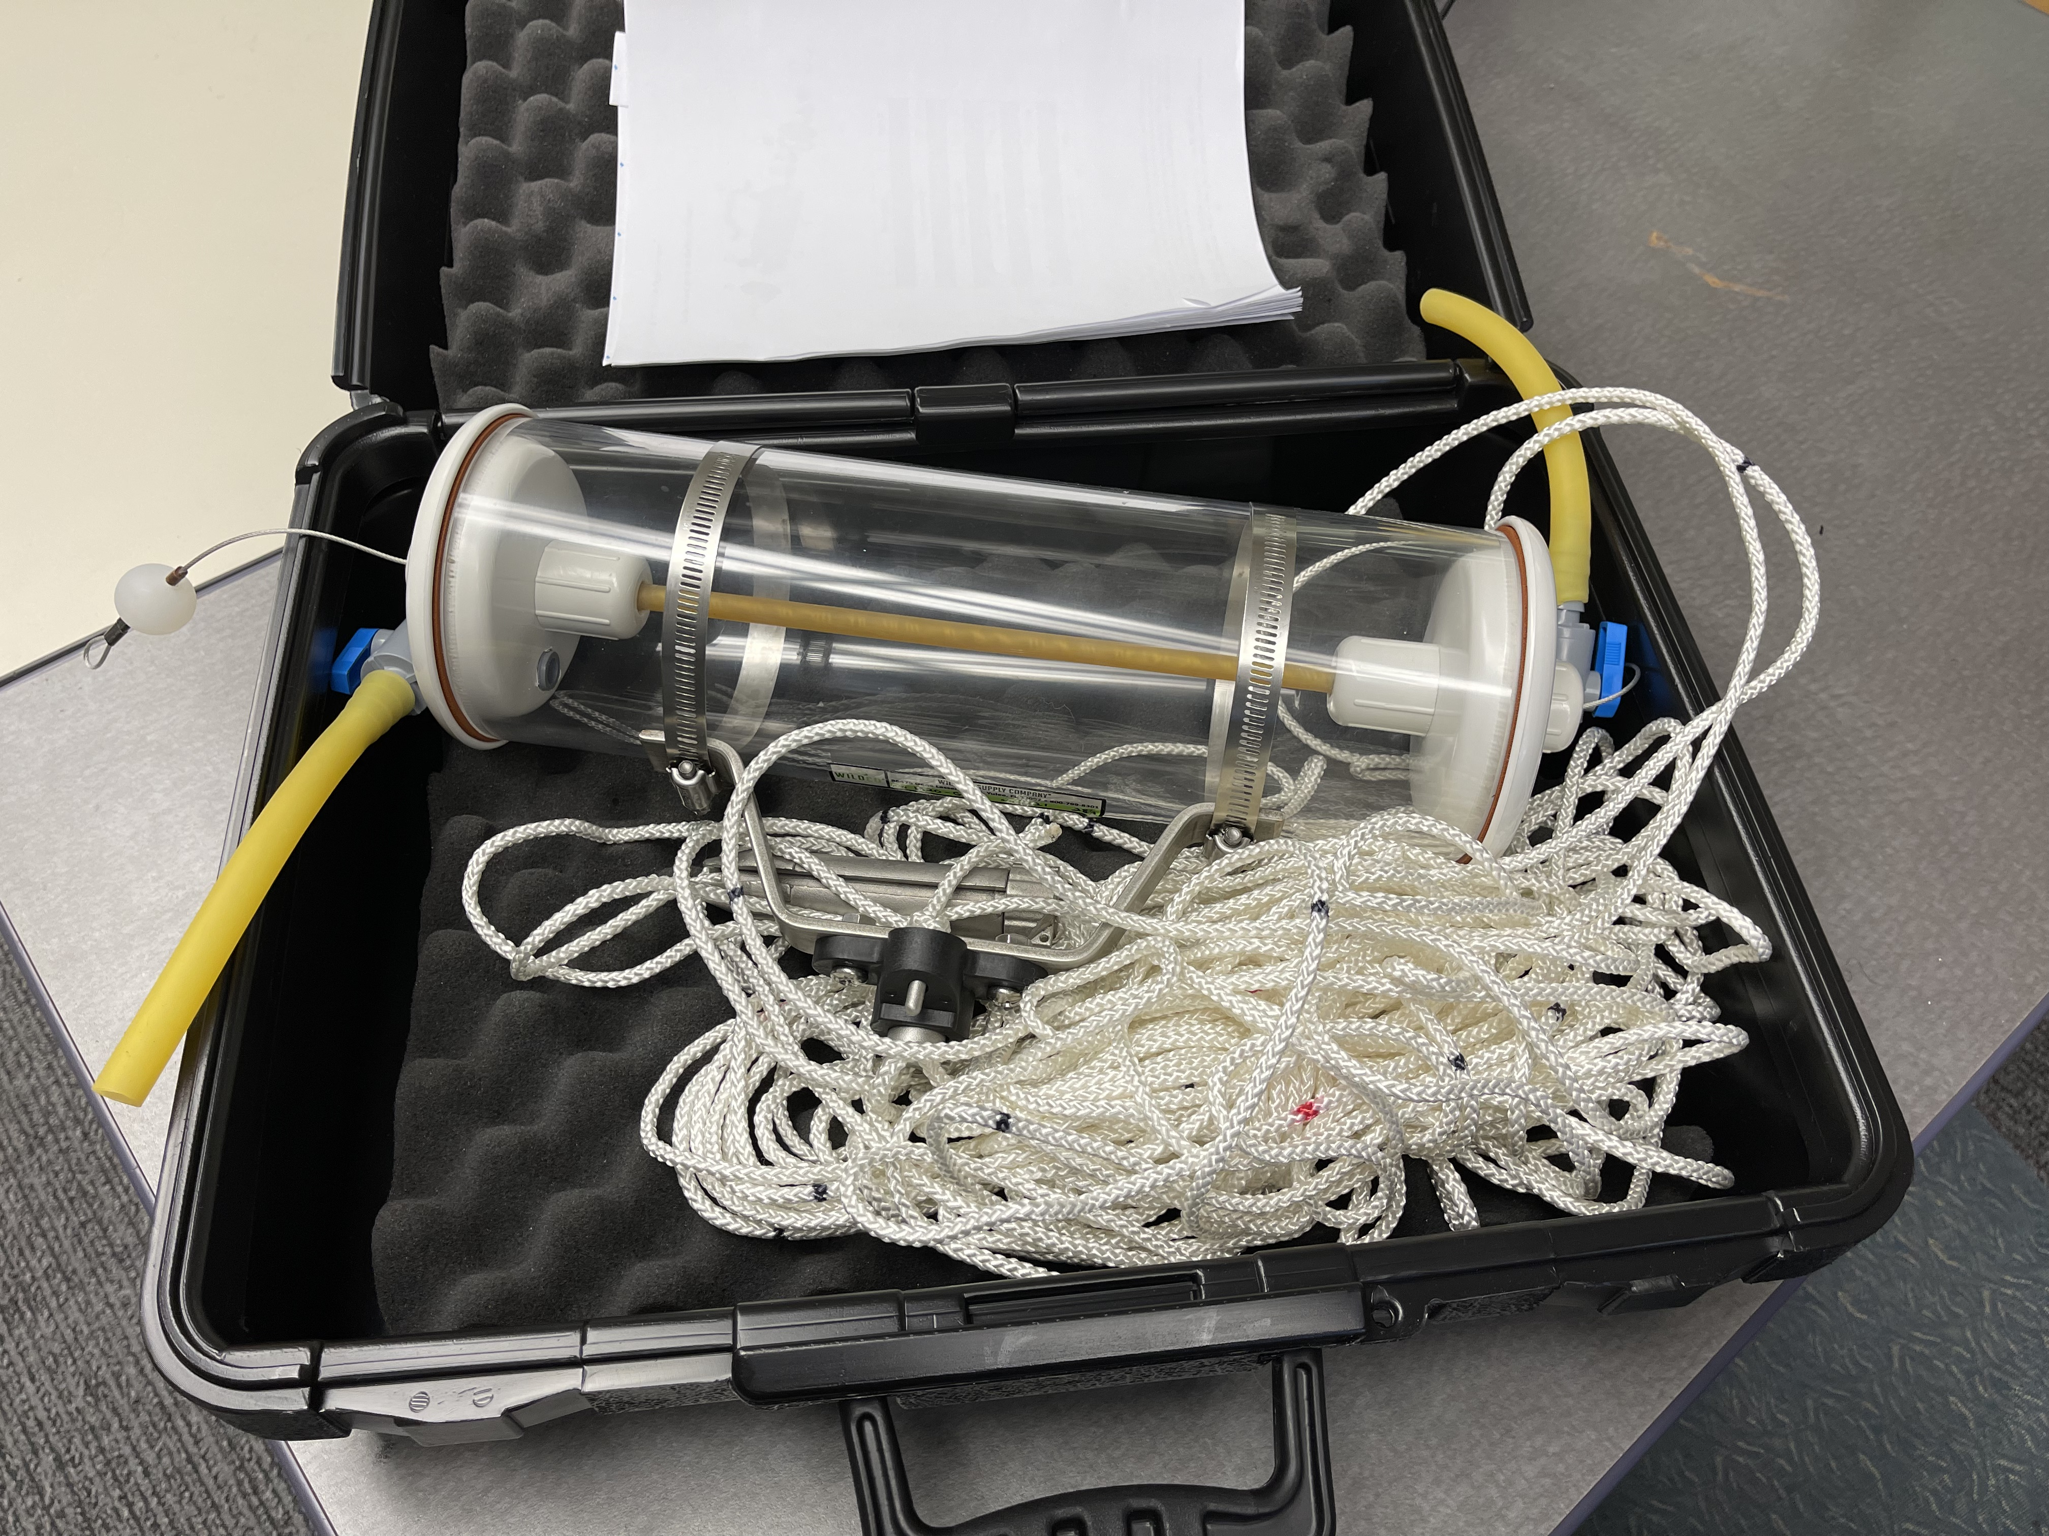
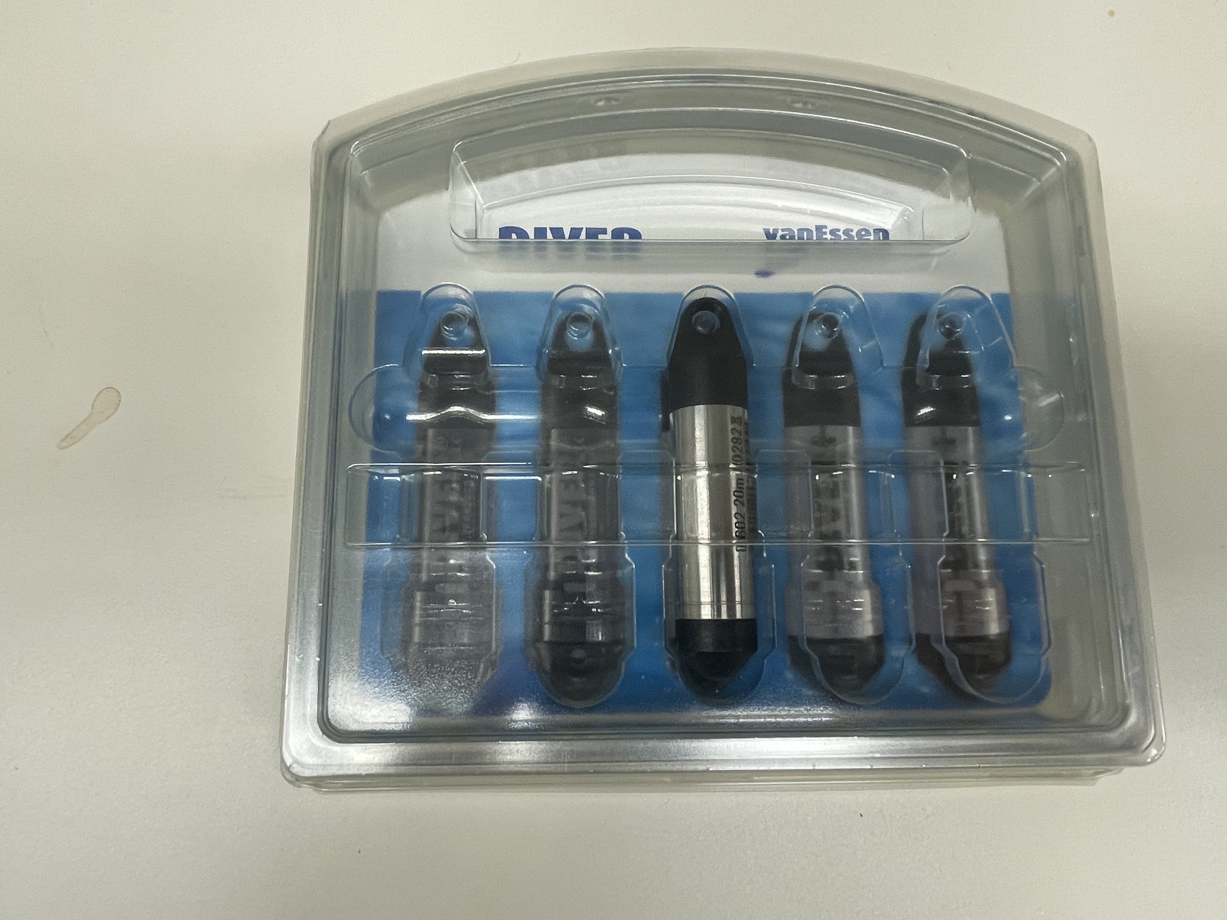
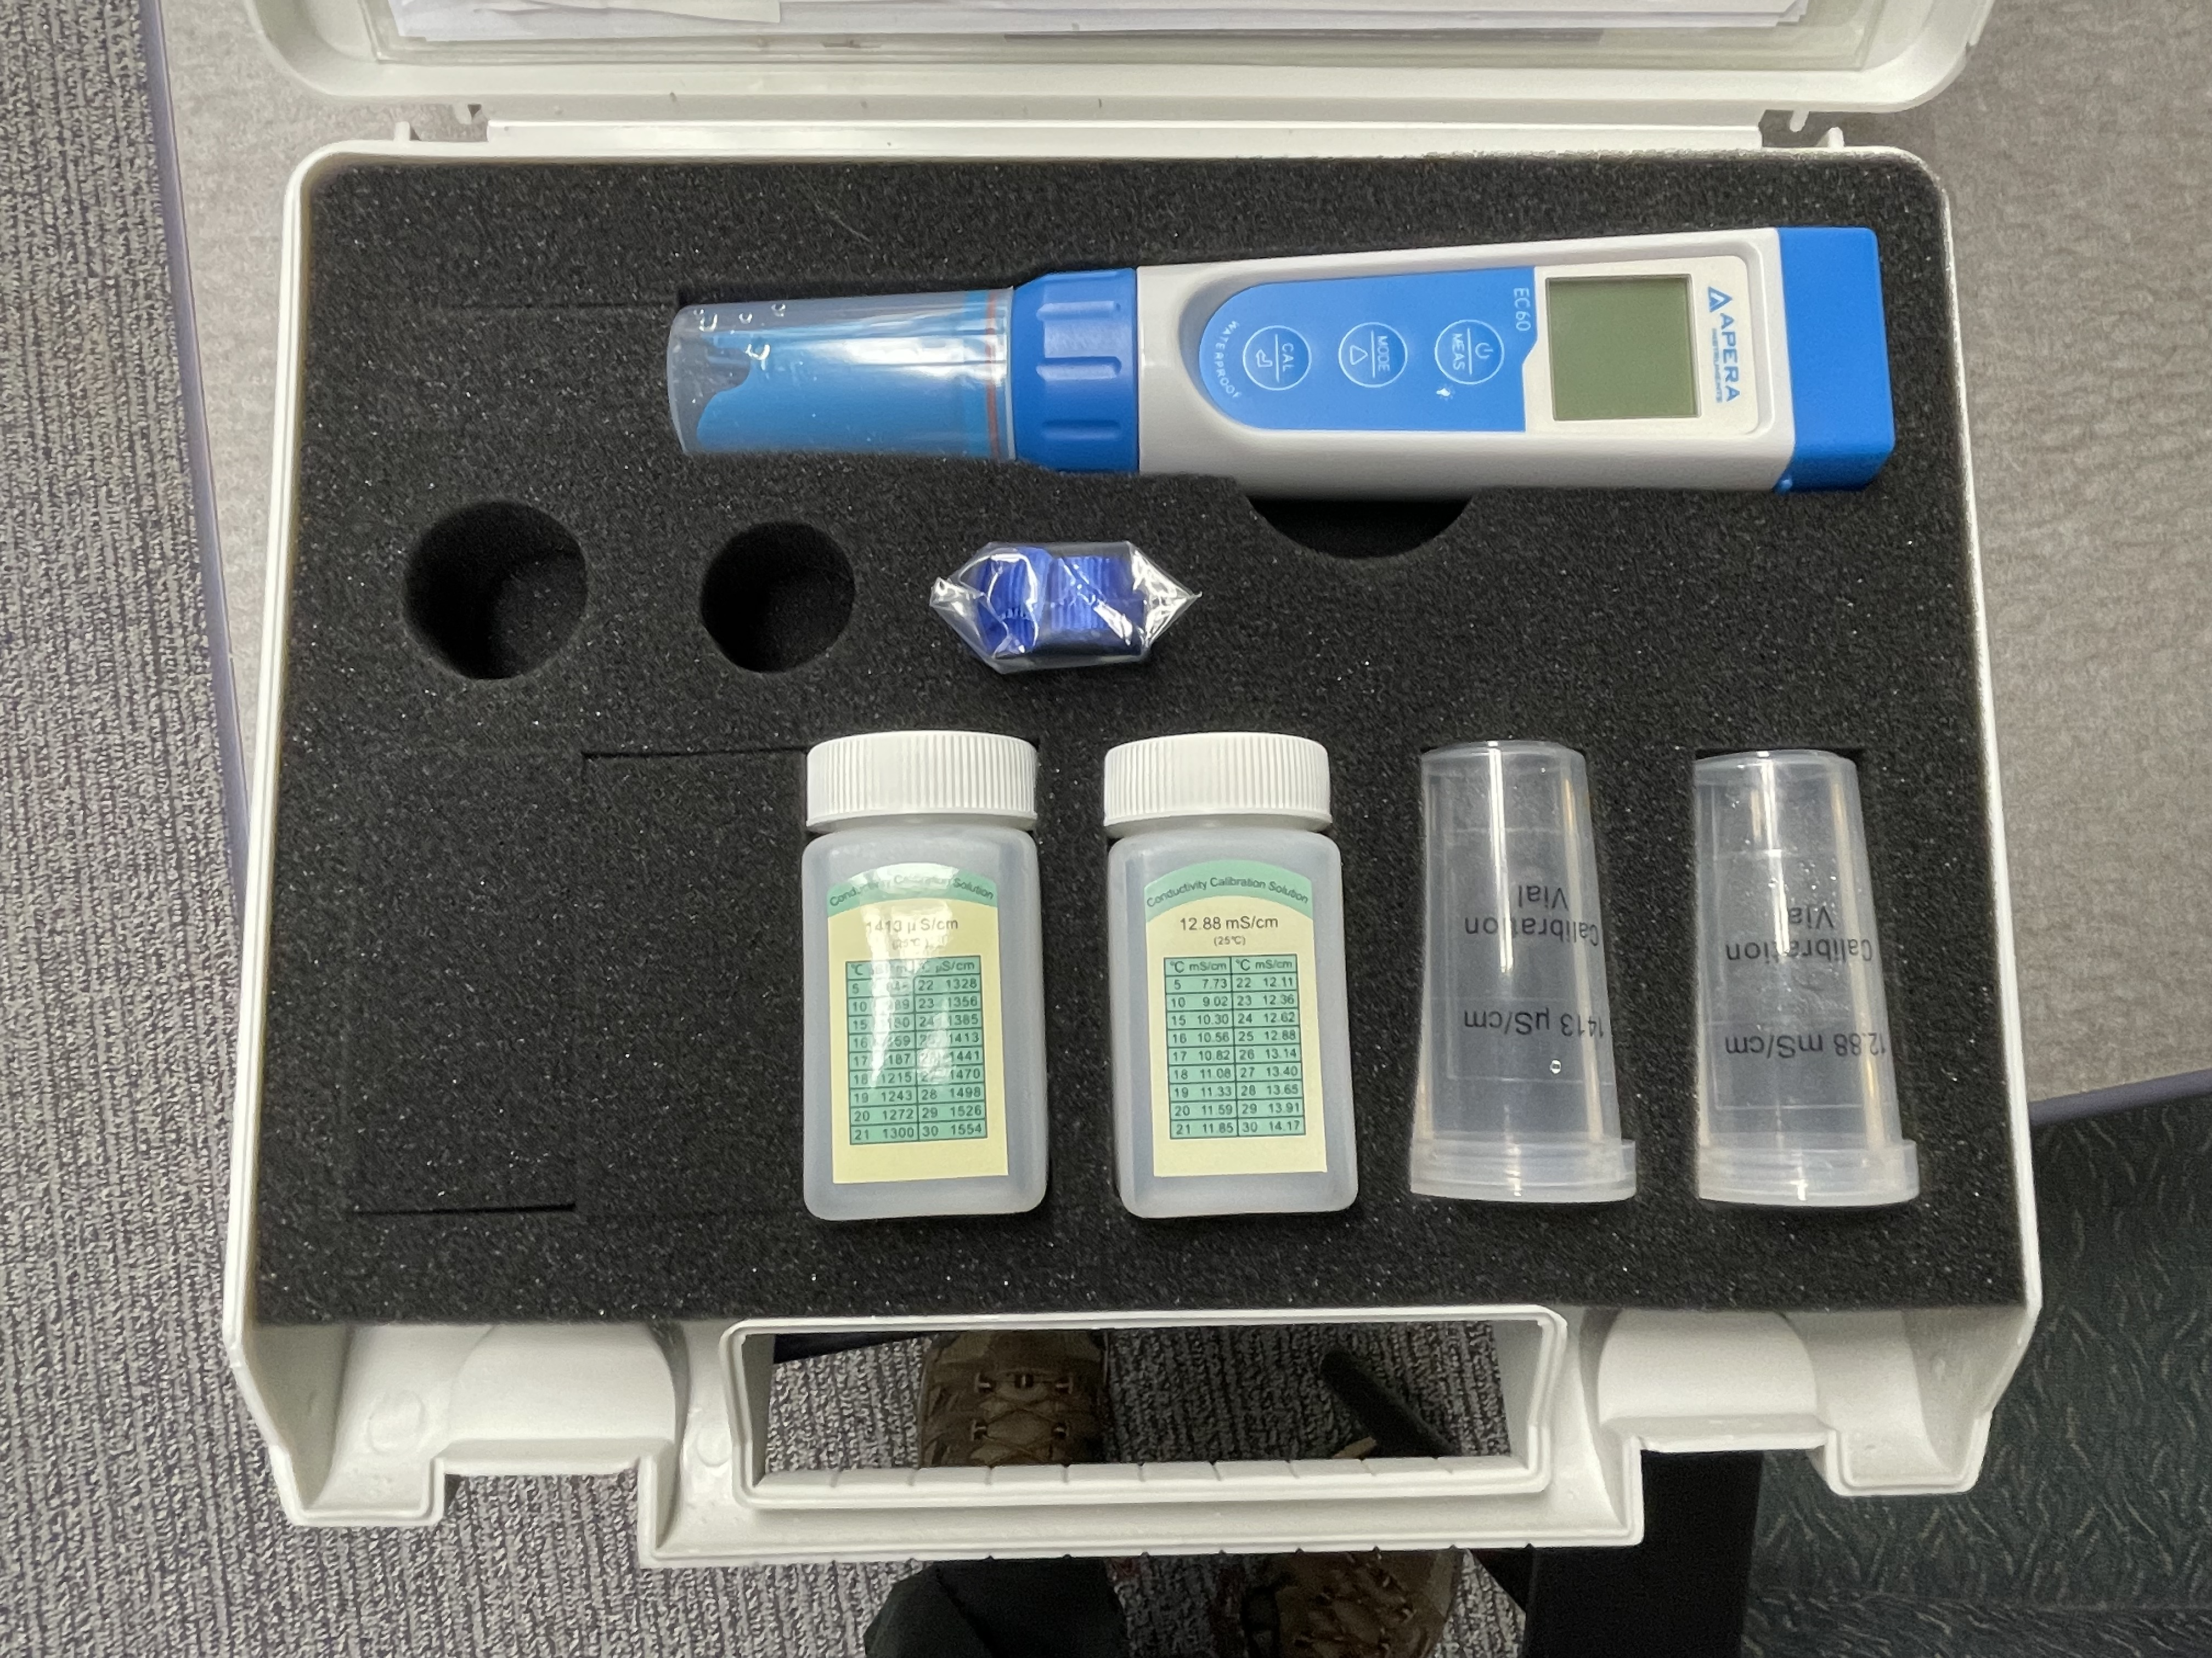
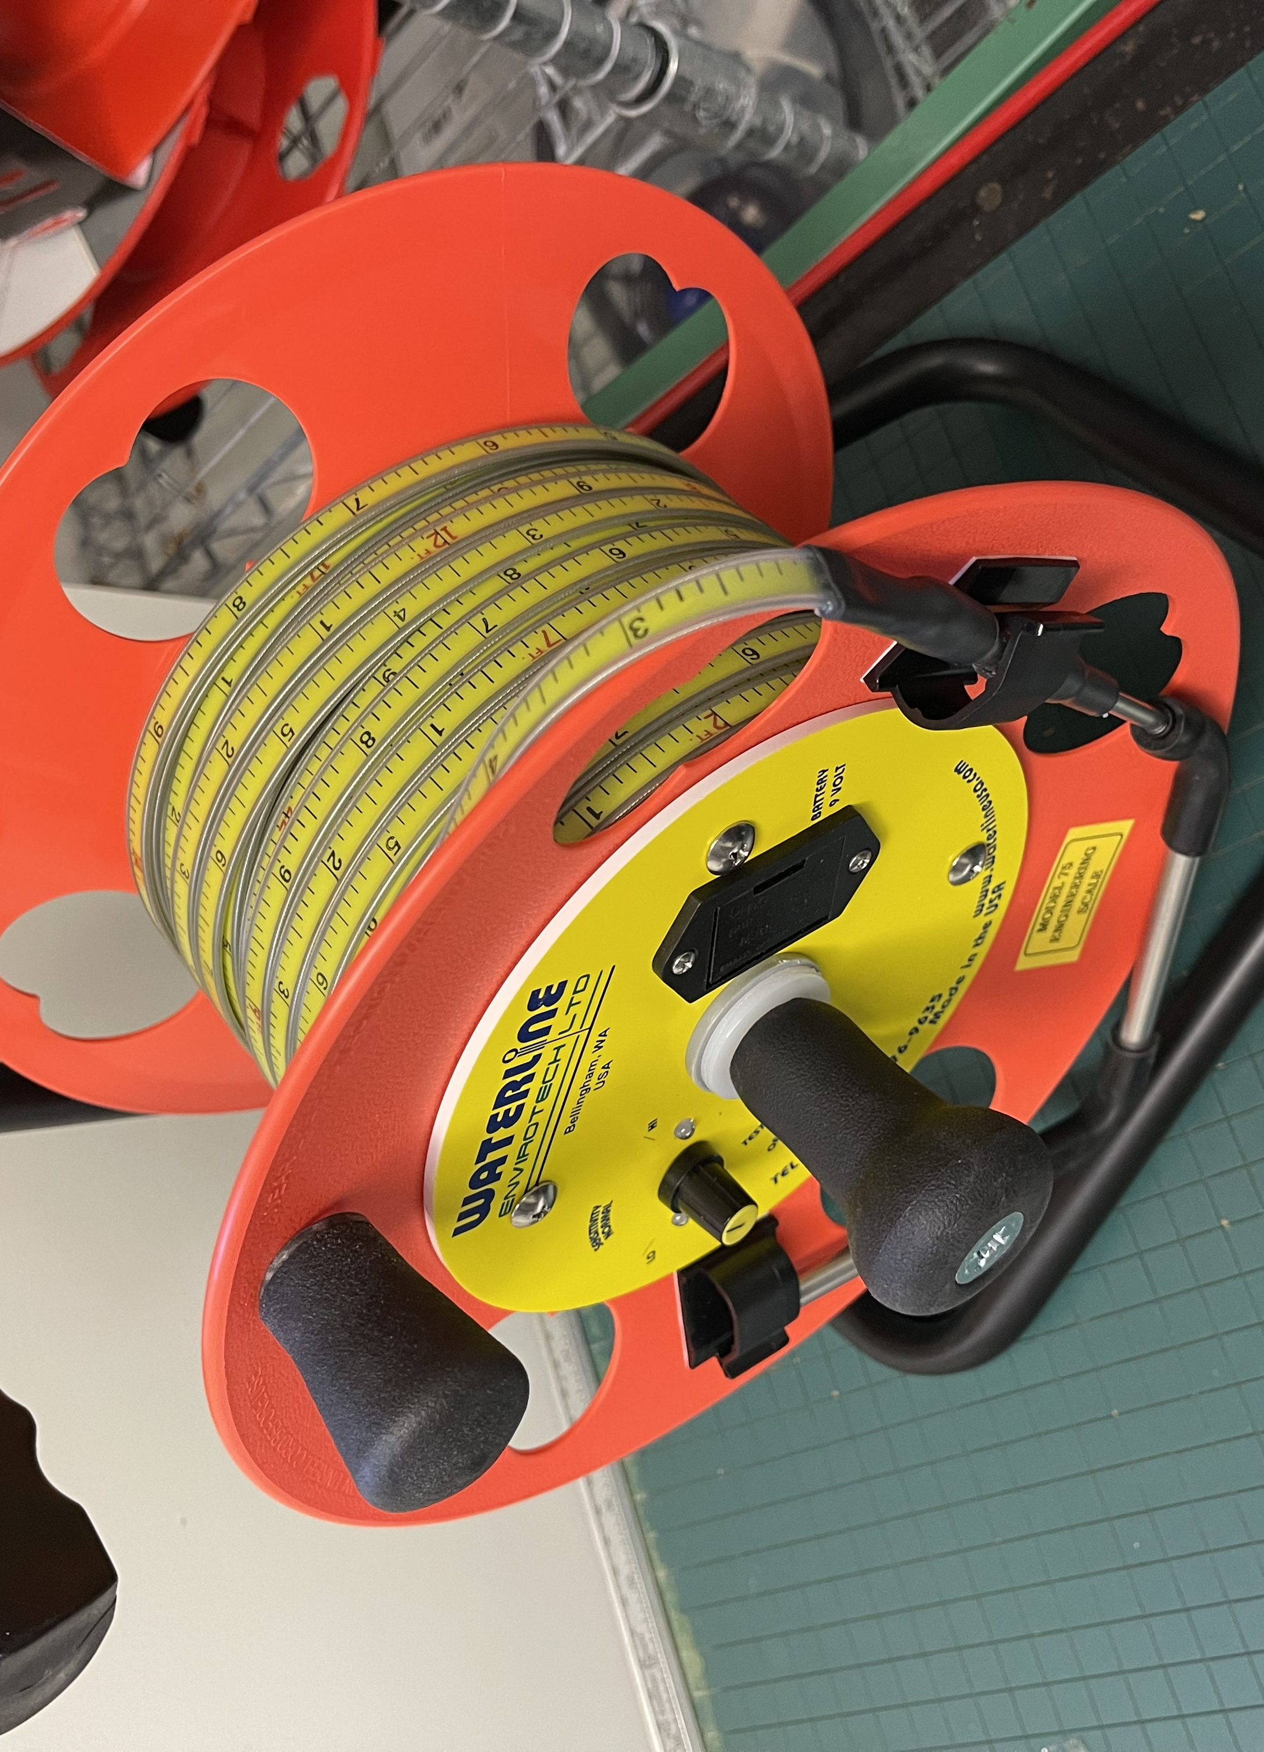
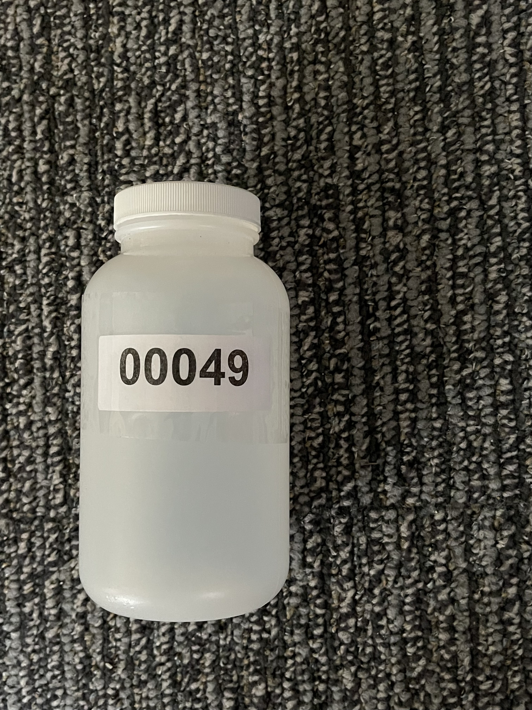
Legacy: Water Testing Equipment

Slide 14
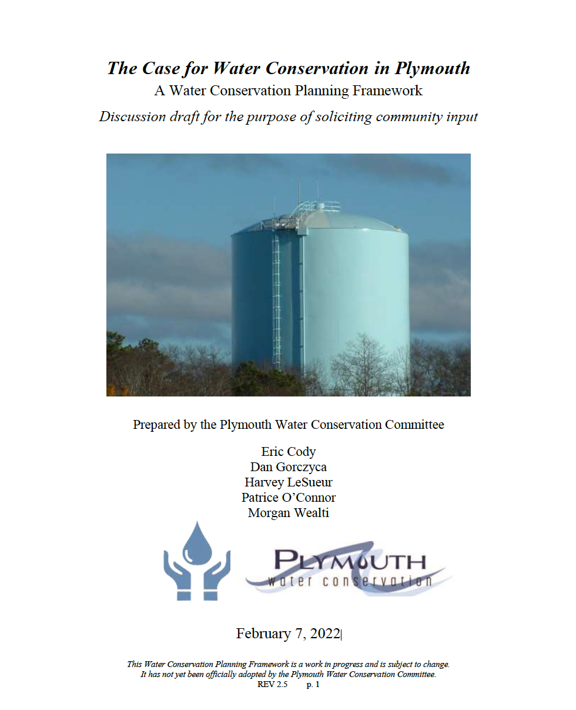
Plymouth Water Conservation Committee

Slide 15
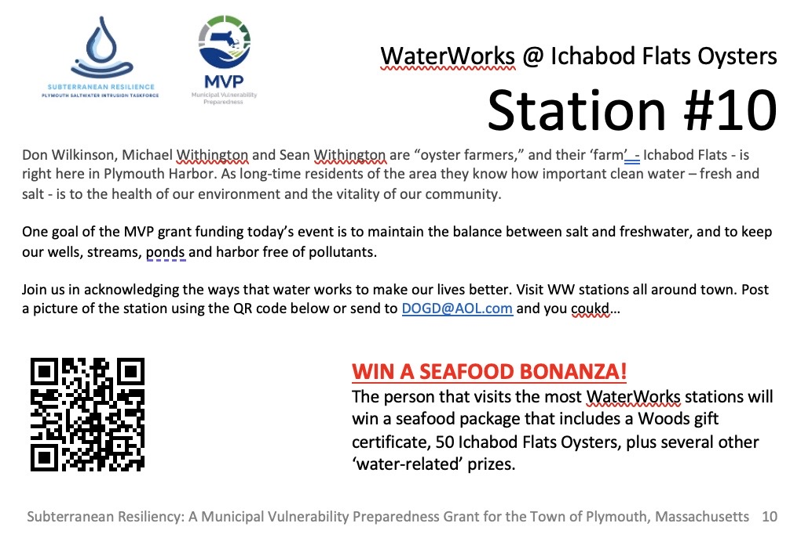

Slide 16

League of Women Voters of the Plymouth Area, Sustainable Plymouth and the Plymouth Public Library

Slide 17
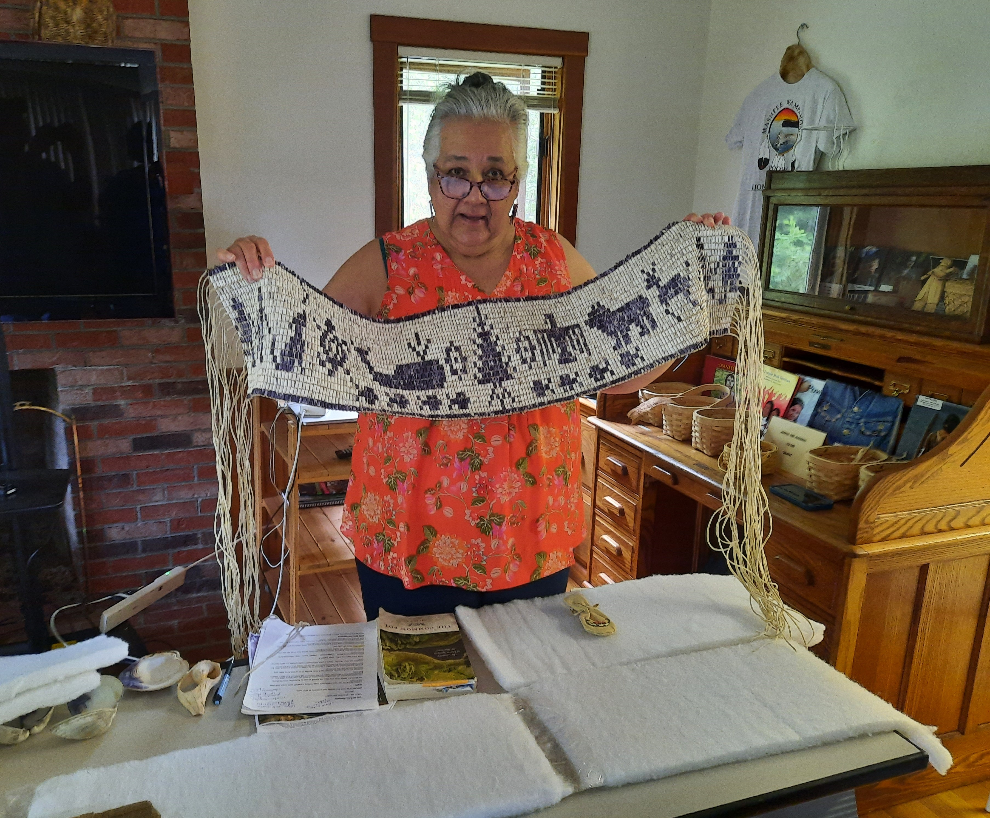
Indigenous Resources Collaborative
The Way of Wampum

Slide 18
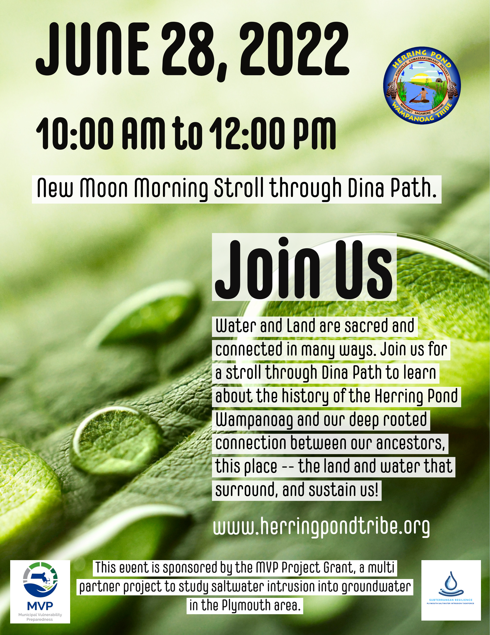
Herring Pond Wampanoag Tribe

Slide 19
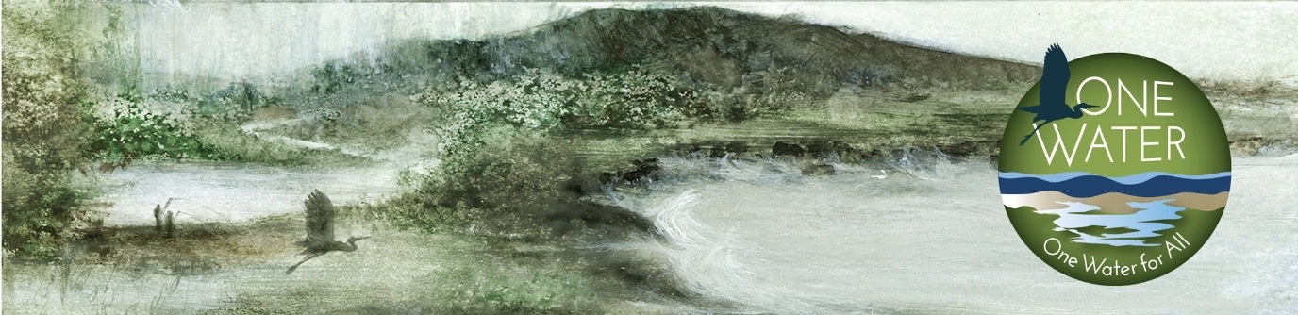
Living Observatory – One Water Website

Slide 20

Subterranean Resiliency:
Predicting, Assessing and Mitigating Saltwater Intrusion

Slide 21
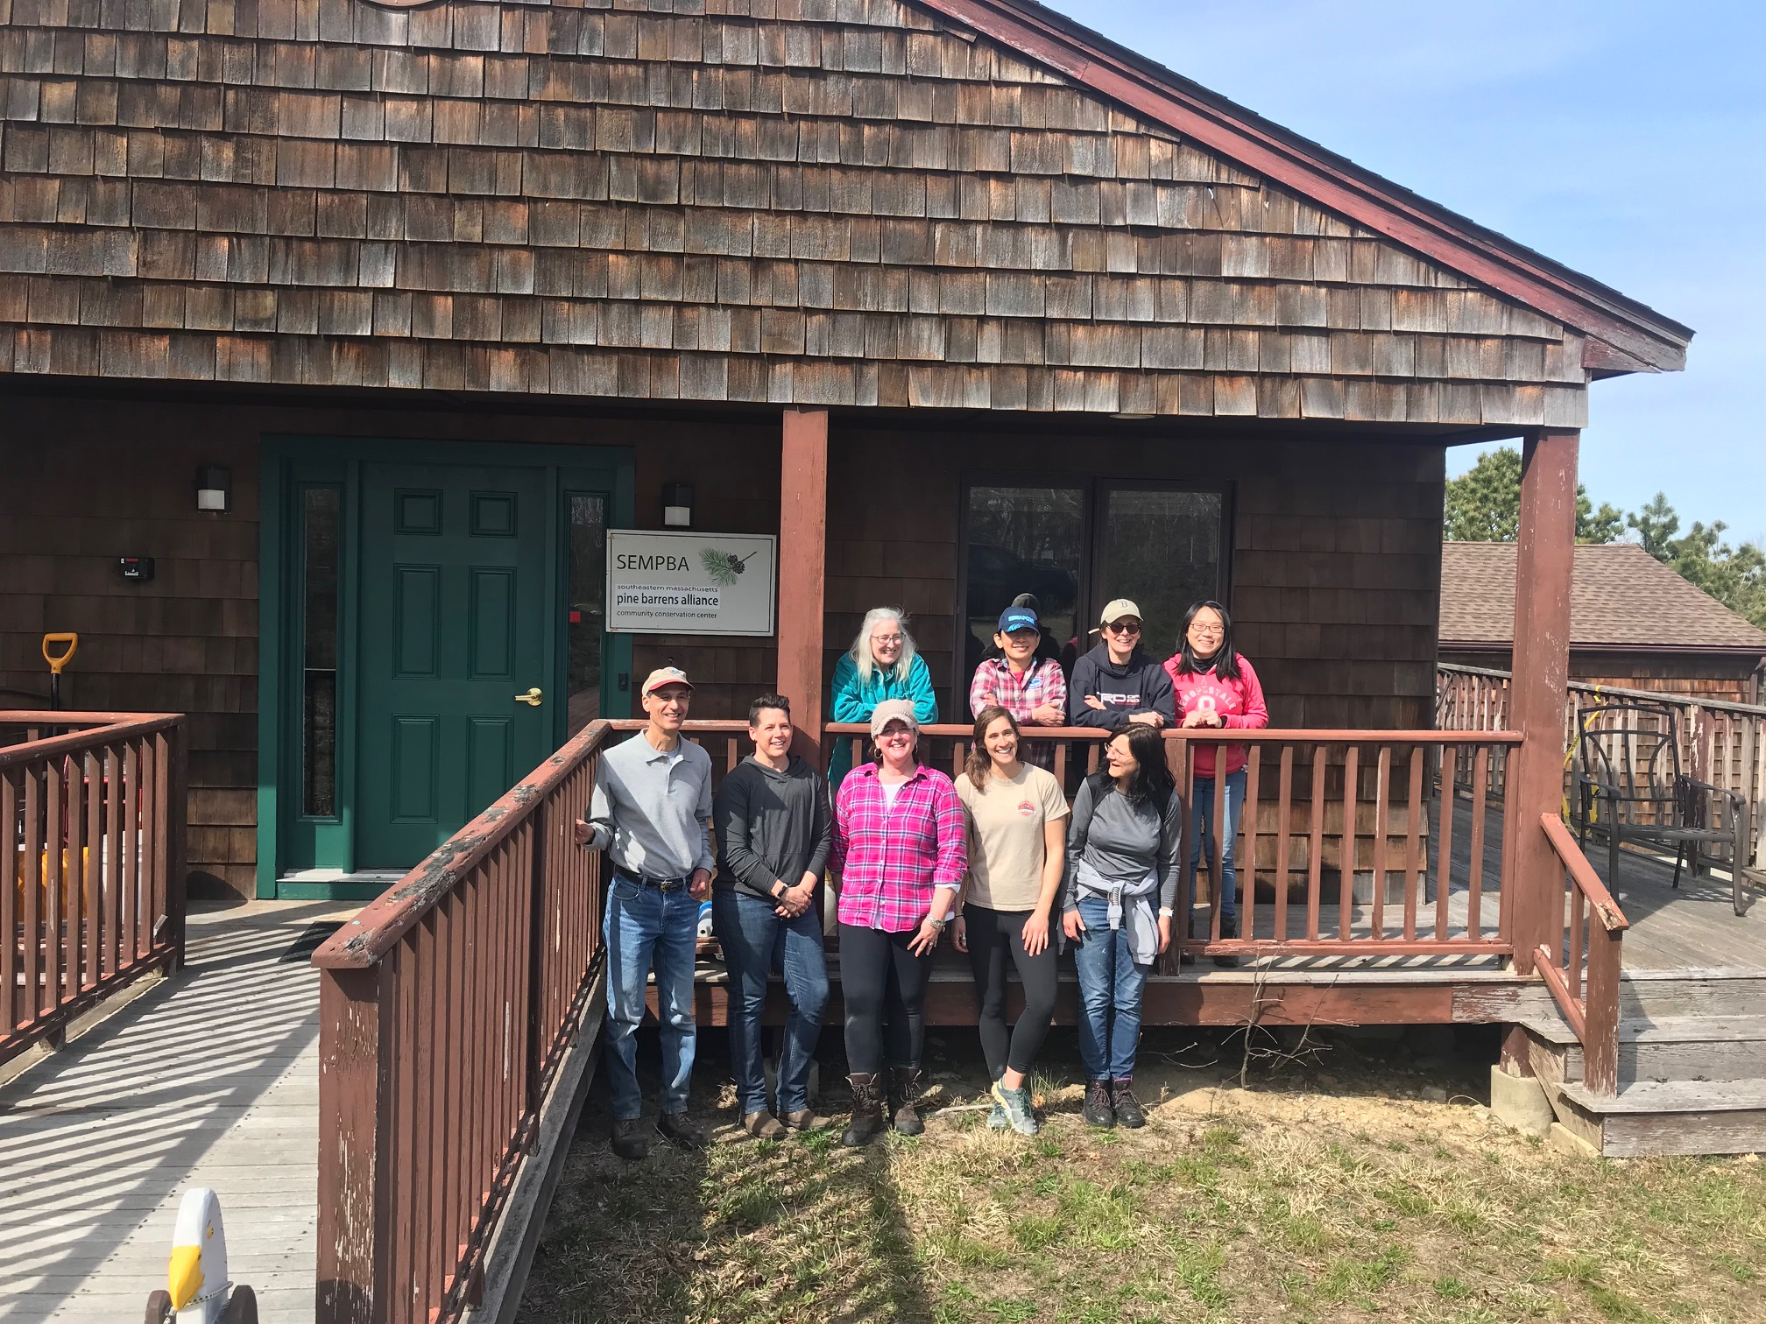
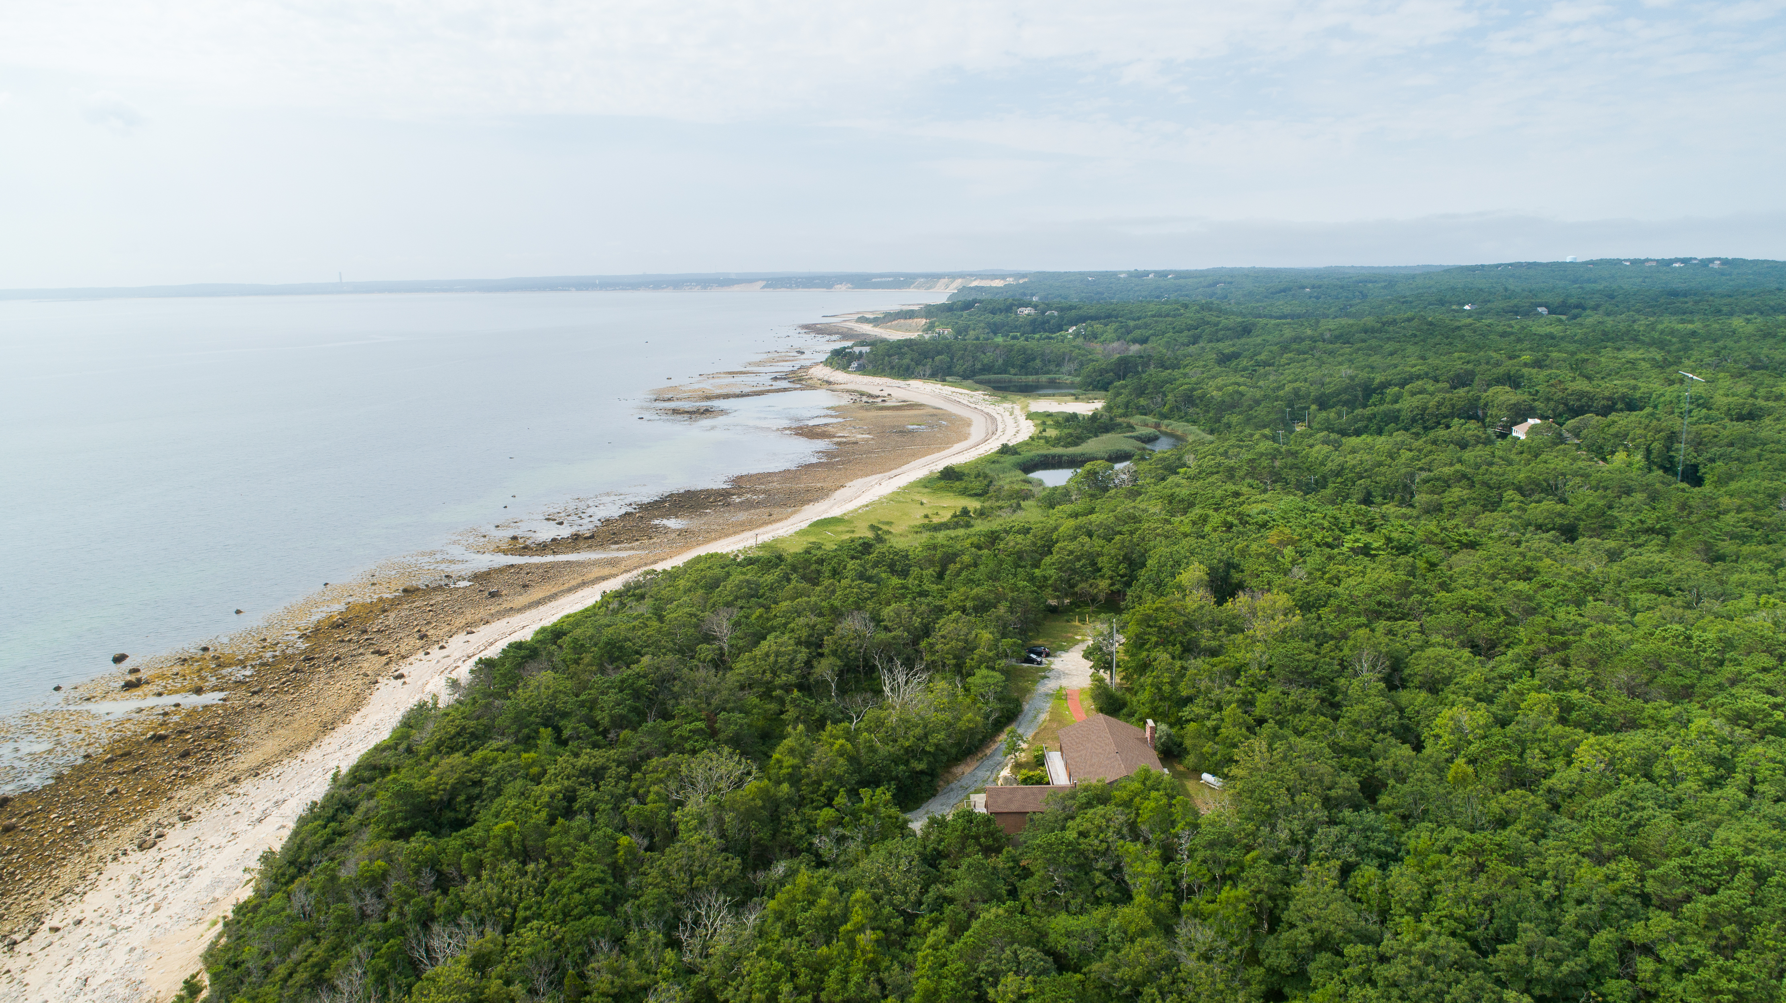
The Center@Center Hill Preserve
158 Center Hill Road Plymouth, MA 02360
SEMPBA.org

