Slide 1
Plymouth Salinity Database
3-10-2023

Slide 2
Methods
Extracted water quality data from USGS NWIS, MassDEP Drinking water (PWS), UMass Acid Rain Monitoring Program, Cape Cod Rivers Observatory, and Tidmarsh Living Observatory
Separated data into surface water, All groundwater, and Public Water Supply (PWS)
Parameters include chloride, specific conductance, and total dissolved solids
Calculated the averages based on parameters and locations
Converted available values to predict the missing parameter
  TDS → Chloride: TDS Value/1.42 TDS→SC: TDS value/0.64
Mapped the salinity concentrations in ArcGIS
Clipped locations to a five mile buffer around the groundwater model boundary

Slide 3
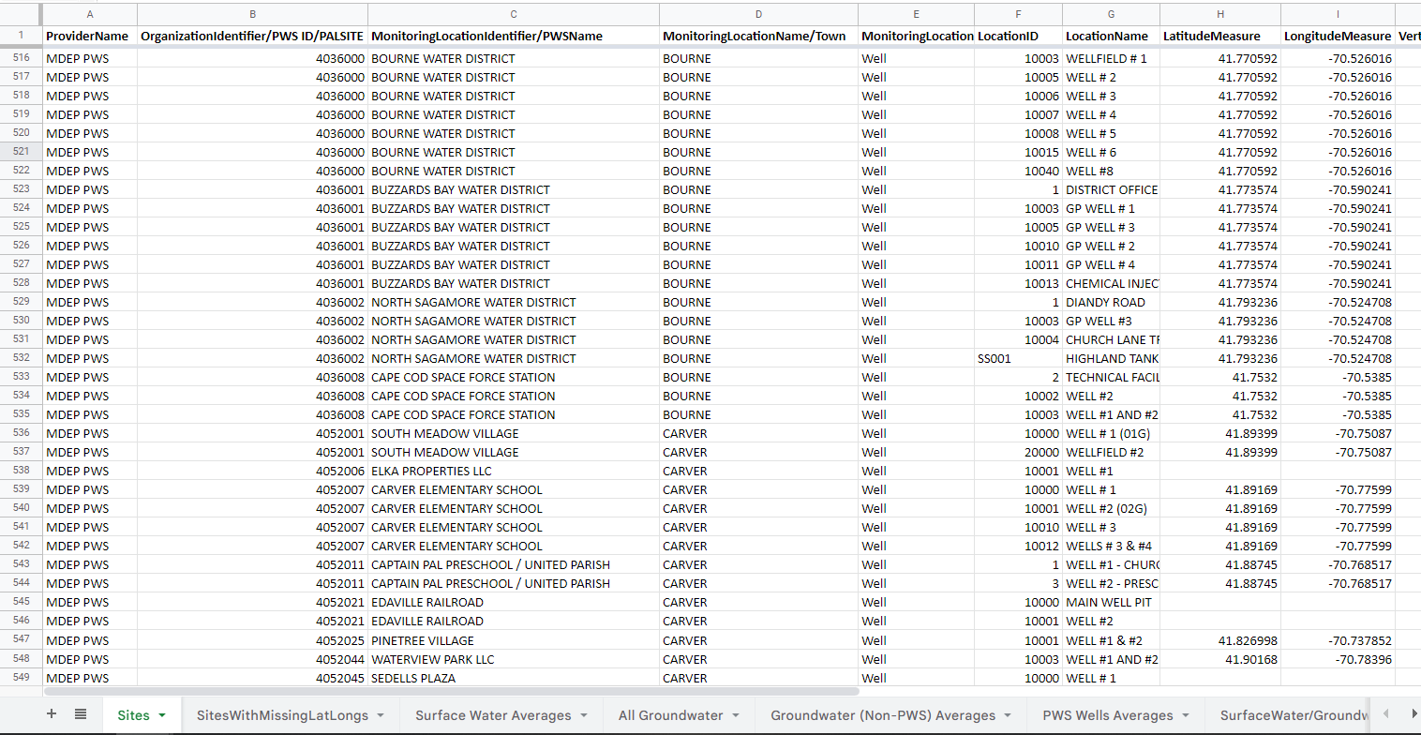
Sites

Slide 4
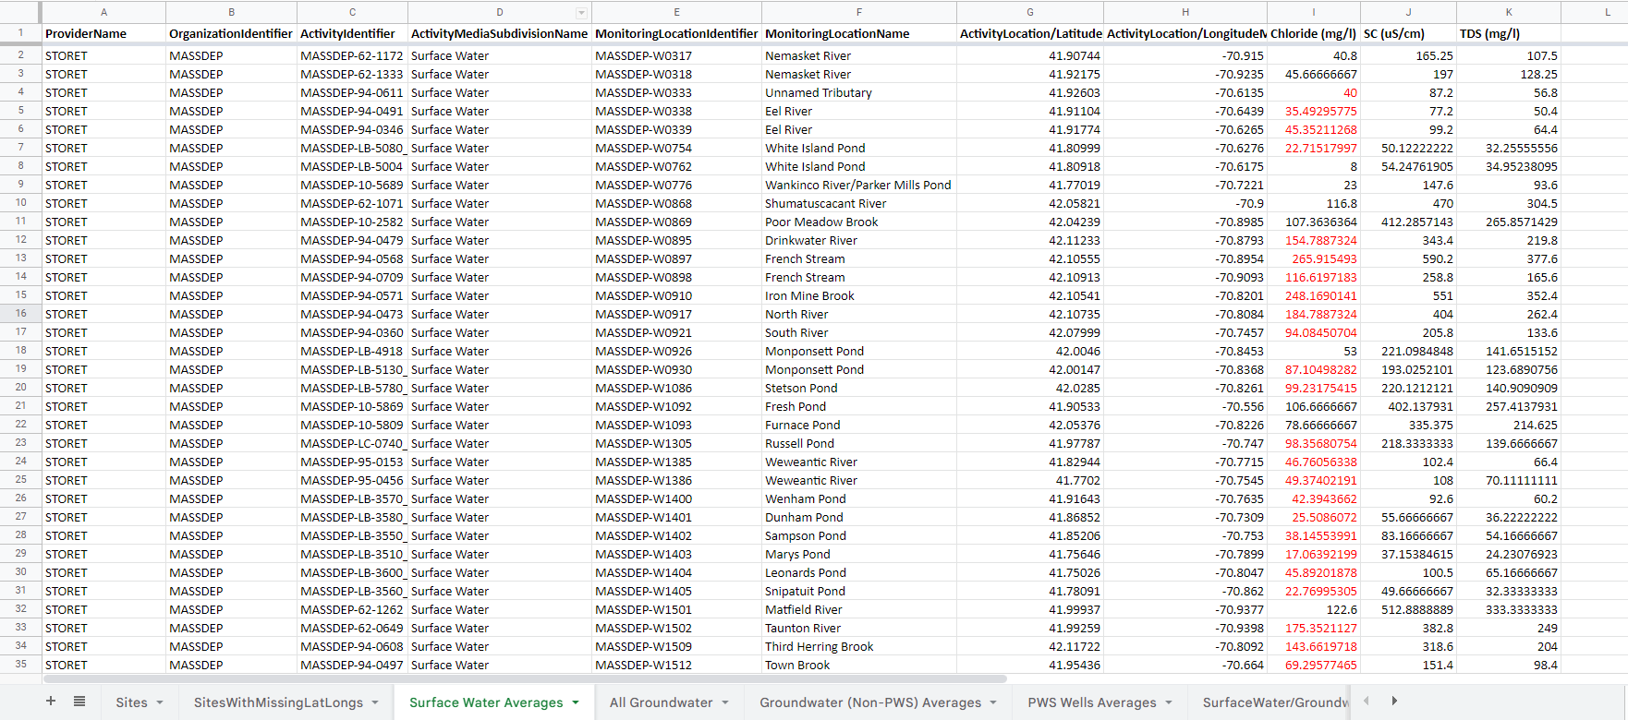
Surface Water Averages

Slide 5
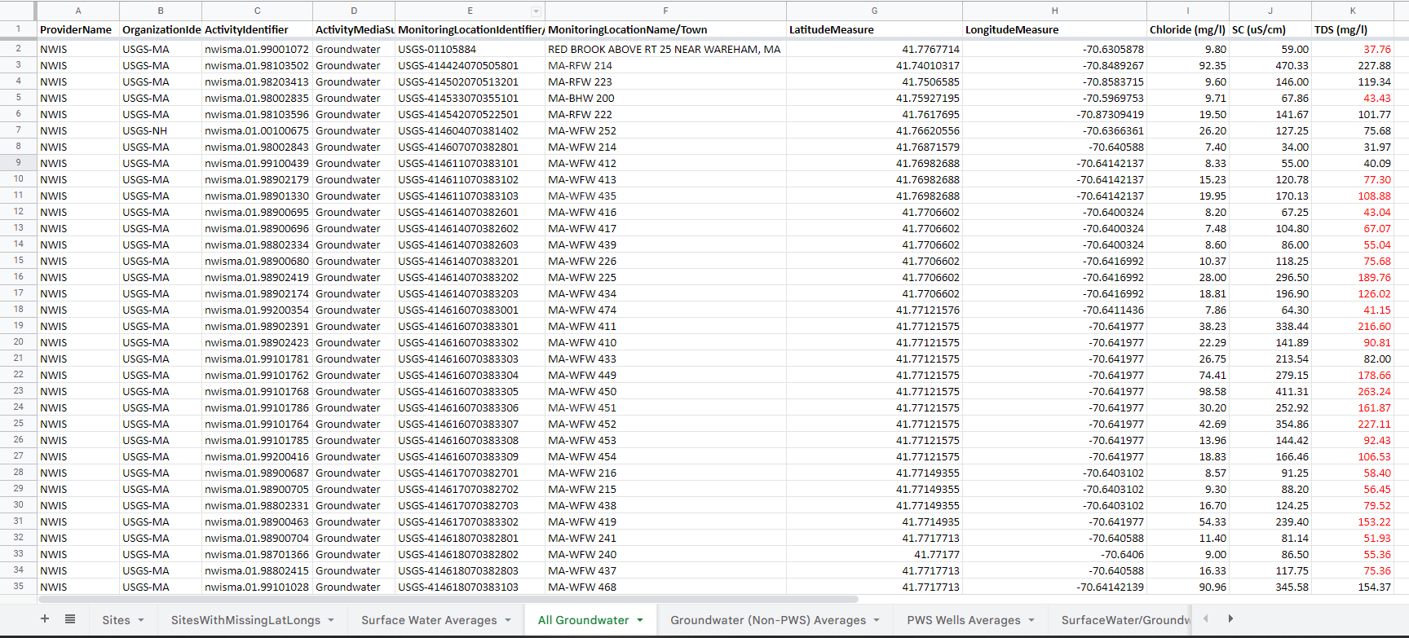
All Groundwater

Slide 6
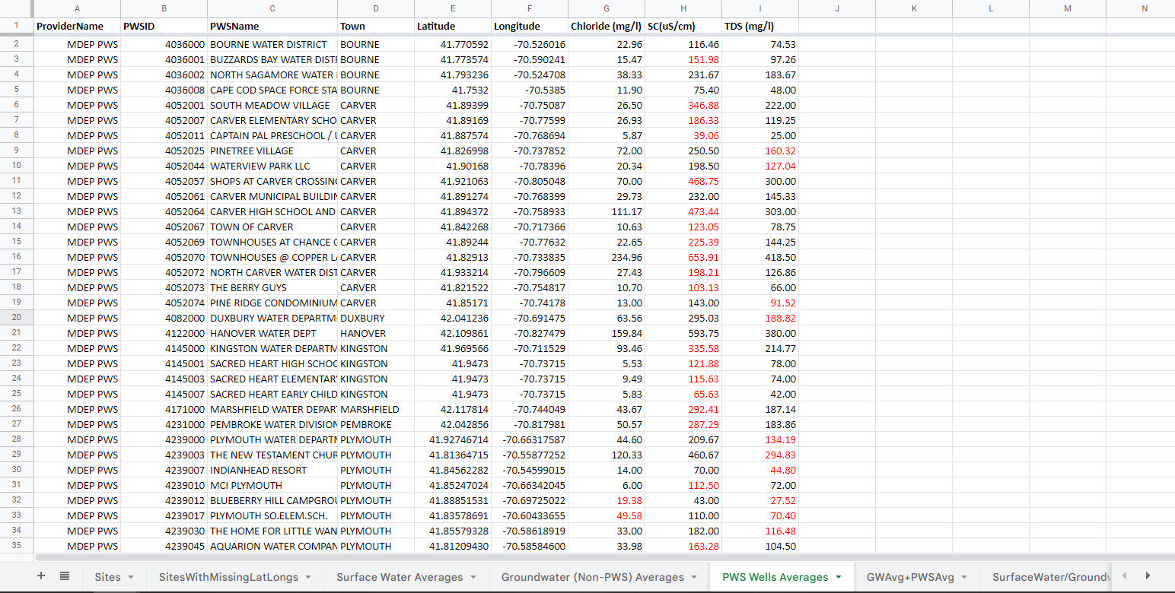
PWS Averages

Slide 7
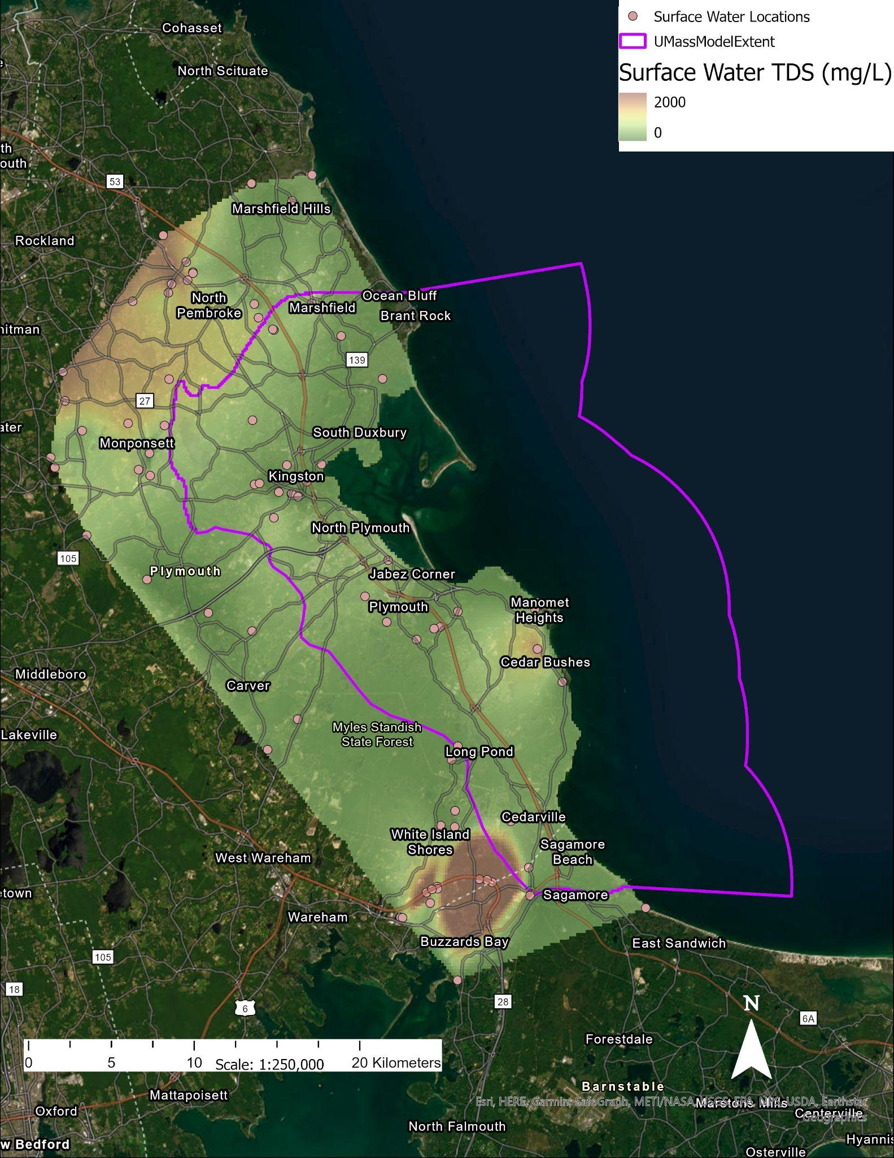
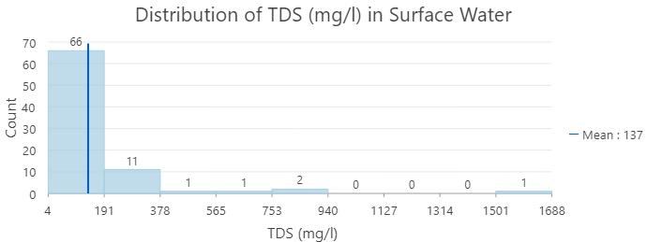
Surface Water TDS (mg/L)
High TDS content along major highway in the South
  Road Salt
Hanover in the North is a hotspot
  Residential area
Minor hotspot in Cedar Bushes area

Slide 8
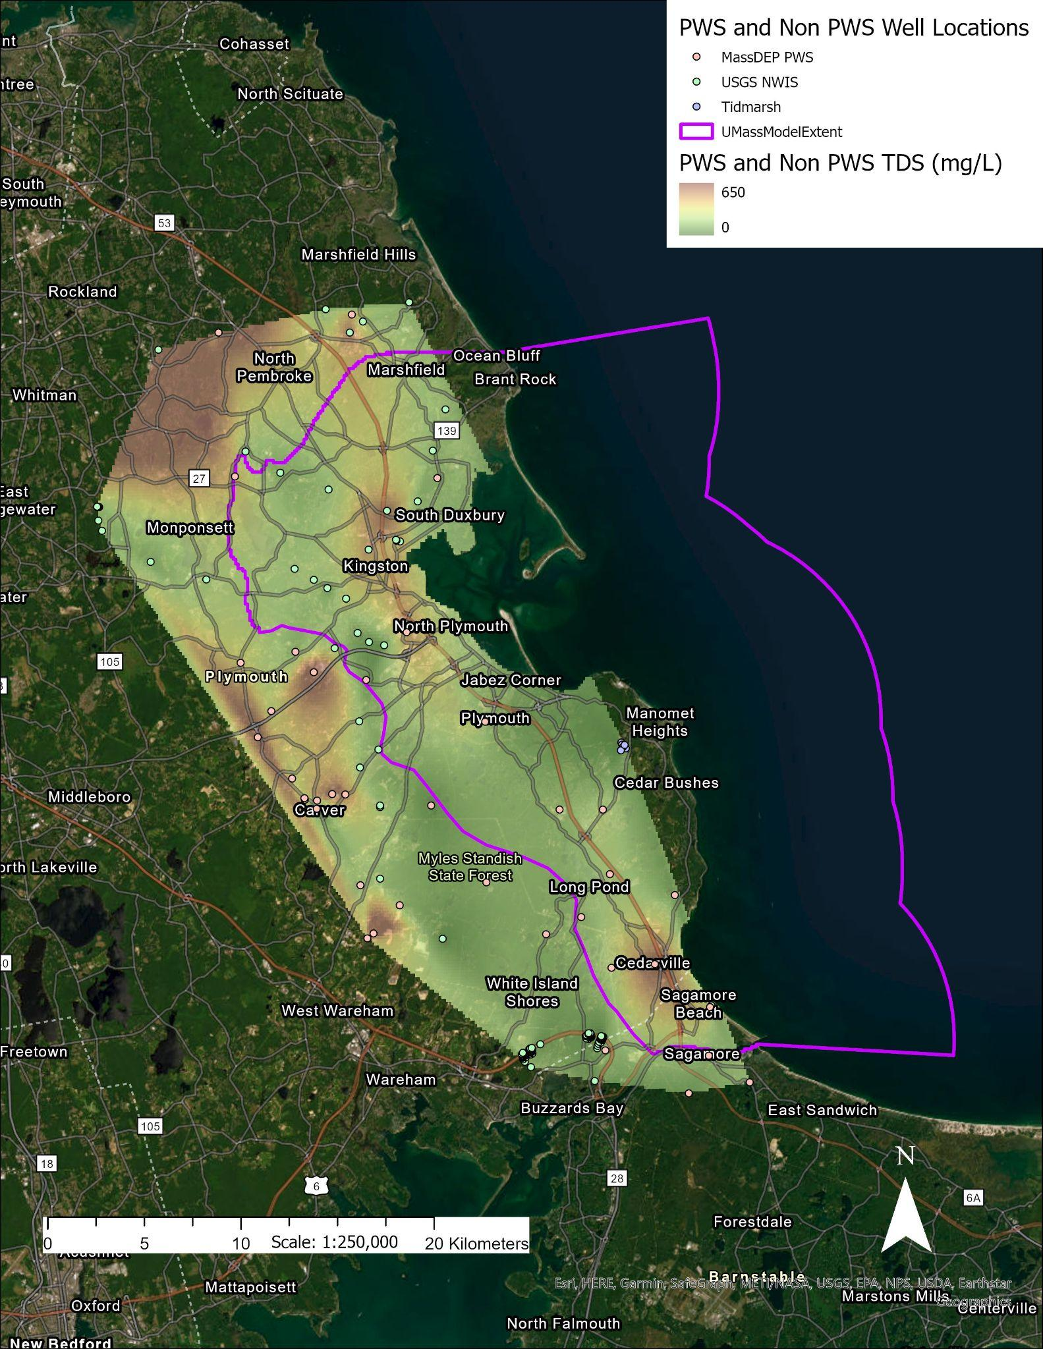
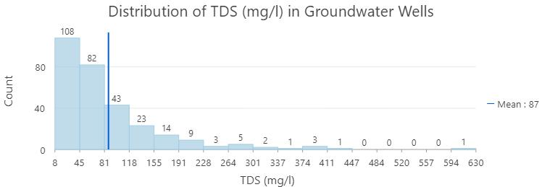
Groundwater TDS (mg/L)
Areas that are commercially and residentially developed show high TDS content
  Road salt
High TDS content in Hanover area in the North
Mid-range TDS content in coastal towns

Slide 9
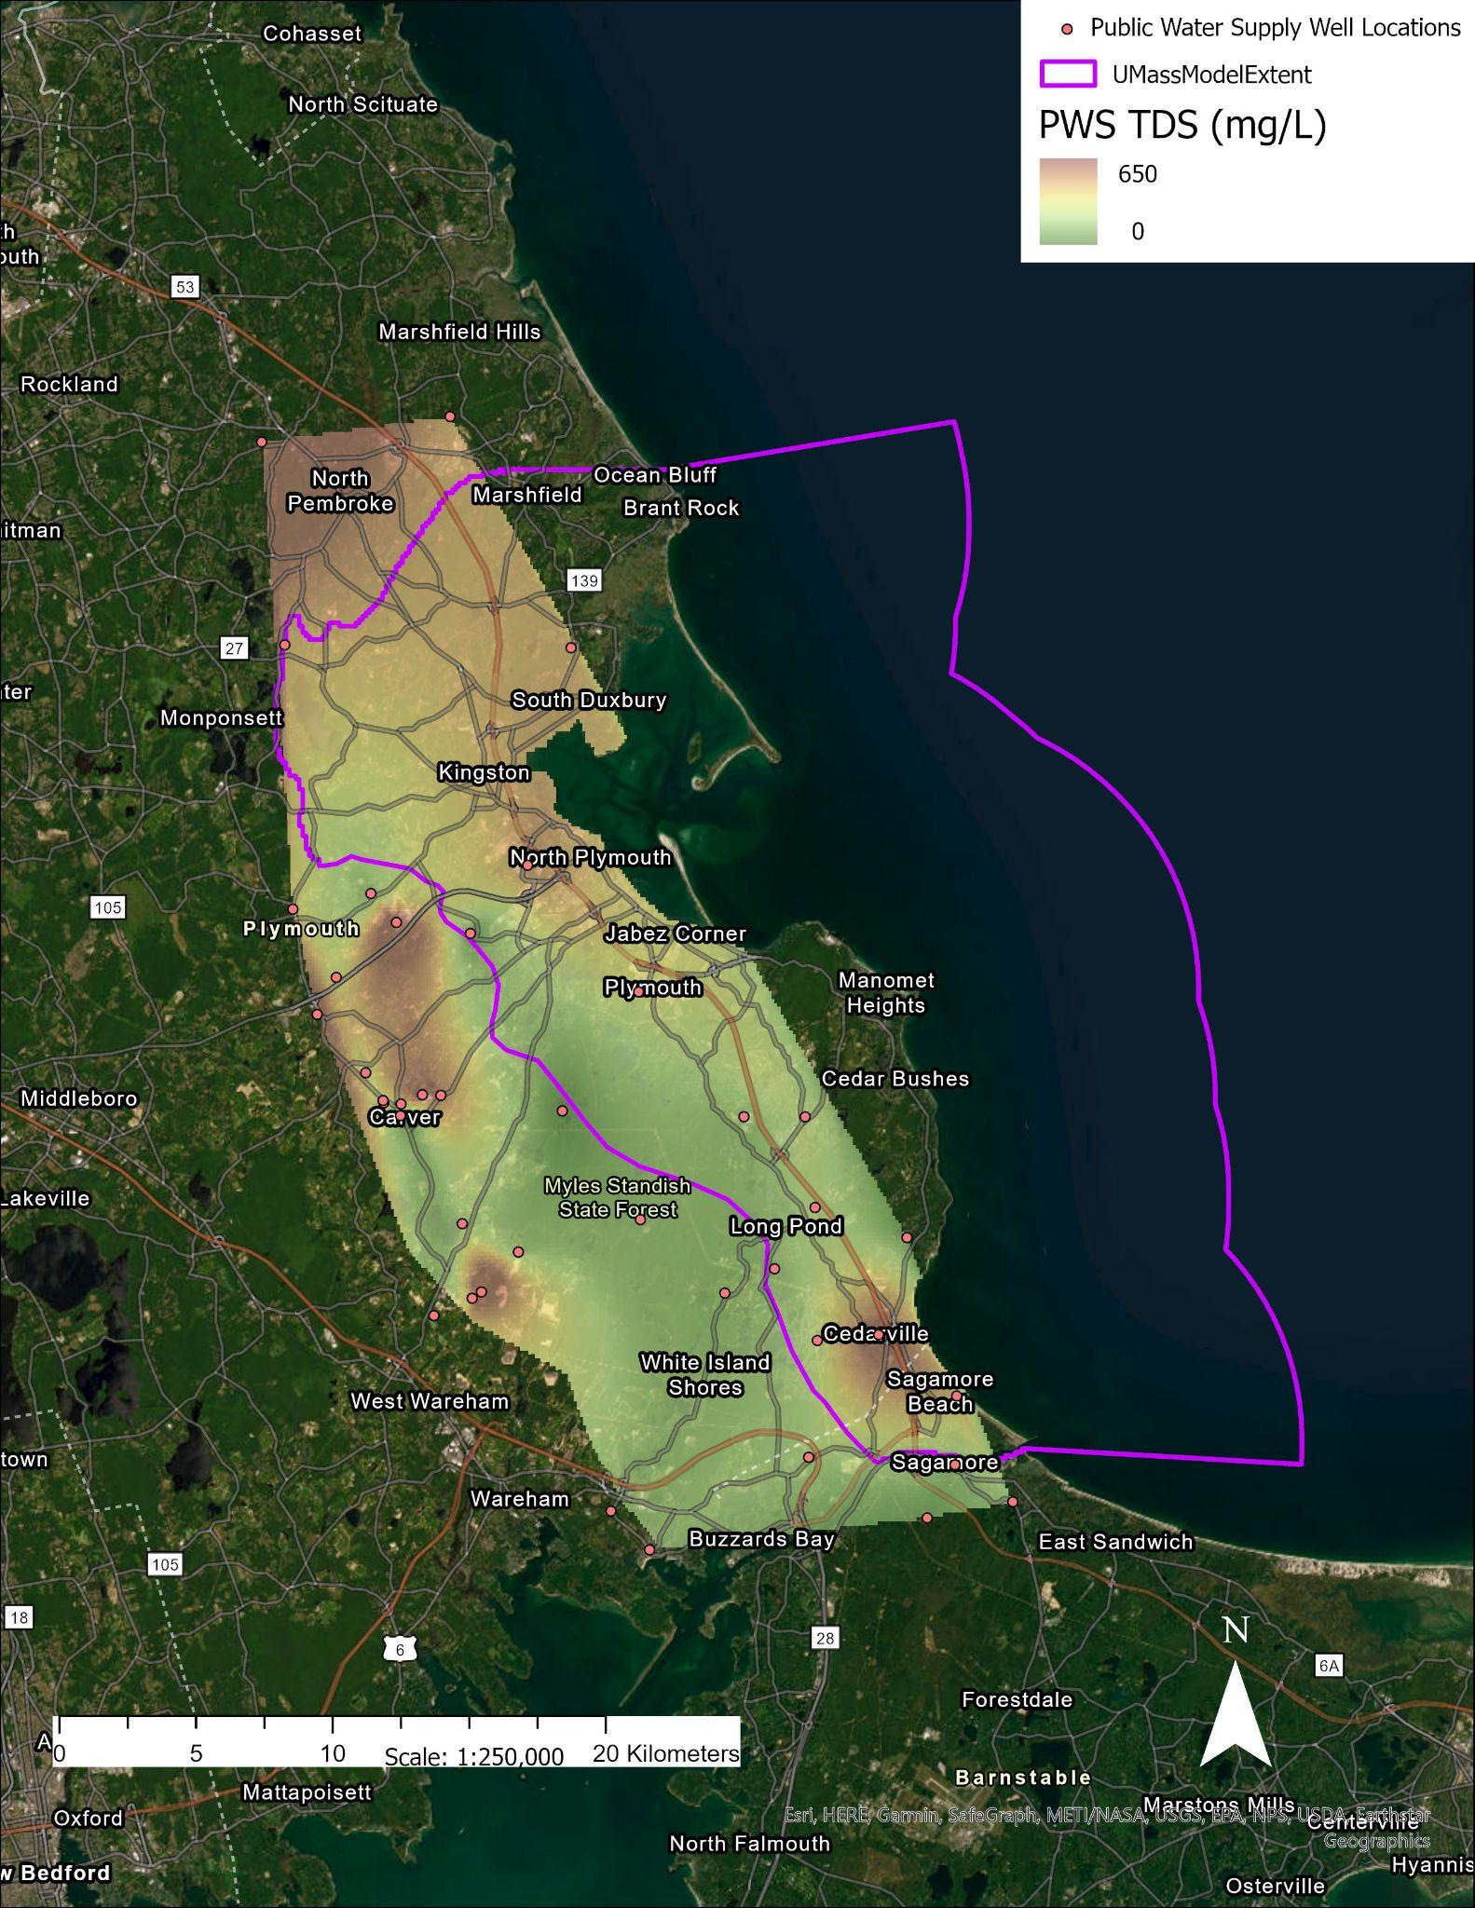
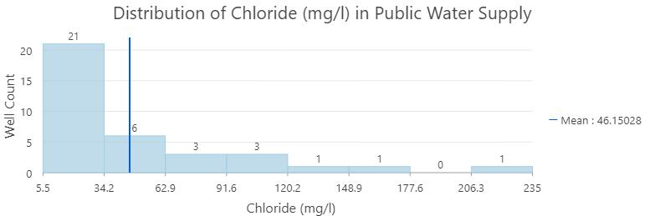
Public Water Supply TDS (mg/L)
Highest TDS content in Carver area
  Schools, housing developments, places of business
High TDS content in Hanover
  Hanover Water Dept.
Mid-range TDS content in coastal towns

Slide 10
Takeaways
Next Steps
Road salt is dominant influence on the TDS content
Saltwater intrusion is the least dominant influence
Hotspot trend in Hanover and North Pembroke
Most groundwater wells in are within the EPA TDS limit of 500 mg/L
Implement rivers and stream shapefiles onto the maps
Investigate land use in the towns with high TDS content
Incorporate salinity values into groundwater model

